Slide 1
ORAL PRACTICE

Slide 2
SHOPPING FOR CLOTHES

Slide 3
Henry is in the clothes department. He wants to buy a shirt. Follow the instructions and simulate the dialogue between him and the shop-assistant.

Slide 4
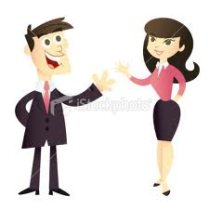
Hello!
Hello! Can I help you?
Answer the greeting and offer assistance.
Greet the shop-assistant.

Slide 5
Yes, please. I’d like a shirt.
What colour, please?
Ask the colour.
Say you want a shirt.

Slide 6
I’d like a black one.
What size are you?
Ask the size.
Say you’d like a black one.

Slide 7
I take a medium size.
Would you like to try it on?
Ask if you would like to try it on.
Say you take a medium size.

Slide 8
Yes, please.
Does it fit?
Say yes.
Ask if it fits.

Slide 9
Yes. How much is it?
€30.
Say yes and ask the price.
Say the price(€30).

Slide 10
It’s very expensive! Do you have a cheaper one?
Say it’s very expensive and ask for a cheaper one.
Here you are. That’s €22.
Give a cheaper one (€22).

Slide 11
I’ll take it. Here you are. Good-bye.
Say you take it. Pay and say good-bye.
Thank you. Good-bye.
Thank and say good-bye.

