Slide 1
CORRECT HW
Leave your notebook open on the table.

Slide 2
Tuesday, the 27th September 2016
In the classroom

Slide 3
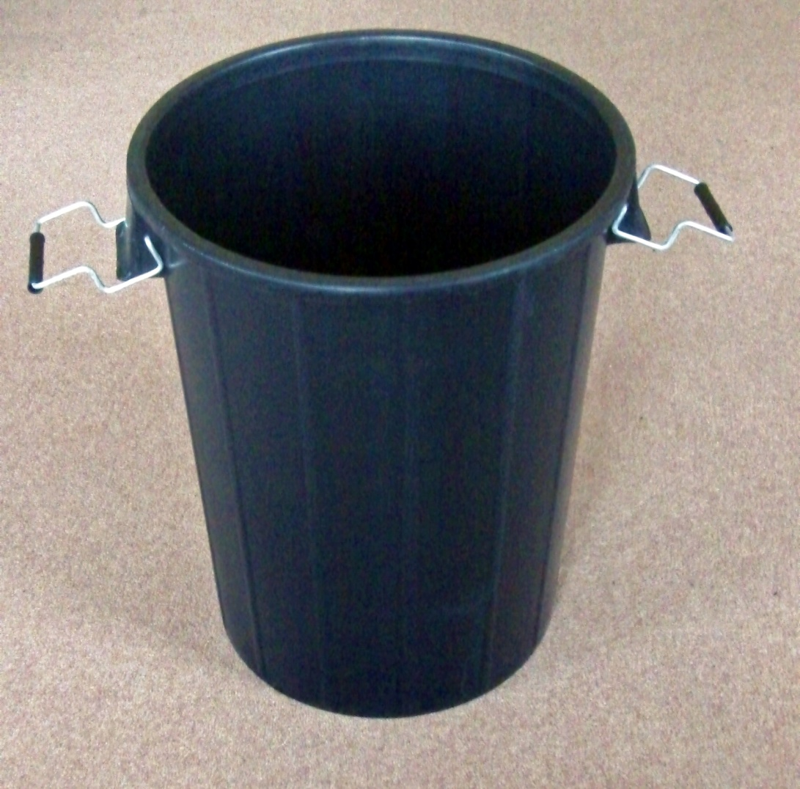
a bin

Slide 4
a board

Slide 5
a book

Slide 7
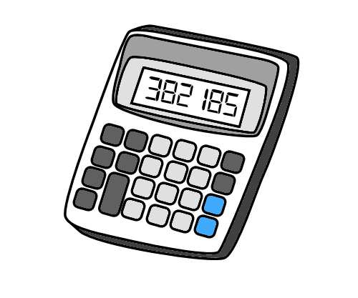
a calculator

Slide 8
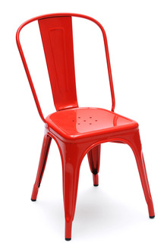
a chair

Slide 9
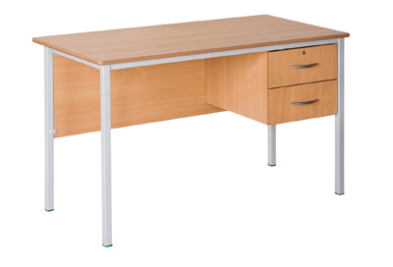
a desk

Slide 12
a dictionary

Slide 13
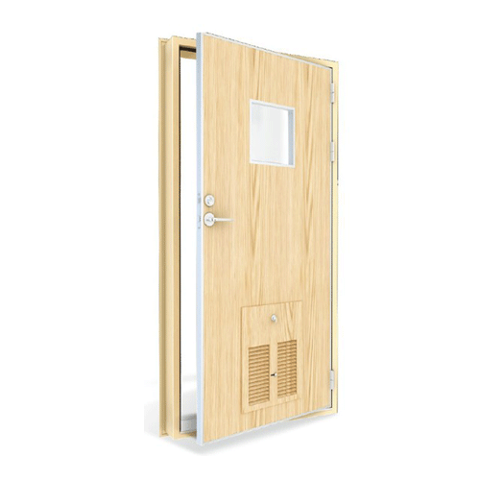
a door

Slide 14
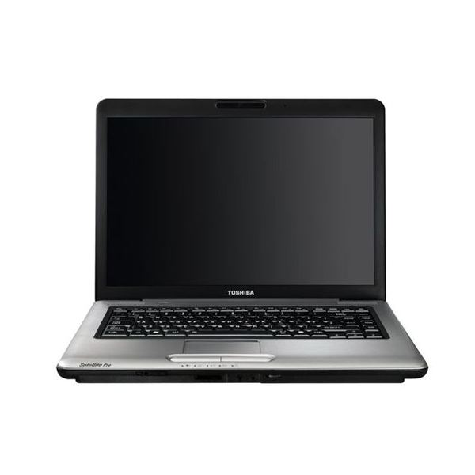
a laptop

Slide 17
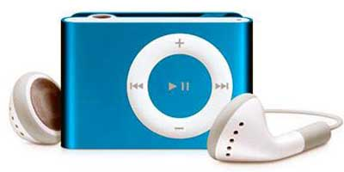
an MP3 player

Slide 18
a notebook

Slide 19
a poster

Slide 22
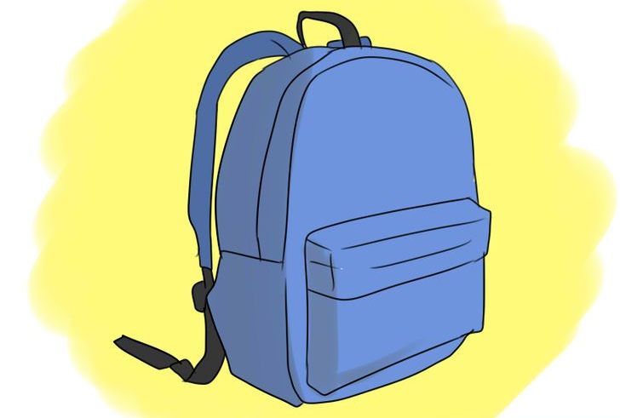
a school bag

Slide 23
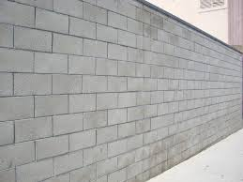
a wall

Slide 24
a window

Slide 27
1) Match the words to the numbers in the picture.
bin board book calculator chair desk dictionary door laptop mp3 player notebook poster school bag wall window

Slide 28
PREPOSITIONS OF PLACE
2) Match the preposition with its translation.
Behind - dentro de
Between - al lado de
In - detrás
In front of - en frente de
On - debajo de
Next to - entre
Under - encima de

Slide 29
3) Look at the picture and comple the sentences in your notebook with the correct preposition.
The MP3 player is _____the desk.
The board is_____ the window and the poster.
The teacher’s desk is ____ the window.
The students are ____ the classroom.
The bin is ____ the teacher’s desk.
The calculator is ____ the book.
The window is ____ the teacher’s desk.

Slide 30
3) Look at the picture and listen. Are the sentences true or false? Correct the false ones.
There is an MP3 player on the floor.
False. There’s and MP3 player on the desk.

