Slide 1
FINNISH EDUCATION
Structured EducationalVisit to Schools/Institutes &Training Seminar in FINLAND
Helsinki,23rd-29th april, 2017

Slide 2
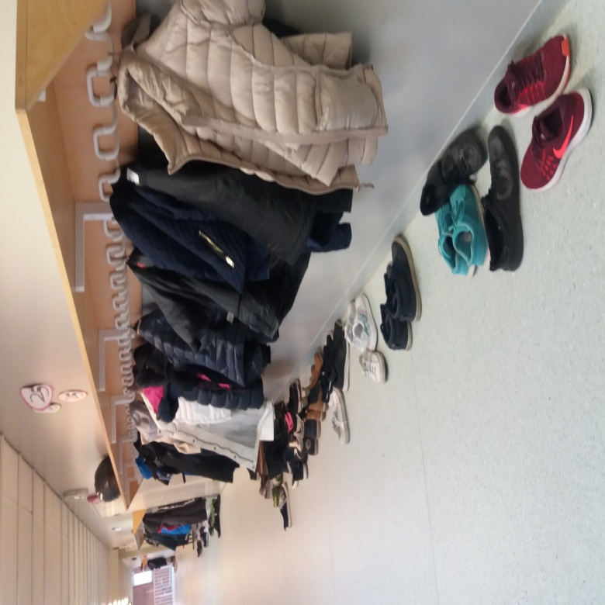
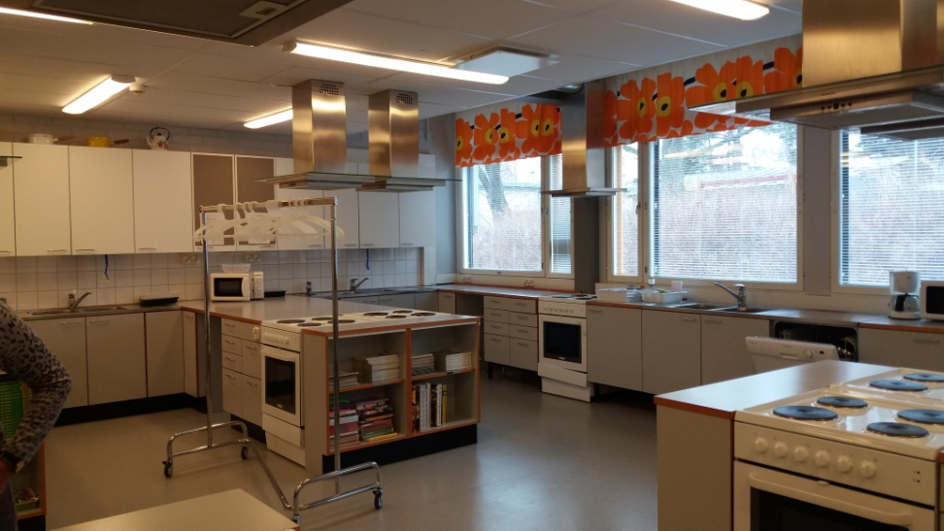
Most representative pictures
School ready for children, not children ready for school
Enhanced equity improves quality

Slide 3
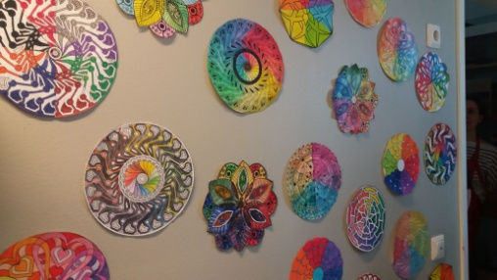
Finnish Educational system in a nutshell
Key words and conclusions: every child is unique, no child behind, inclusion, less is more ,learning by doing, prevention is cheaper than repair.
Professionalism: collaboration, personalization, trust based responsibility, equity.
Improving curriculum, contents and access: The key of the educational success.

Slide 4
How I will disseminate my experience:
I will upload some king of report about my experience, conclusions, photos and learning on the facebook.
I will report my colleagues and show pictures of my structured course in Helsinki when we get together at school.
Then I will show my students in class all the pictures I have taken and tell them about the importance of being european citizens and all the advantages we can get from erasmus projects.
Next year all the members our working group on erasmus project will disseminate the whole experience in the media. Let our community and our cities and villages know about our work in the project.
I will extract some possible applications in my school related to organization, autonomy and managment when our Board get together for next school year preparation.

Slide 5
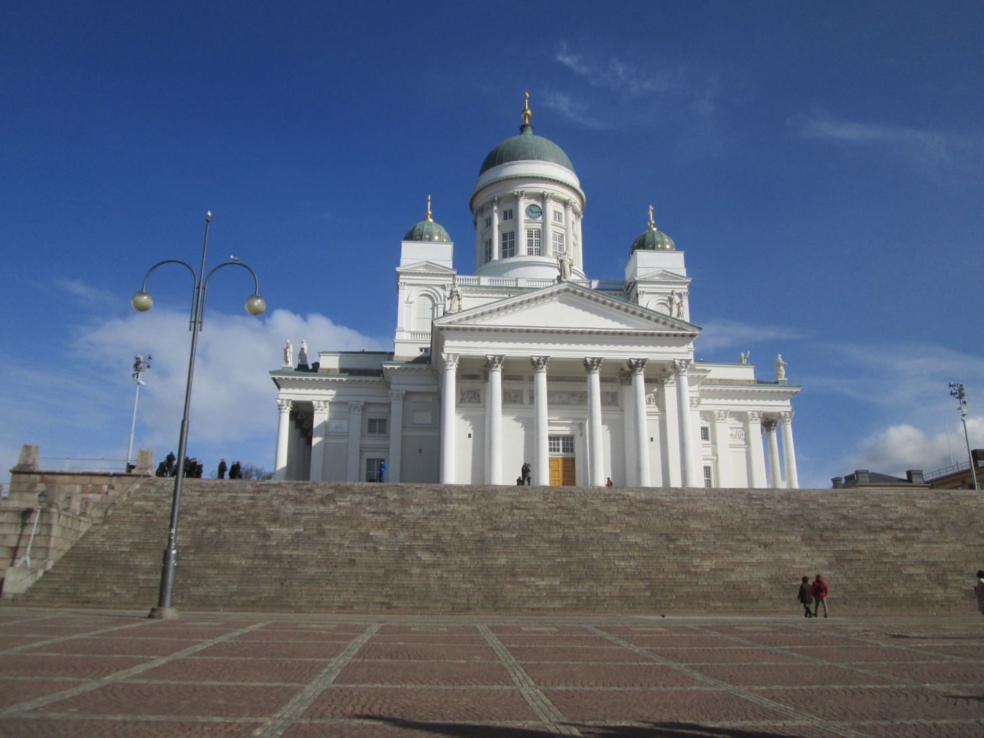
Good bye Helsinki.

