Slide 1
1ºNIVEL AVANZADO MODELO 1 (1st term) A
TAREA 1: MONÓLOGO
Talk about the statement below, saying if you agree or disagree. Give reasons.
‘It’s important for friends to be interested in the same things.’
Talk for about 3-4 minutes.
TAREA 2: DIÁLOGO
You’re talking to a friend about cyberchondria. You don’t think you’re a cyberchondriac, but couldn’t live without health websites. You use them almost daily and think they are of great help.
Try to come to an agreement. You both are expected to speak for, at least, 4 or 5 minutes. YOU BEGIN.

Slide 2
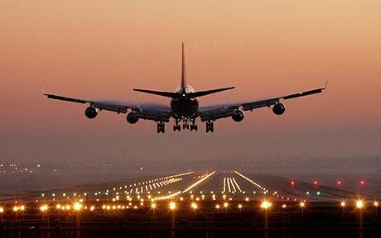
1ºNIVEL AVANZADO MODELO 1 (1st term) B
TAREA 1: MONÓLOGO
Talk about the statement below, saying if you agree or disagree. Give reasons.
‘People should fly less because it causes pollution.’
Talk for about 3-4 minutes.
TAREA 2: DIÁLOGO
You’re talking to a friend about cyberchondria. You think A is a cyberchondriac, he/she couldn’t live without health websites. In your opinion, they are misleading and harmful
Try to come to an agreement. You both are expected to speak for, at least, 4 or 5 minutes.

Slide 3
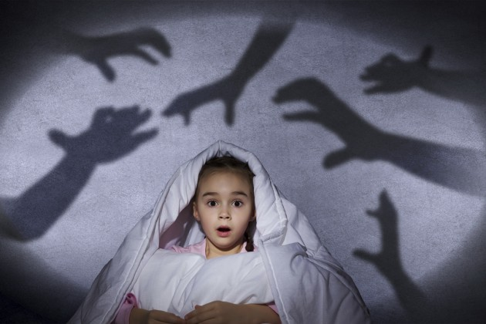
1ºNIVEL AVANZADO MODELO 1(1st term) C
TAREA 1: MONÓLOGO
Talk about a nightmare experience you have lived. Give details about the place, the time and the events. Talk for about 3-4 minutes.
TAREA 2: DIÁLOGO
You’re talking to a friend about cyberchondria. You don’t think you’re a cyberchondriac, but you sometimes use health websites and think they can be useful if you use them properly.
Try to come to an agreement. You both are expected to speak for, at least, 4 or 5 minutes.

Slide 4
1ºNIVEL AVANZADO MODELO 2 (1st term) A
TAREA 1: MONÓLOGO
You have phoned a radio programme to tell them about a curious incident you’ve recently experienced.
When did it happen and what was the background to the story?
What was the curious incident?
How do you feel about it?
Talk for about 3-4 minutes.
TAREA 2: DIÁLOGO
You are part of a renowned law firm. You believe that it is possible to have both a successful career and a united family at the same time, Student B thinks it is almost impossible to do so.
Try to come to an agreement. You both are expected to speak for, at least, 4 or 5 minutes.
In order to carry out this task, you must go through all these point:
- Greet your partner and define the tasks you normally do at work.
- Your family is a traditional one, you always find the time to gather everyone together.
- You think that it is possible to have both a successful career and a united family.
- Try to convince your partner that families can stay strong and united if they really work for that.

Slide 5
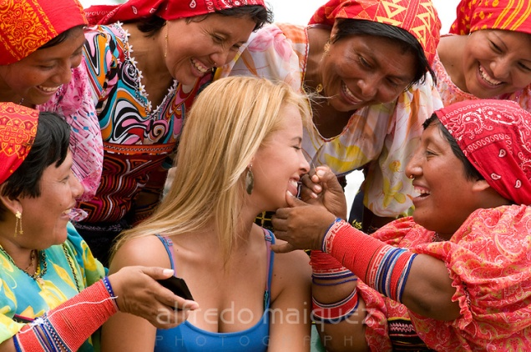
1º NIVEL AVANZADO MODELO 2 (1st term) B
TAREA 1: MONÓLOGO
Imagine that you are an experienced traveller. Choose a place you have visited and whose customs were shocking or surprising for you. Talk about a funny anecdote for 3-4 minutes. When did you start the trip? Where did you finally go? Why this place and not another one?
Describe a funny anecdote.
Did you feel any prejudices based on common stereotypes?
To what extent may "cultural shock" affect a person's view?
TAREA 2: DIÁLOGO
You are a newly promoted sergeant in the United States army. You believe that it is almost impossible to have both a successful career and a united family at the same time, Student A thinks it is possible to do so.
Try to come to an agreement. You both are expected to speak for, at least, 4 or 5 minutes. YOU BEGIN.
In order to carry out this task, you must go through all these points:
- Greet your partner and define the tasks you normally do at work.
- You think that it is NOT possible to have both a successful career and a united family.
- You do not often see your family, since you are normally on a mission abroad.
- Try to convince your partner that families can easily break up due to the distance created by duties.
- Try to come to an agreement.

Slide 6
1º NIVEL AVANZADO MODELO 3 (1st term) A
TAREA 1: MONÓLOGO
“Extreme interviewing”, that is, using bizarre questions at job interviews, is one of the latest trends in the USA. What’s your experience about this topic? Have you ever been to a job interview? What kind of questions did they ask you? Did you get the job?
Talk between 3-4 minutes.
TAREA 2: DIÁLOGO
You have just watched a documentary on the paranormal. Discuss it with a friend.
You have never experienced a paranormal happening and you find it really hard to believe.
You both are expected to speak for, at least, 4 or 5 minutes.

Slide 7
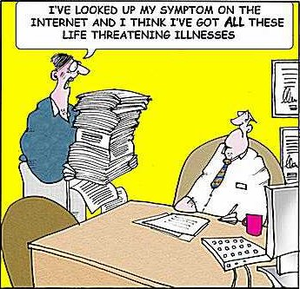
1ºNIVEL AVANZADO MODELO 3 (1st term) B
TAREA 1: MONÓLOGO
Answer the question below. Give reasons and examples and tell an anecdote.
‘Are you or anyone you know a hypocondriac?
Talk for about 3-4 minutes.
TAREA 2: DIÁLOGO
You have just watched a documentary on the paranormal. Discuss it with a friend.
You have experienced a couple of paranormal happenings and, although in the past you found it hard to believe, now there are things you couldn’t explain otherway.
You both are expected to speak for, at least, 4 or 5 minutes. YOU BEGIN.

Slide 8
1º NIVEL AVANZADO MODELO 4 (1st term) A
TAREA 1: MONÓLOGO
Imagine you are about to start a new job and you have to introduce yourself to your future workmates. You have to tell them about your work experience as well as your personal skills and background. Talk between 3-4 minutes.
In your presentation, you have to develop the basic elements of a CV. Focus on:
Your education
Your work experience
Languages
Hobbies and interests
TAREA 2: DIÁLOGO
You are a doctor. Your next patient has been to the health centre 3 times this week, he’s a complete hypochondriac. Listen to him, ask him about his symptoms and try to convince him that he should wait to see how they develop.
You both are expected to speak for, at least, 4 or 5 minutes. YOU BEGIN.

Slide 9
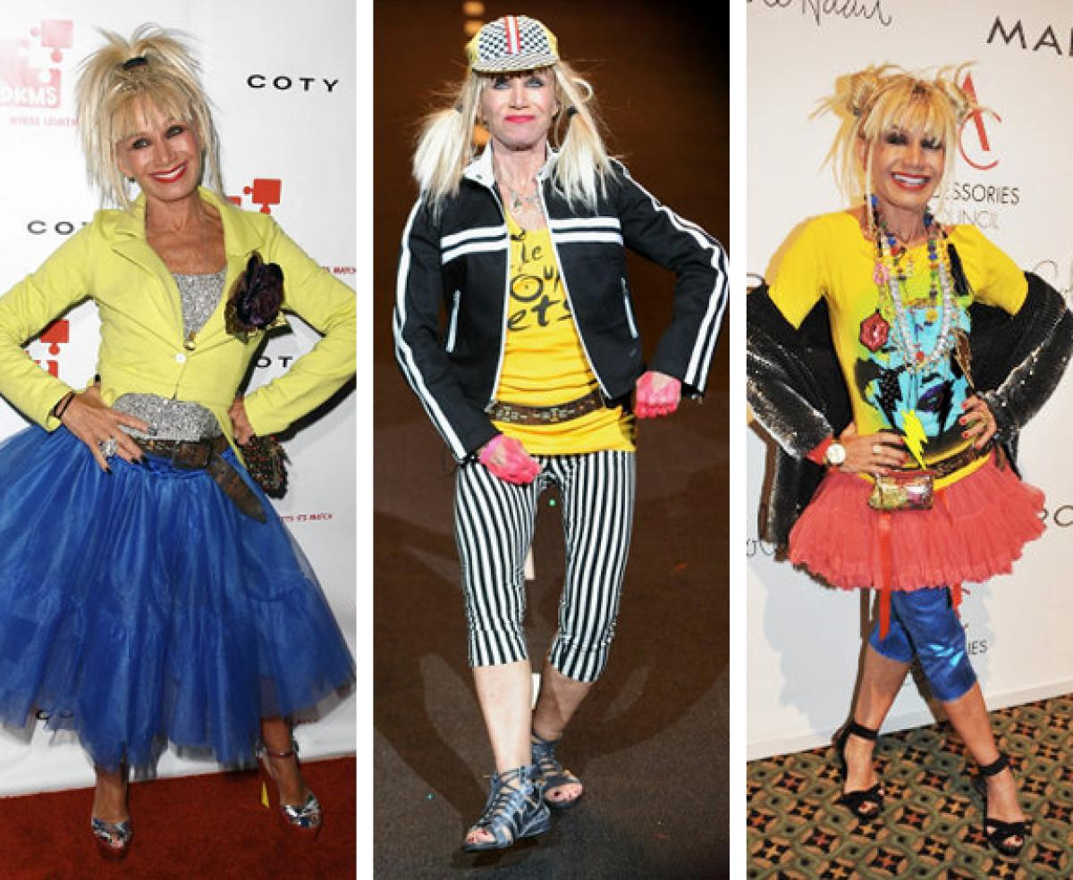
1ºNIVEL AVANZADO MODELO 4 (1st term) B
TAREA 1: MONÓLOGO
Talk about the statement below, saying if you agree or disagree. Give reasons.
‘People should dress their age.’
Talk for about 3-4 minutes.
TAREA 2: DIÁLOGO
You’re at the doctor’s. You haven’t been feeling well recently. Tell the doctor about your symptoms and explain that you have taken a look at some health websites . You are convinced you suffer from a strange and dangerous disease.
You both are expected to speak for, at least, 4 or 5 minutes.

