Slide 1
SPEAKING TEST SHEETS
SECOND TERM

Slide 2
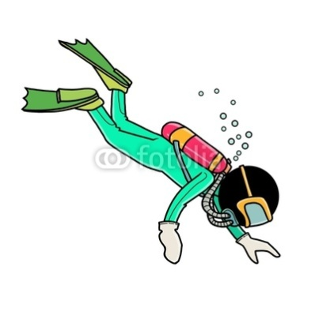
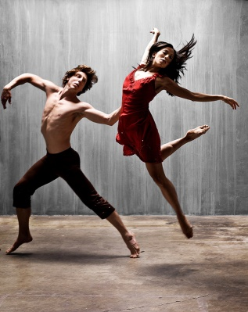
NIVEL INTERMEDIO MODELO 1 (2nd Term) A
TAREA 1: MONÓLOGO
Prepare and deliver a monologue about what you are able to do, would like to be able to do.... Talk about something you’ve tried to learn, but have never been able to do well; something you learnt to do after a lot of effort.
TAREA 2: DIÁLOGO
Your best friend is going to be twenty on Saturday. You want to give him/her a surprise so organise a surprise birthday party for him/her helped by other friends.
Use sentences like “We should / shouldn’t; You should /shouldn’t; He/she should/shouldn’t when talking to your friends. Try to come to an agreement. YOU BEGIN THE CONVERSATION.

Slide 3
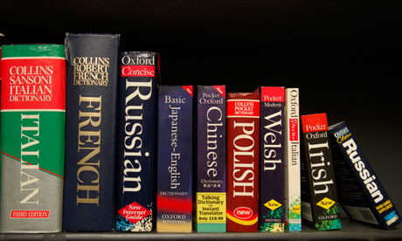
NIVEL INTERMEDIO MODELO 1 (2nd Term) B
TAREA 1: MONÓLOGO
Prepare and deliver a monologue about the importance of learning modern languages (English, French, German, Japanese, etc.). Give tips which can help you to learn a foreign language.
TAREA 2: DIÁLOGO
You are going to be twenty on Saturday. You want to invite your friends but they want to organise a surprise birthday party for you. You are not supposed to know anything about it.
Use sentences like “We should / shouldn’t; You should /shouldn’t; we can / we could …” when talking to your friends. Try to come to an agreement.

Slide 4
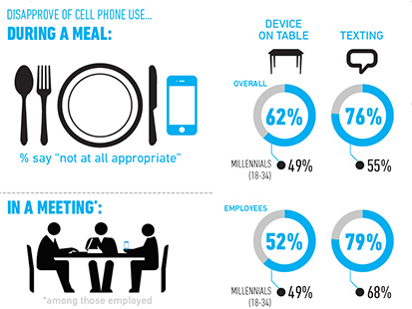
NIVEL INTERMEDIO MODELO 2 (2nd Term) A
TAREA 1: MONÓLOGO
Prepare and deliver a monologue about mobile phone etiquette: what you must/mustn’t/have to/don’t have to/should/shouldn’t do when using your mobile phone.
TAREA 2: DIÁLOGO
Plan a trekking excursión for you and your friends.
Use sentences like “We should / shouldn’t; You should /shouldn’t; we can; we must/mustn’t; we have to/we don’t have to when talking to your friends. Try to come to an agreement.

Slide 5
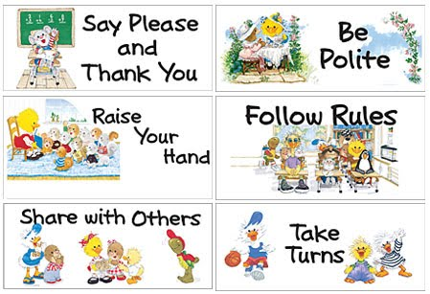
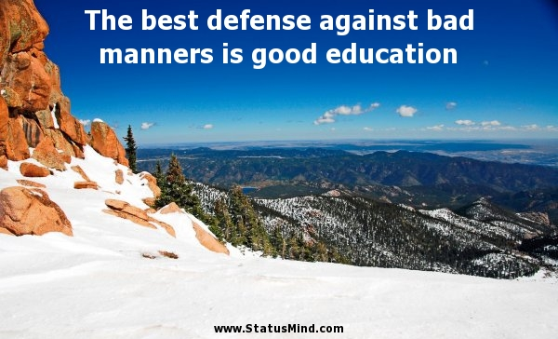
NIVEL INTERMEDIO MODELO 2 (2nd Term) B
TAREA 1: MONÓLOGO
Prepare and deliver a monologue about good and bad manners when you are invited to somebody’s house; on social networking sites; when greeting people, etc. Use must/mustn’t/have to/don’t have to/should/shouldn’t.
TAREA 2: DIÁLOGO
Your friend wants to plan a trekking excursion. Be prepared to accept and give suggestions.
Use sentences like “We should / shouldn’t; You should /shouldn’t; we can; we must/mustn’t; we have to/we don’t have to when talking to your friends. Try to come to an agreement. YOU BEGIN THE CONVERSATION.

Slide 6
NIVEL INTERMEDIO MODELO 3 (2nd Term) A
TAREA 1: MONÓLOGO
Prepare and deliver a monologue about the sports you like and/or don’t like and say why you like it/them.
TAREA 2: DIÁLOGO
You are with a friend at a restaurant and your mobile phone rings. You answer it and your friend is disappointed. Be prepared to apologise to him/her for it.
Use sentences like “I’m sorry but…, I completely disagree with…, I know I shouldn’t… / I know it’s not polite…” when talking to your friend. Try to come to an agreement.

Slide 7
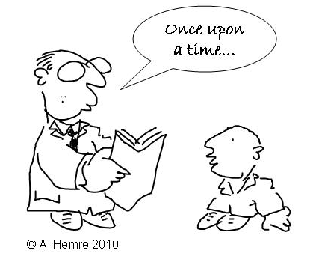
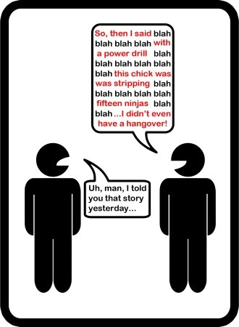
NIVEL INTERMEDIO MODELO 3 (2nd Term) B
TAREA 1: MONÓLOGO
Prepare and deliver a monologue about an anecdote: a time you cheated in an exam or a time you got lost. Start your anecdote in this way: “I’m going to tell you about a time when…; This happened a few years ago…; When I was younger….”
TAREA 2: DIÁLOGO
You are with a friend at a restaurant and his/her mobile phone rings. He/she answers it and you are disappointed. Be prepared to give mobile phone rules and to accept apologies from him/her.
Use sentences like “I’m sorry but…, I completely disagree with…, You should/shouldn’t/must/mustn’t/have to… / I know it’s not polite…” when talking to your friend. Try to come to an agreement. YOU BEGIN THE CONVERSATION.

Slide 8
NIVEL INTERMEDIO MODELO 4 (2nd Term) A
TAREA 1: MONÓLOGO
Prepare and deliver a monologue about what you usually do and what you used to do when you were younger related to your personal life.
TAREA 2: DIÁLOGO
You are with an English friend and do not know exactly how to behave because our Spanish greeting rules are not the same as their rules. Ask him/her about English rules and be prepared to talk about our rules.
Use a variety of modal verbs like “must/mustn’t; have to/don’t have to; should/shouldn’t” when talking to your friend. Try to come to an agreement.YOU BEGIN THE CONVERSATION.

Slide 9
NIVEL INTERMEDIO MODELO 4 (2nd Term) B
TAREA 1: MONÓLOGO
Prepare anddeliver a monologue about your reading habits, that is, what you like reading either in Spanish or in any other languages. Talk about the best/worst book you have ever read.
TAREA 2: DIÁLOGO
You are English and you are with a Spanish friend who would like to know exactly how to behave because his/her Spanish greeting rules are not the same as your rules. Be prepared to answer his/her questions and at the same time to ask him/her about Spanish rules.
Use a variety of modal verbs like “must/mustn’t; have to/don’t have to; should/shouldn’t” when talking to your friend. Try to come to an agreement.

Slide 10
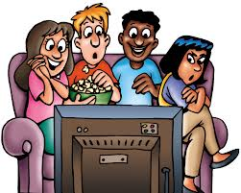
NIVEL INTERMEDIO MODELO 5 (2nd Term) A
TAREA 1: MONÓLOGO
Prepare and deliver a monologue about your favourite TV show giving reasons
TAREA 2: DIÁLOGO
Your English friend is visiting you in summer and he/she would like to do a sightseeing tour.
Tell him/her what he/she shouldn’t miss doing and visiting.
Use modal verbs like “should (have)/shouldn’t…” when talking to your friend. Try to come to an agreement.

Slide 11
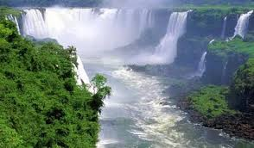
NIVEL INTERMEDIO MODELO 5 (2nd Term) B
TAREA 1: MONÓLOGO
Prepare and deliver a monologue about an experience that you will never forget, giving reasons.
TAREA 2: DIÁLOGO
You are English and would like to visit Spain in summer and do a sightseeing tour. Ask your Spanish friend what you should do or visit
Use modal verbs like “should (have)/shouldn’t…” when talking to your friend. Try to come to an agreement. YOU BEGIN THE CONVERSATION.

Slide 12
NIVEL INTERMEDIO MODELO 6 (2nd Term) A
TAREA 1: MONÓLOGO
Prepare and deliver a monologue about your best friend: when, where you met him/her; what he/she is like, the things you have in common, etc.
TAREA 2: DIÁLOGO
You think that the best place to live is in a big city. On the contrary, your classmate thinks the best place to live is in the country. Support your ideas by means of phrases such as: “In my opinion, personally, I agree, I disagree”, etc.
Try to come to an agreement. YOU BEGIN THE CONVERSATION.

Slide 13
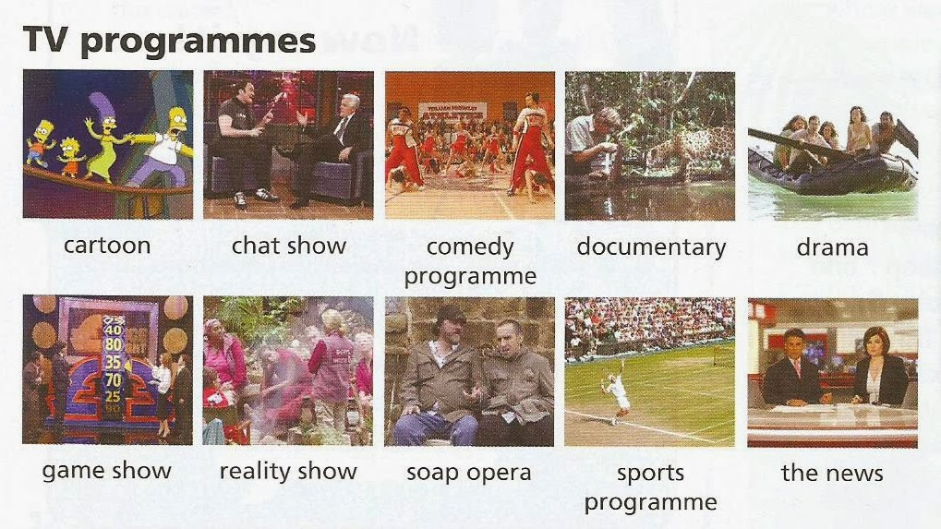
NIVEL INTERMEDIO MODELO 6 (2nd Term) B
TAREA 1: MONÓLOGO
Prepare and deliver a monologue about your pet hate about television, that is, what you don’t like about television and its programmes.
TAREA 2: DIÁLOGO
You think that the best place to live is in the country. On the contrary, your classmate thinks the best place to live is in a big city. Support your ideas by means of phrases such as: “In my opinion, personally, I agree, I disagree”, etc.
Try to come to an agreement.

Slide 14
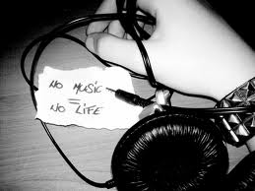
NIVEL INTERMEDIO MODELO 7 (2nd Term) A
TAREA 1: MONÓLOGO
Prepare and deliver a monologue about the impact of the Internet in the music industry: if the Internet is good/bad for the music industry.
TAREA 2: DIÁLOGO
You are going to do your oral exam next week and you would like your classmate to help you prepare it. Use phrases such as: “Could you do me a big favour…?, Do you think you could…?, Would you mind…? Decide what you are going to do to prepare it.
Try to come to an agreement. YOU BEGIN THE CONVERSATION.

Slide 15
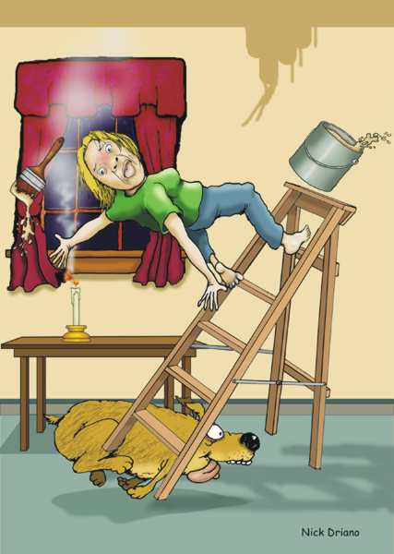
NIVEL INTERMEDIO MODELO 7 (2nd Term) B
TAREA 1: MONÓLOGO
Prepare and deliver a monologue about a time you had an accident (either at home or in the car) or got a sports injury
TAREA 2: DIÁLOGO
You are going to do your oral exam next week and your classmate would like you to help him/her prepare it. Use phrases such as: “of course not, sure, not at all, it’s all right, etc”. Decide what you are going to do to prepare it.
Try to come to an agreement.

