Slide 1
SPEAKING TEST SHEETS
THIRD TERM

Slide 2
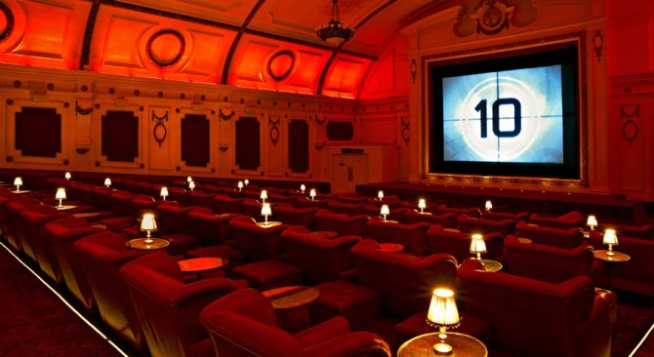
NIVEL INTERMEDIO MODELO 1 A
TAREA 1: MONÓLOGO
Prepare and deliver a monologue about films and cinema. Explain your preferences and describe the last film you saw
TAREA 2: DIÁLOGO
A few weeks ago you realized your mobile telephone company has been charging you for a service you had cancelled months ago. You go to the mobile shop to complain.
Explain to the shop asisstant what your problem is and that you want to make a complaint. Warn him/her about the actions you will take if they don’t solve the problem. Try to come to an agreement. YOU BEGIN THE DIALOGUE.

Slide 3
NIVEL INTERMEDIO MODELO 1 B
TAREA 1: MONÓLOGO
Prepare and deliver a monologue about your dream house. Describe the ideal location, services and facilities. Give as much detail as you can.
TAREA 2: DIÁLOGO
You are working as an assistant at a mobile telephone shop. You receive a customer who wants to make a complaint.
Explain to the customer that it is the problem of the telephone company and you cannot see what you could do. Explain what actions he/she could take. Try to come to an agreeent.

Slide 4
NIVEL INTERMEDIO MODELO 2 A
TAREA 1: MONÓLOGO
Prepare and deliver a monologue about something important you have learnt at school. Talk about what you learnt and why it was so important for you.
TAREA 2: DIÁLOGO
You and your friends are planning a surprise 30th birhtday party for Peter, another friend. You offered to decide on the location of the event and what present should be bought. Think about two possible different options.
Discuss your options with your friend. YOU BEGIN THE DIALOGUE.

Slide 5
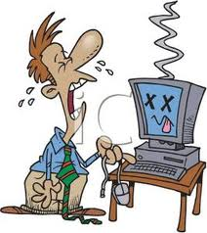
NIVEL INTERMEDIO MODELO 2 B
TAREA 1: MONÓLOGO
Imagine you had no computer for a week. Prepare and deliver a monologue about how that would affect your daily life and the activities you could do instead to keep you busy.
TAREA 2: DIÁLOGO
You and your friend are planning a surprise 30th birthday party for Peter, another friend. You offered to decide on which food and drinks should be bought. Think about the likes and dislikes of other guests to make sure that everyone will be happy. You also have to think about what kind of music should be played or if a singer/band should be invited.
Dicuss your options with your friend.

Slide 6
NIVEL INTERMEDIO MODELO 3 A
TAREA 1: MONÓLOGO
Imagine you had no TV for a week. Prepare and deliver a monologue about how that would affect your daily life and the activities you could do instead to keep you busy.
TAREA 2: DIÁLOGO
You are talking about old times with a workmate. Tell him/her about your days at school, the kind of school it was, your favourite teacher and one you really hated, the subjects you were good and bad at,… And answer hir/her questions. YOU BEGIN THE DIALOGUE.

Slide 7
NIVEL INTERMEDIO MODELO 3 B
TAREA 1: MONÓLOGO
Prepare and deliver a monologue about a film you like.
TAREA 2: DIÁLOGO
You are talking about old times with a workmate. Tell him/her about your days at school, the kind of school it was, your favourite teacher and one you really hated, the subjects you were good and bad at,… And answer hir/her questions.

Slide 8
NIVEL INTERMEDIO MODELO 4 A
TAREA 1: MONÓLOGO
Prepare and deliver a monologue about something important you have learnt at school. Talk about what you learnt and why it was so important for you.
TAREA 2: DIÁLOGO
You are going to the cinema next weekend and haven’t decided what film to see yet. Ask your friend to recommend you a good film to see. Tell him/her about your likes and dislikes. YOU BEGIN THE DIALOGUE.

Slide 9
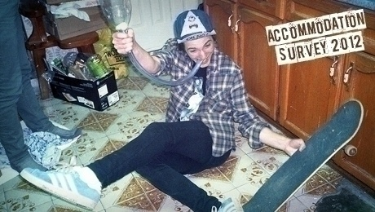
NIVEL INTERMEDIO MODELO 4 B
TAREA 1: MONÓLOGO
Prepare and deliver a monologue about an awful house you lived in when you were at university.
TAREA 2: DIÁLOGO
A friend of yours is going to the cinema next weekend and haven’t decided what film to see yet. Ask him about his/her likes and dislikes and recommend him/her a film you have liked.

Slide 10
NIVEL INTERMEDIO MODELO 5 A
TAREA 1: MONÓLOGO
Prepare and deliver a monologue about what the ideal school would be for you.
TAREA 2: DIÁLOGO
You and your friend have just finished your final exams and are talking about the results you think you might get. Tell him/her what marks you think you are going to get, and what you would do if you passed all the subjects or if you failed any subject. YOU BEGIN THE DIALOGUE.

Slide 11
NIVEL INTERMEDIO MODELO 5 B
TAREA 1: MONÓLOGO
Prepare and deliver a monologue about how your life would change if you won the lottery.
TAREA 2: DIÁLOGO
You and your friend have just finished your final exams and are talking about the results you think you might get. Tell him/her what marks you think you are going to get, and what you would do if you passed all the subjects or if you failed any subject.

Slide 12
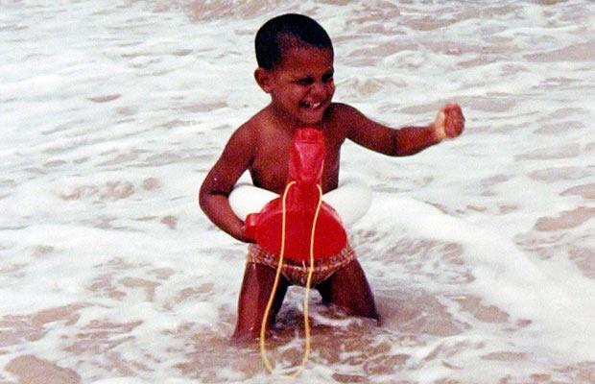
NIVEL INTERMEDIO MODELO 6 A
TAREA 1: MONÓLOGO
Prepare and deliver a monologue about how different your life would have been if you had been born Barack Obama.
TAREA 2: DIÁLOGO
You and your boyfriend/girlfriend are going to buy your first house together. Talk about what you would like it to be like. YOU BEGIN THE DIALOGUE.

Slide 13
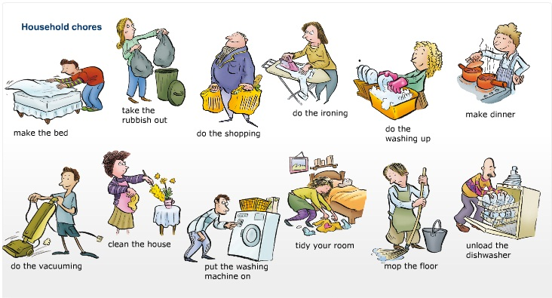
NIVEL INTERMEDIO MODELO 6 B
TAREA 1: MONÓLOGO
Everybody has household jobs or chores. Prepare and deliver a monologue about the chores that you do. Talk about which you enjoy doing, which you don’t mind doing and which you hate doing and why.
TAREA 2: DIÁLOGO
You and your boyfriend/girlfriend are going to buy your first house together. Talk about what you would like it to be like.

Slide 14
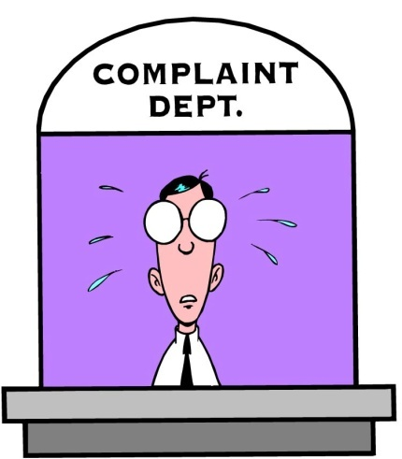
NIVEL INTERMEDIO MODELO 7 A
TAREA 1: MONÓLOGO
Prepare and deliver a monologue about a situation in which you had to make a complaint because you didn’t get what you had paid for (in a shop, hotel, restaurant).
TAREA 2: DIÁLOGO
You are with a friend talking about what kind of school you would like your children to study in. You think a mixed state school is the best idea, but your friend has a different opinion. Try to come to an agreement.
YOU BEGIN THE DIALOGUE.

Slide 15
NIVEL INTERMEDIO MODELO 7 B
TAREA 1: MONÓLOGO
Prepare and deliver a monologue about what you would do if you could change the world to make it better.
TAREA 2: DIÁLOGO
You are with a friend talking about what kind of school you would like your children to study in. You think a single-sex boarding school is the best idea, but your friend has a different opinion. Try to come to an agreement.

