Slide 1
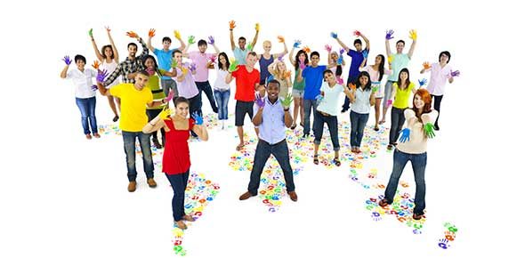
SOCIETY

Slide 2
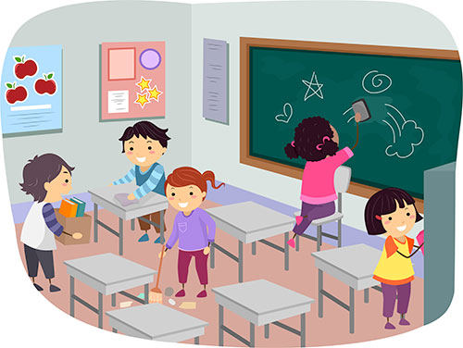
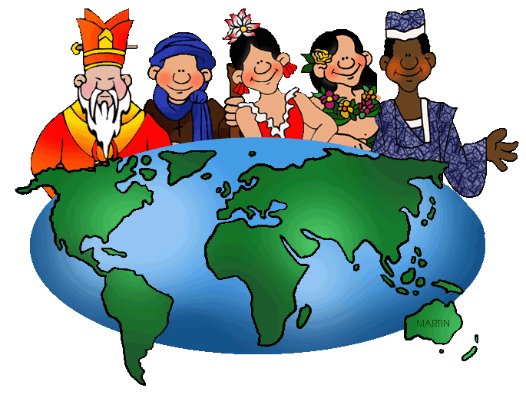
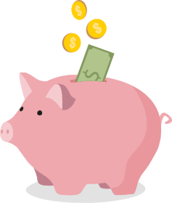
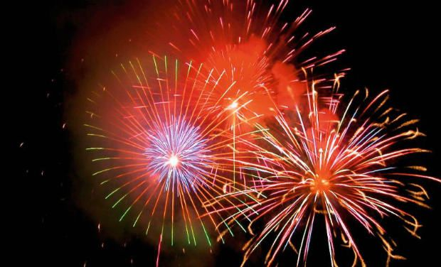
VOCABULARY
Population
Responsibility
City council
Culture
Saving
Festivity

Slide 3
FAMILY, SCHOOL AND FRIENDS
Our society is organized in different groups with some rules.
In our family we have rules, there are different chores at home:
https://www.youtube.com/watch?v=qKrbn1W8QjU

Slide 4
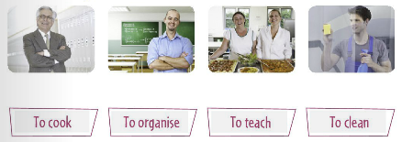
TEACHERS AND SCHOOL STAFF
In the school there are many people working.

Slide 5
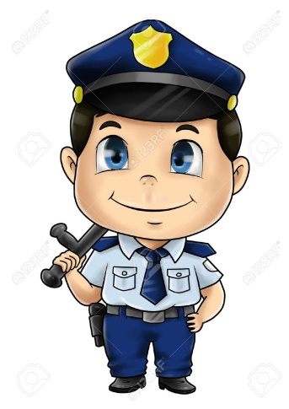
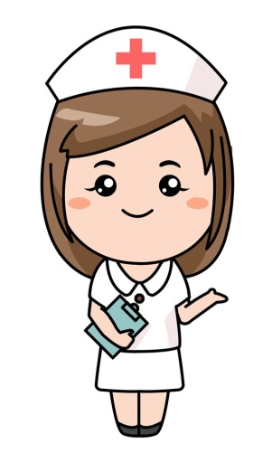
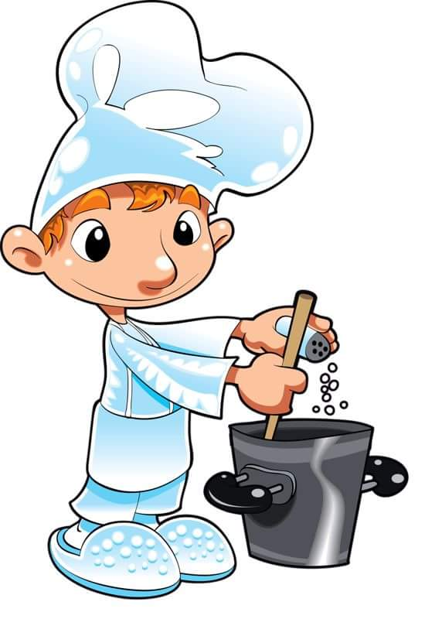
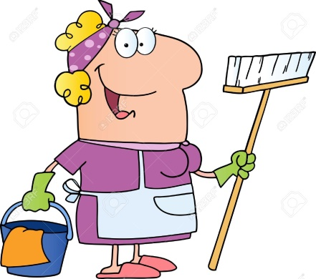
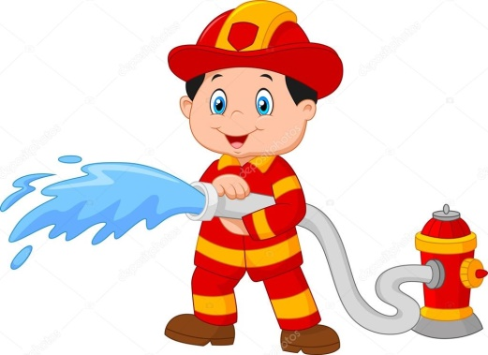
WHAT ARE SCHOOL JOBS?

Slide 6
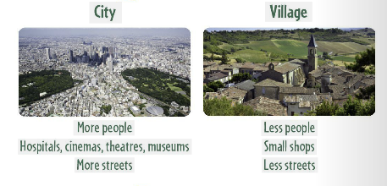
THE PLACE WHERE WE LIVE
https://www.youtube.com/watch?v=EfD2k9beP-4

Slide 7
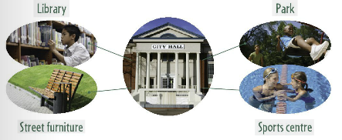
THE TOWN HALL
The CITY COUNCIL is an elected group of people who organise our city or village.
We pay to have public services.

Slide 8
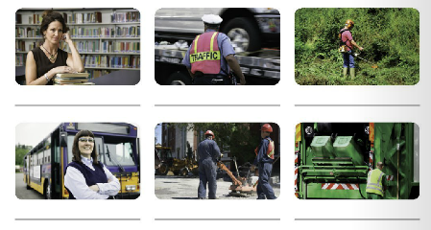
PUBLIC SERVICES
Some people work for the council to provide PUBLIC SERVICES.
LIBRARY
POLICE
GARDENS AND PARKS
TRANSPORT
PAVING
RUBBISH COLLECTION

Slide 9
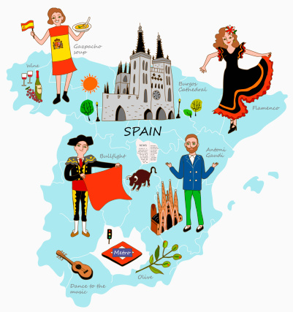
LANGUAGE AND CULTURE
Spain has a rich, ancient culture with several events every year.
https://www.youtube.com/watch?v=Cup08wNYJ2Y

Slide 10
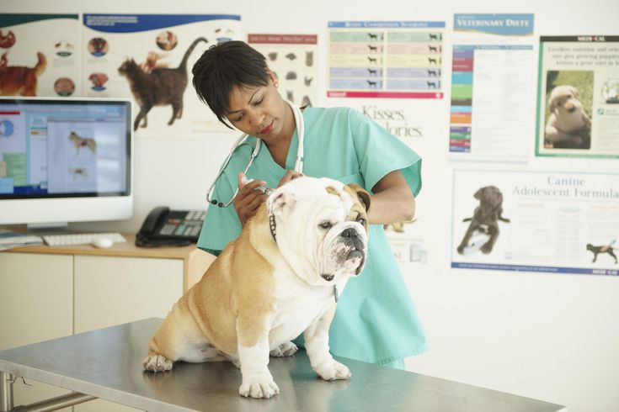
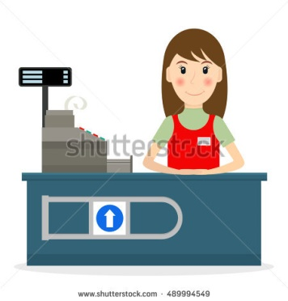
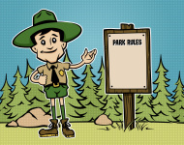
JOBS
People have a job to provide a service to society, also we need a job to earn money.
NURSE
TEACHER
VETERINARIAN
SHOP ASSISTANT
POLICE
FOREST GUARD

Slide 11
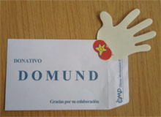
MONEY
We pay for products and services with money.
We need money for…
BUY PRODUCTS
SAVING
SOLIDARITY

Slide 12
MASS MEDIA AND ADVERTISING
Through the media we get a lot of information.
We can find adverts that informs about products.
I read…
I surf…
I listen to…
I watch…

