Slide 1
TRIVIA TIME!!

Slide 2
1. THIS IS….
HAPPY B) SAD
C)SURPRISED D) SCARED

Slide 3
2. THE SENSE FOR THIS FLOWER IS…
SMELLING B) TASTING
C)TOUCHING D) HEARING

Slide 4
3. WHAT IS THE NAME OF THIS BONE?
SPINE B) FEMUR
C)RIBCAGE D) SKULL

Slide 5
4. WHAT IS THE NAME OF THIS MUSCLE?
BICEPS B) PECTORAL
C)ABDOMINAL D) MASSETER

Slide 6
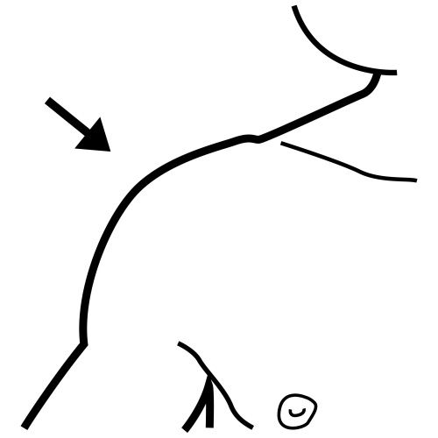
5. WHAT IS THE NAME OF THIS JOIN?
NECK B) KNEE
C)SHOULDER D) WRIST

