Slide 1
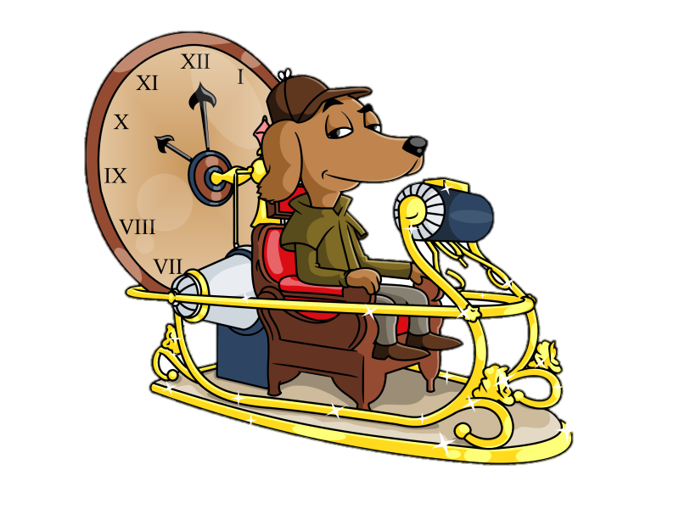
UNIT 5: THE MINISTRY OF TIME
NAME: …………………………………………………………………………………………………………
CLASS: ………………………………………………

Slide 2
INDEX
I LEARN TOYS.
I LEARN A NEW SENTENCE.
FINAL TASK.

Slide 3
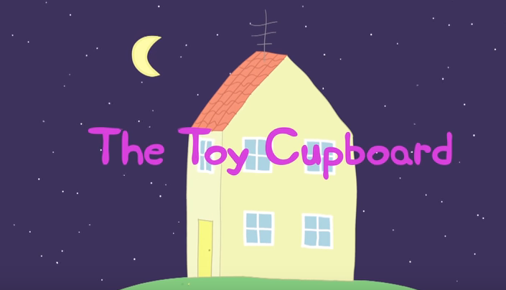
1. I LEARN TOYS.
***We use a Peppa Pig episode to introduce the topic.
We ask students to guess the meaning of the word «toy».
https://www.youtube.com/watch?v=BIgeoM3mF7Q

Slide 4
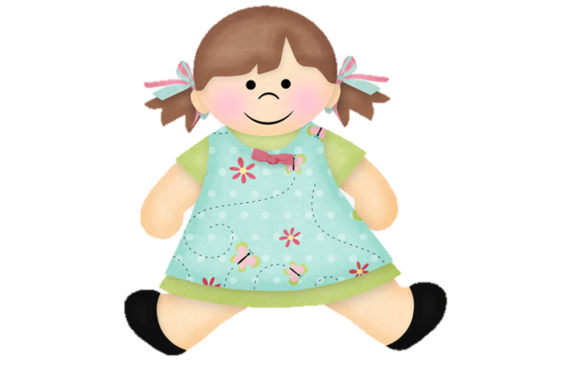
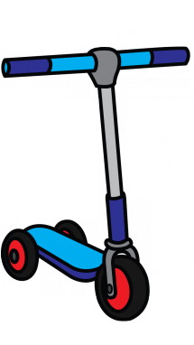
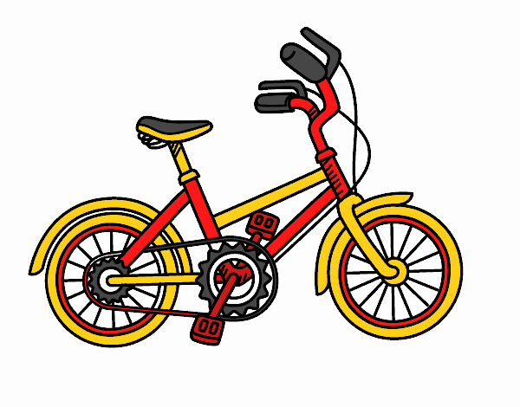
1. I LEARN TOYS.
DOLL
BALL
SCOOTER
BIKE

Slide 5
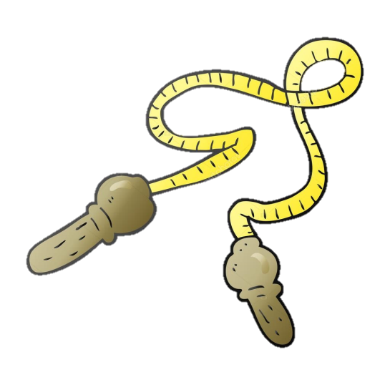
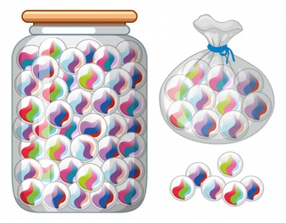
1. I LEARN TOYS.
SKIPPING ROPE
MARBLES
CAR
TEDDY BEAR

Slide 6
1. I LEARN TOYS.
GAMES
Listen and repeat with different voices and rhythms.
(Mr. Sock, the Class mascot) ***(WE AGREE A GESTURE FOR EACH WORD)
Hot & Cold.
Guess the toy.

Slide 7
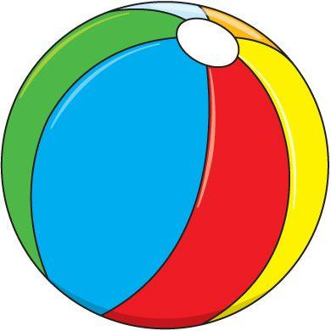
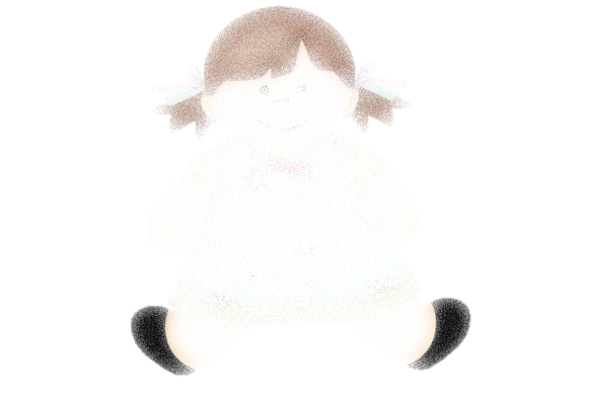
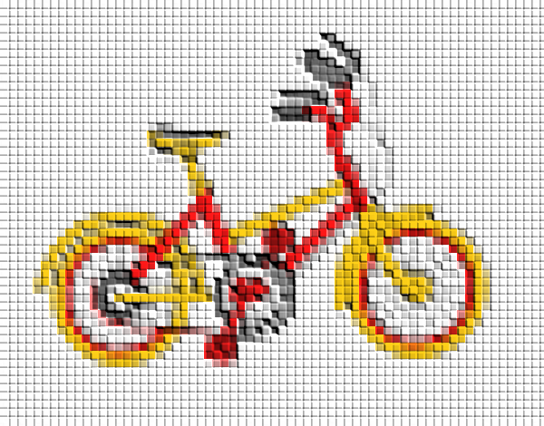

Slide 8
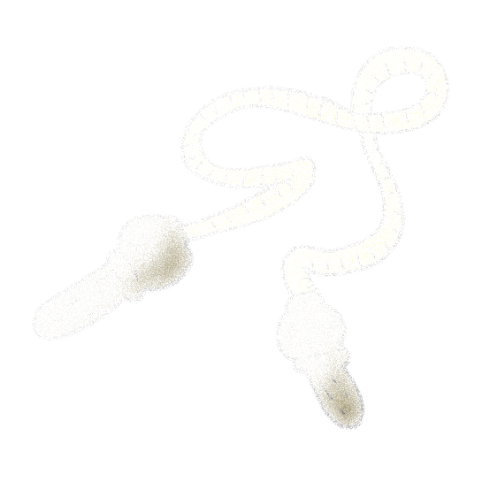
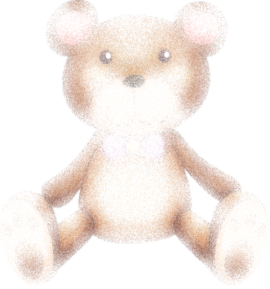

Slide 9
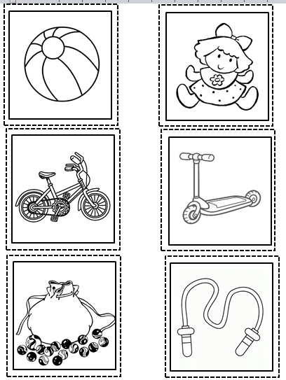
1. I LEARN TOYS.
NUMBERED HEADS TOGETHER
GAMES
Listen & Clap (song)
Show me…

Slide 10
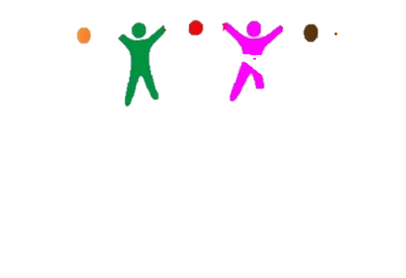
1. I LEARN TOYS.
GAMES
Memory game (***using the cards)
NUMBERED HEADS TOGETHER
https://buscapalabras.com.ar/sopa-de-letras-de-toys_24.html

Slide 11
2. I LEARN A NEW SENTENCE
I’ve got a …

Slide 12
2. I LEARN A NEW SENTENCE
GAMES
Pass the ball (***Each student will say the sentence «I’ve got a …» and pass the ball to another student. The teacher will show flashcards for students to know the word they will have to add at the end of the sentece).
Find your partners (***Students will walk around the class saying the sentence they have learnt to find children with the same cards as them).
Wild cards(***Students shuffle their cards and place them face down in front of them. Each student takes a card and says «I’ve got a …» at the same time s/he puts it in the middle. If the next student puts the same card, s/he collects all the cards of the middle. The game ends when one player runs out of cards.

Slide 13
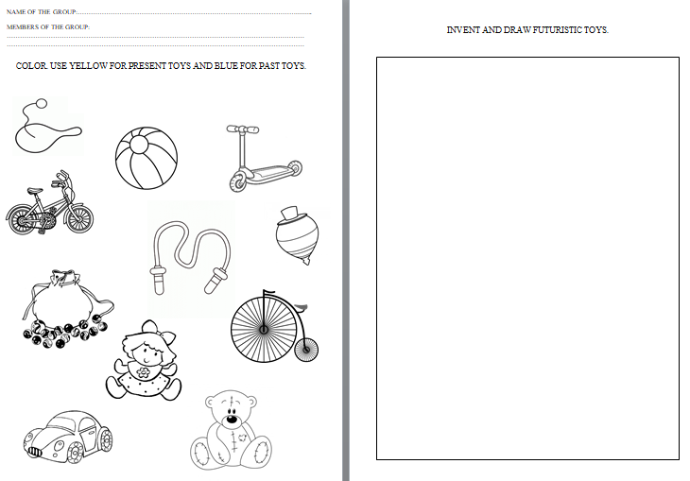
2. I LEARN A NEW SENTENCE
NUMBERED HEADS TOGETHER
WORKSHEET

Slide 14
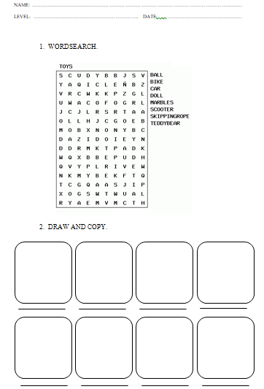
2. I LEARN A NEW SENTENCE
WORKSHEET

Slide 15
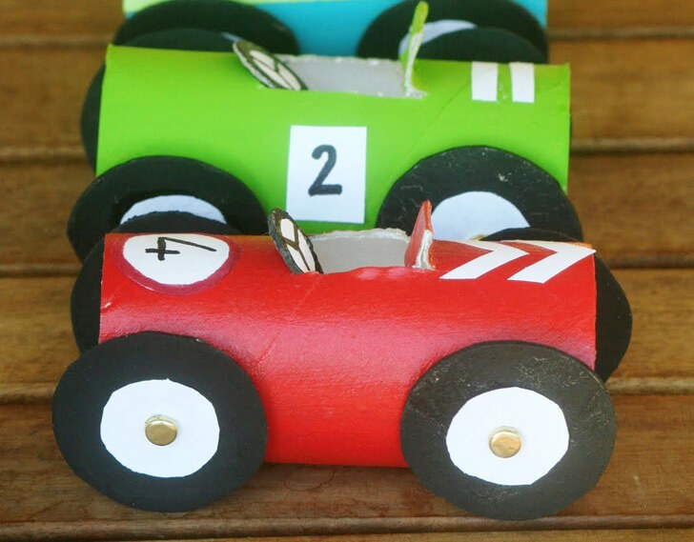
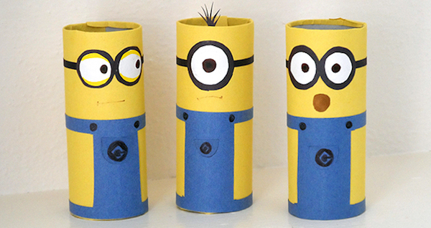
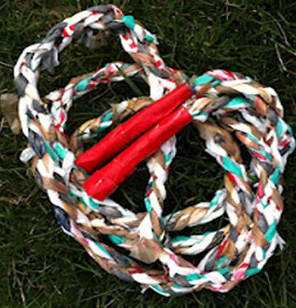
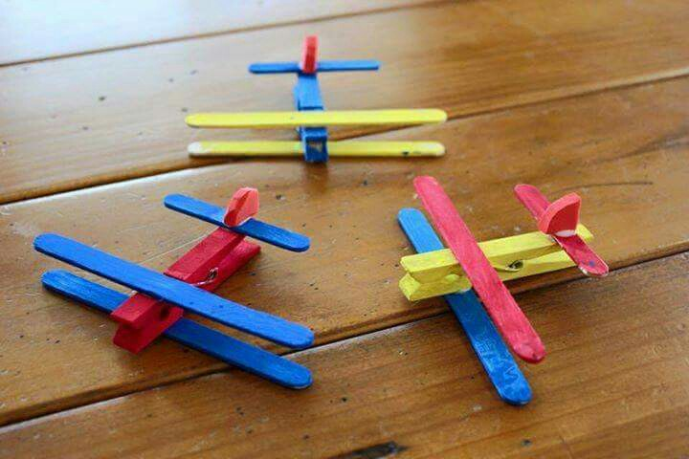
3. FINAL TASK
NUMBERED HEADS TOGETHER

