Slide 1
UNIT 2: THE CALENDAR
NAME: ………………………………………………………………………………………………………………………………………………………………………CLASS: ………………………………..

Slide 2
I LEARN DAYS OF THE WEEK
I LEARN MONTHS
I LEARN NUMBERS
I LEARN A NEW SENTENCE
FINAL TASK
INDEX

Slide 3
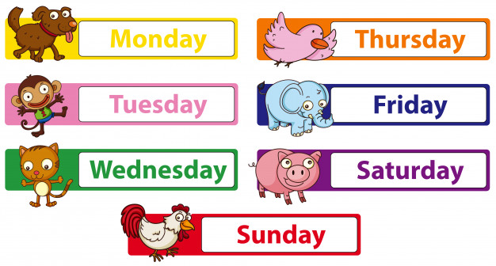
1. I LEARN DAYS OF THE WEEK

Slide 4
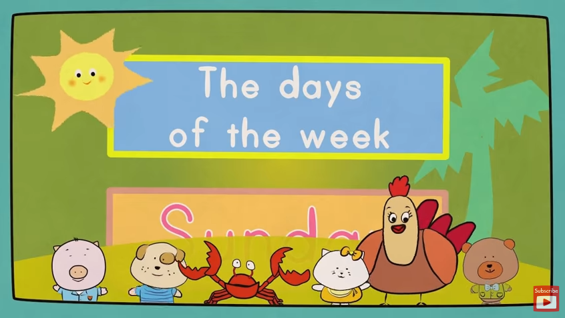
1. I LEARN DAYS OF THE WEEK
https://www.youtube.com/watch?v=mXMofxtDPUQ

Slide 5
1. I LEARN DAYS OF THE WEEK
GAMES
- Listen and point.
- Listen and repeat with different voices and rhythms.
(Mr. Sock, the Class mascot) ***(WE AGREE A GESTURE FOR EACH WORD)
- Listen and stand up. ***(WE ASSIGN EACH STUDENT A DAY OF THE WEEK, IF WE SAY HIS/HERS, S/HEMUST STAND UP)

Slide 6
1. I LEARN DAYS OF THE WEEK
GAMES
Whisper and touch.
What’s up? (¿Qué tengo en el coco?)
- Cross the river.
NUMBERED HEADS TOGETHER

Slide 7
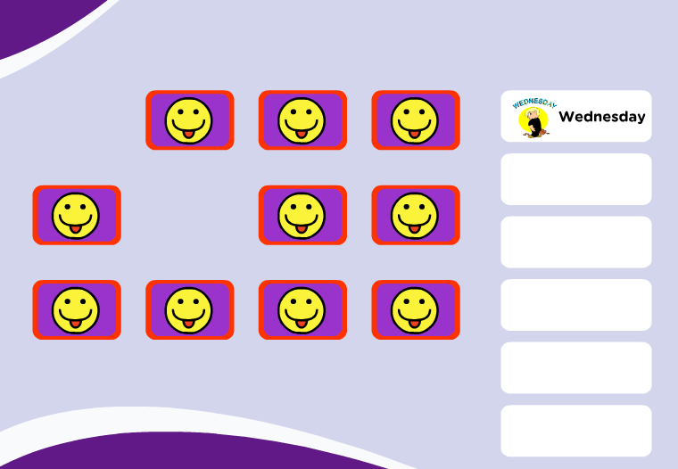
1. I LEARN DAYS OF THE WEEK
NUMBERED HEADS TOGETHER
https://www.eslgamesplus.com/days-of-the-week-esl-vocabulary-game/

Slide 8
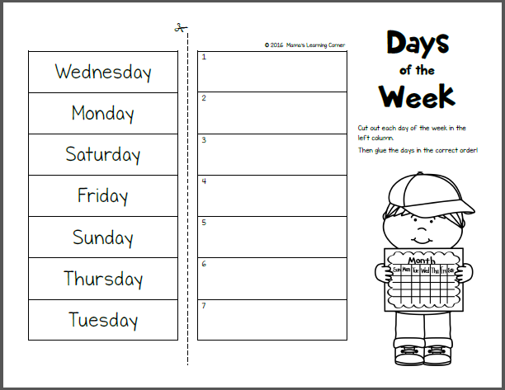
1. I LEARN DAYS OF THE WEEK
ONE FOR ALL

Slide 9
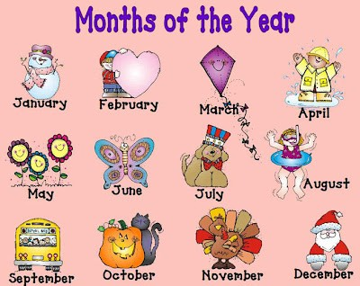
2. I LEARN MONTHS
JANUARY
FEBRUARY
MARCH
APRIL
AUGUST
MAY
JUNE
JULY
SEPTEMBER
OCTOBER
NOVEMBER
DECEMBER

Slide 10
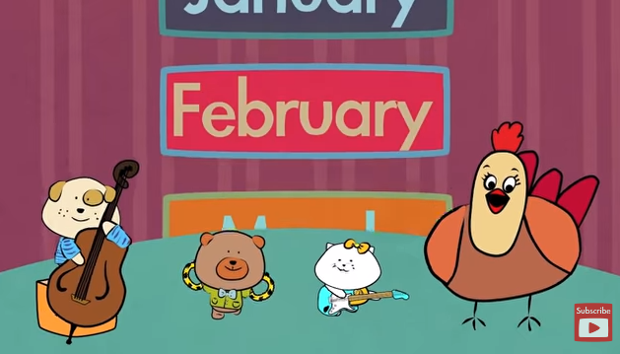
2. I LEARN MONTHS
https://www.youtube.com/watch?v=Fe9bnYRzFvk

Slide 11
2. I LEARN MONTHS
GAMES
- Months Clapping Game
- Fly swatter
- Jump the Months and say
NUMBERED HEADS TOGETHER

Slide 12
2. I LEARN MONTHS
NUMBERED HEADS TOGETHER
https://www.mes-games.com/months.php

Slide 13
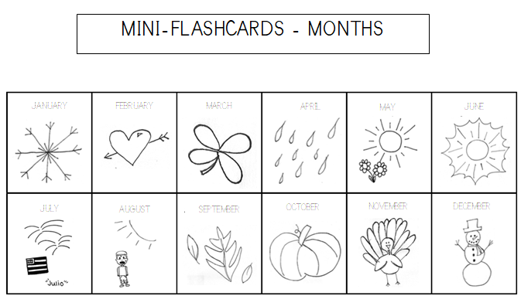
2. I LEARN MONTHS

Slide 14
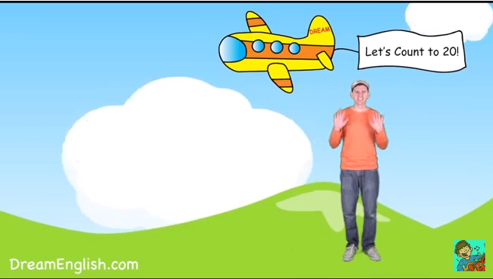
3. I LEARN NUMBERS
https://www.youtube.com/watch?v=0VLxWIHRD4E

Slide 15
3. I LEARN NUMBERS
TPR GAME
GAMES
- Fruit salad (fruta prohibida).
The scarf game.
BINGO

Slide 16
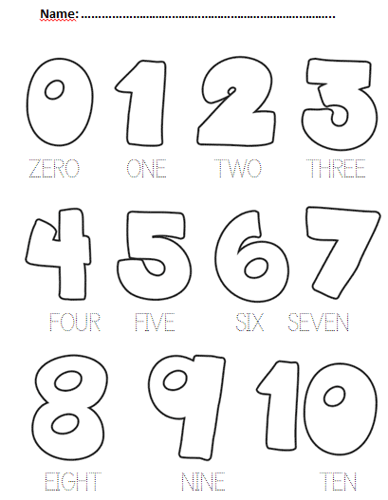
3. I LEARN NUMBERS
We teach numbers from 1 to 31 orally (in a written form, only from 1 - 10).

Slide 17
4. I LEARN A NEW SENTENCE
What’s the date today?
It’s …

Slide 18
4. I LEARN A NEW SENTENCE
We tell the story to the sts and make them repeat over and over again the words and structure we have taught them previously.

Slide 19
5. FINAL TASK
PENCILS IN THE CENTRE
Students write month, (the one of his/her birhtday), days of the week and numbers.
We use the final task to ask and answer questions in pairs.

Slide 20
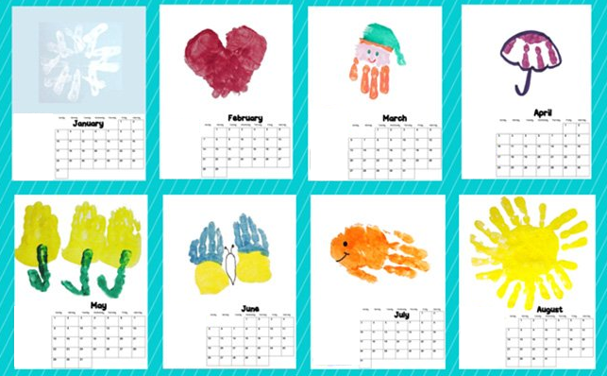
5. FINAL TASK

