Slide 1
G g

Slide 2
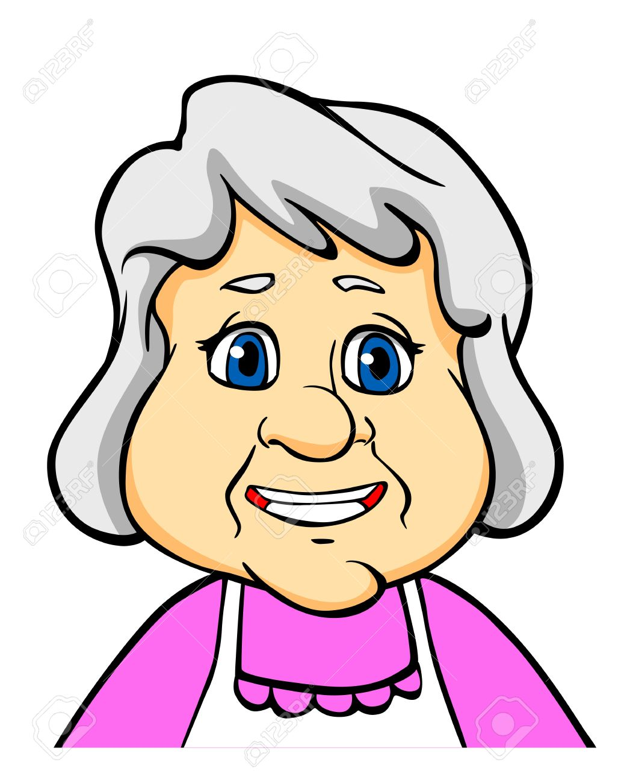
Granny

Slide 3
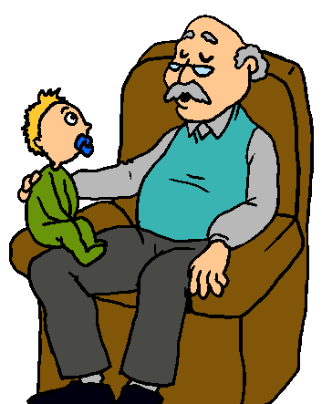
Grandad

Slide 4
Green

Slide 5
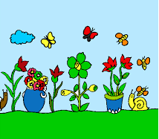
Garden

Slide 6
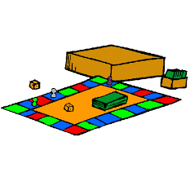
Game

Slide 7
Girl

