Slide 1
1. Click on the objects and listen.

Slide 2
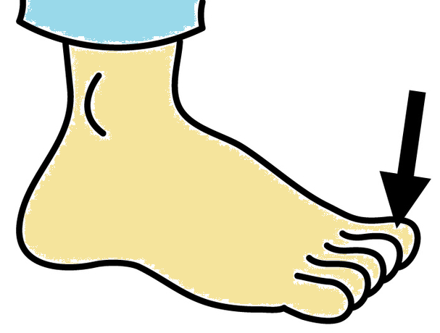
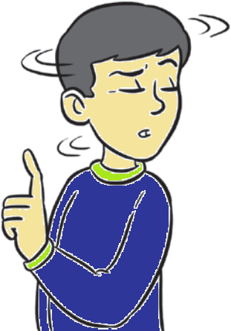

Slide 3
2. Trace. Look and complete.

Slide 5
3. Click on the words and pictures with O sound.

Slide 6
Phone
Leg
Toe
Head

Slide 7
Yes!

Slide 8
No!

