Slide 1
B b

Slide 2
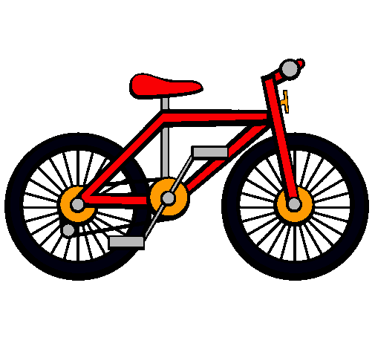
Bike

Slide 3
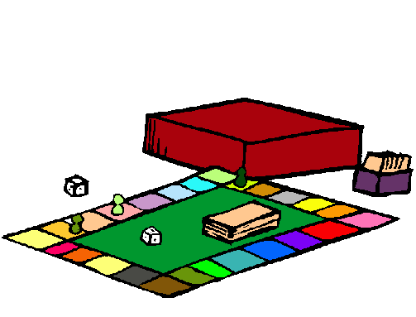
Board game

Slide 4
Ball

Slide 5
Book

Slide 6
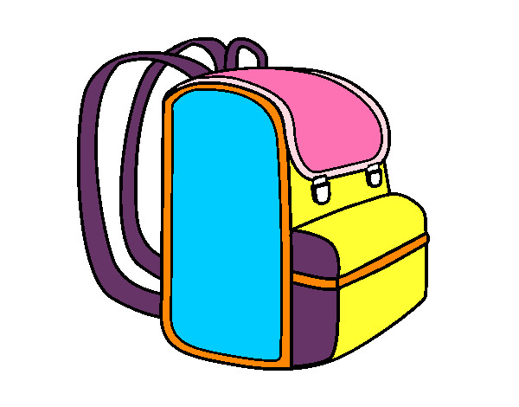
Bag

Slide 7
Banana

Slide 8
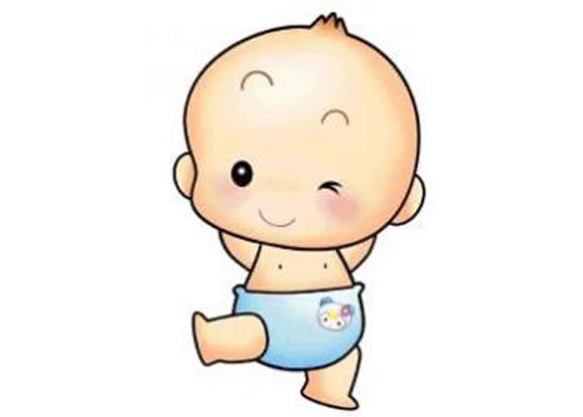
Baby

