Slide 1
1. Click on the objects and listen.

Slide 2
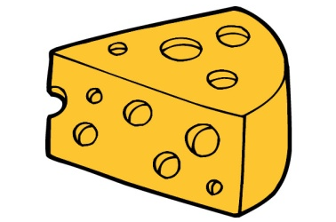
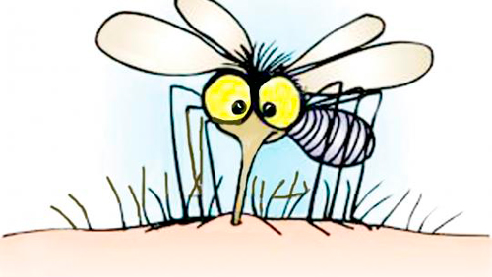
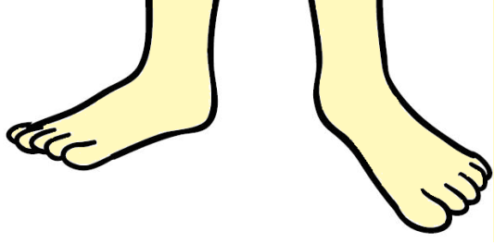
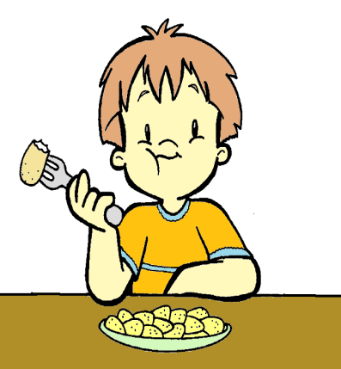

Slide 3
2. Trace. Look and complete.

Slide 4
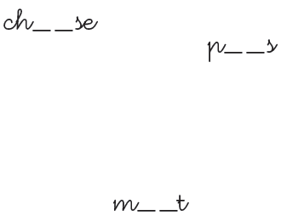

Slide 5
3. Click on the words and pictures with ee or ea sound.

Slide 6
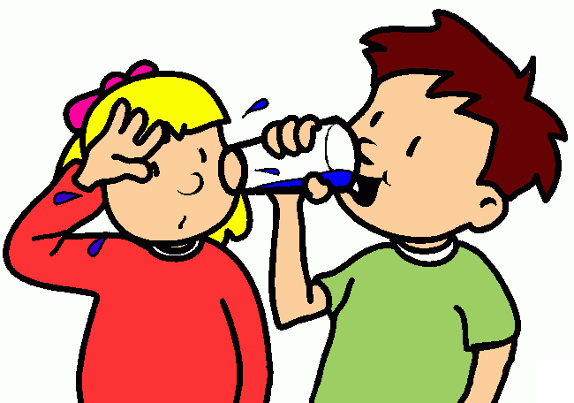
Bee
Meat
Feet
Bear
Cheese

Slide 7
Yes!
Back
Finish

Slide 8
No!
Finish
Back

Slide 9
Bye!

