Slide 1
MACHINES

Slide 2
CLASSIFICATIONOF THE MACHINES
According to the transformation that takes place: energetic or of information.
According to the place of application: at home, in transportation, in industry, etc.
according to whether they have movement or not: static or dynamic

Slide 3
PARTS OF MACHINES
Structures
Control elements
Engine
transmission elements

Slide 4
LEVER
the levers are rigid bars that oscillate by a point of support

Slide 5
TYPES OF LEVERS
First class lever: the point of support is between the force and the load example: scissor and hammers
Second class lever: the load is between the point of support and the force, example: opener and wheelbarrow.
Third class lever: the force is between the point of support and the load, example: tweezers and shovel.

Slide 6
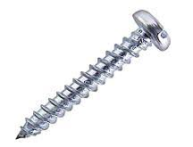
SCREW

Slide 7
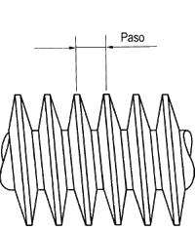
PARTS OF SCREW
pitch: it´s the distance between the teeth.

Slide 8
PARTS OF SCREW (2)
THE METRIC: indicates the millimeters that it has in diameter

Slide 9
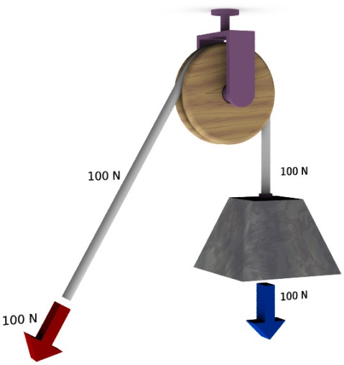
PULLEY
A pulley is a wheel whith a groove in which a rope or bell can be placed. this way you can lift weights more comfortably
F=R

Slide 10
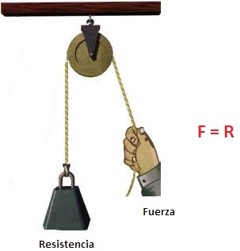
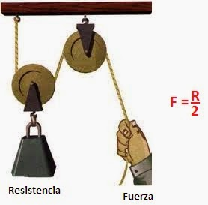
TYPES OF PULLEY
mobile pulley
fixed pulley

Slide 11
WORK
W= work
F= force
D= distance

Slide 12
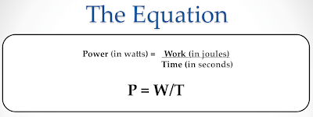
POWER

Slide 13
POWER(2) performance=
useful energy
_____________________ x100
total energy

