Slide 1
TECHNOLOGY UNIT 1
TECHNOLOGICAL PROCCESS

Slide 2
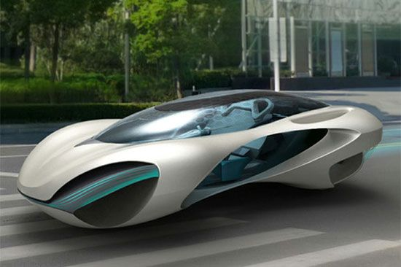
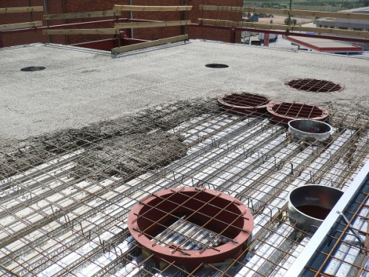
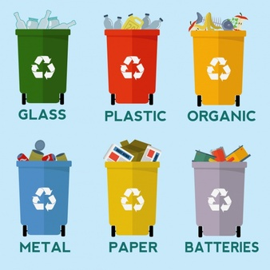
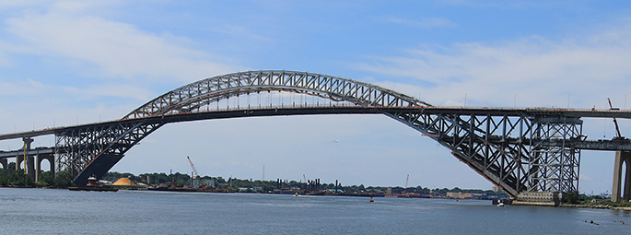
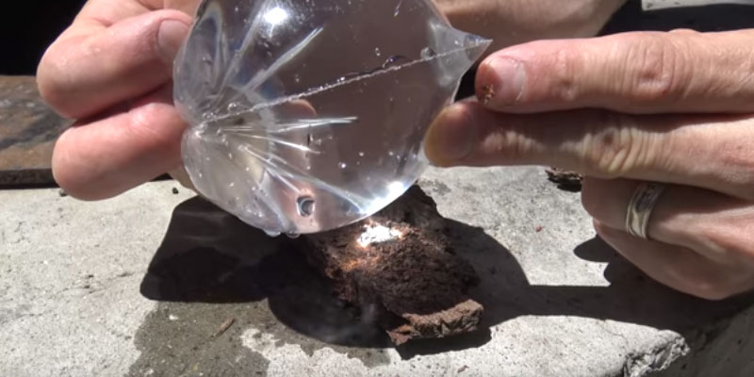
¿What´s technology?
Technology: The definition of technology is science or knowledge put into practical use to solve problems or invent useful tools.

Slide 3
Exercises
1, 2, 3 page 24.

Slide 4
¿What´s technology?
TECHNOLOGICAL PROCESS:
Is the work method used by technology.
Consists of the ordered sequence of steps that must be followed in order to satisfy a need or solve a problem.

Slide 5
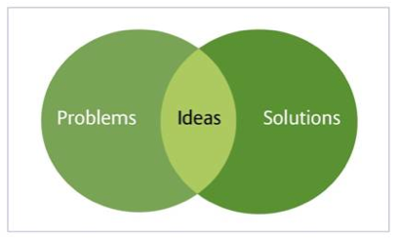
¿What´s technology?
A possible and simple sequence of the technological process could be something like this:
NECESSITY OR PROBLEM
IDEA
DEVELOPMENT OF THE IDEA
CONSTRUCTION
VERIFICATION AND
VALIDATION

Slide 6
Exercises
4, 5, 6, page 24.

Slide 7
¿What´s technology?
FACTORS INFLUENCING THE TECHNOLOGICAL PROCCESS:
Physics knowledge and scientific concepts.

Slide 8
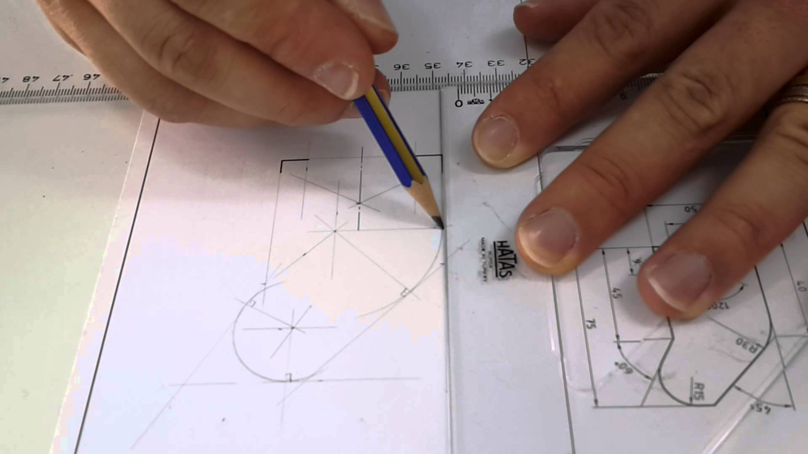
¿What´s technology?
FACTORS INFLUENCING THE TECHNOLOGICAL PROCCESS:
Technical drawing.

Slide 9
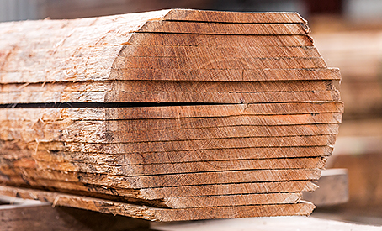
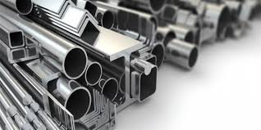
¿What´s technology?
FACTORS INFLUENCING THE TECHNOLOGICAL PROCCESS:
Materials and its properties.
Wood Metal

Slide 10
¿What´s technology?
FACTORS INFLUENCING THE TECHNOLOGICAL PROCCESS:
Working
techniques.

Slide 11
¿What´s technology?
FACTORS INFLUENCING THE TECHNOLOGICAL PROCCESS:
Economical factors.

Slide 12
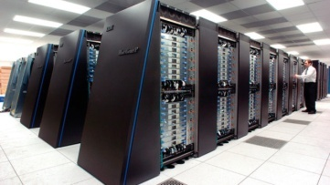
¿What´s technology?
FACTORS INFLUENCING THE TECHNOLOGICAL PROCCESS:
Informatics.

Slide 13
Exercises
7, 8, page 24.

Slide 14
PHASES OF THE TECHNOLOGICAL PROCCESS
Look for a necessity.
Recompilation and analysis of previous solutions.
Design your original solution.
Choose the best one of the previous solutions.
Development of your chosen solution.
Project planning.
Budget.
Construction.
Verification and validation.
Memory project.

Slide 15
PHASES OF THE TECHNOLOGICAL PROCCESS
The key ones:
Describing and analyzing the need or problem.
Searching for information.
Generating and selecting ideas.
Executing the design.
Evaluating.

Slide 16
PHASES OF THE TECHNOLOGICAL PROCCESS
EXAMPLE: Disordered crayons.
Describing and analyzing the need or problem.
Pencil case to store drawind materials.
Needs to be cheap, easy to make, safe and we have to use recycled materials

Slide 17
PHASES OF THE TECHNOLOGICAL PROCCESS
Searching for information.
Search for information about existing design ideas and solutions which solve the problem or need.
You can use books, catalogues, internet,…

Slide 18
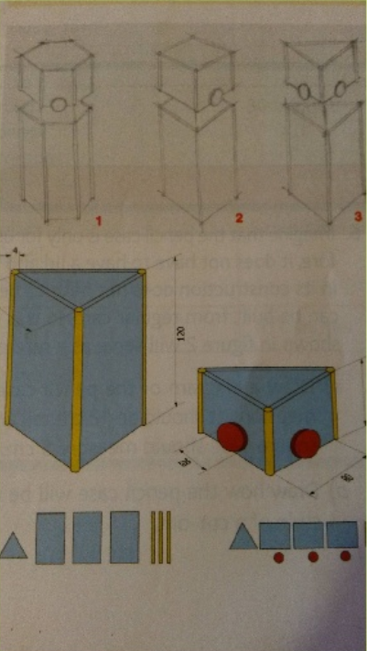
PHASES OF THE TECHNOLOGICAL PROCCESS
Generating Create new ideas or consider one or more of the existing solutions.
Use a rich picture
Propose solution: sketching.
Best idea selection:
technical drawing.

Slide 19
PHASES OF THE TECHNOLOGICAL PROCCESS
Plan the work:
Draft a work plan which specifies the tasks that must be completed and the resources needed to complete them.
Build the object.

Slide 20
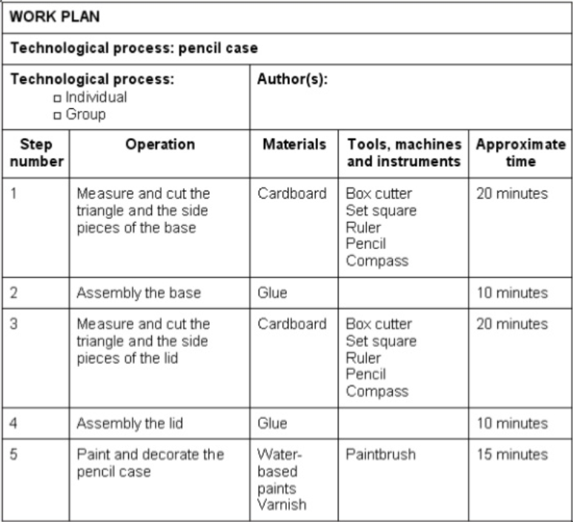
PHASES OF THE TECHNOLOGICAL PROCCESS

Slide 21
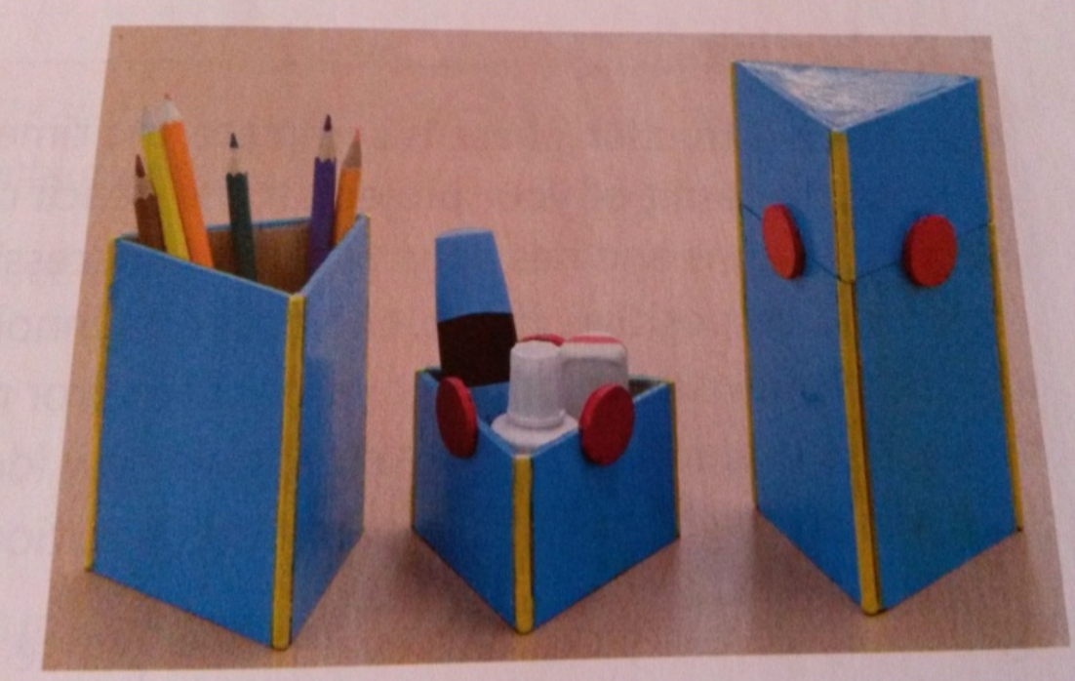
PHASES OF THE TECHNOLOGICAL PROCCESS
Executing the design.

Slide 22
PHASES OF THE TECHNOLOGICAL PROCCESS
Check the object.
Does it solve the problem?
Yes, it´s cool!
No. What´s worng with it?

Slide 23
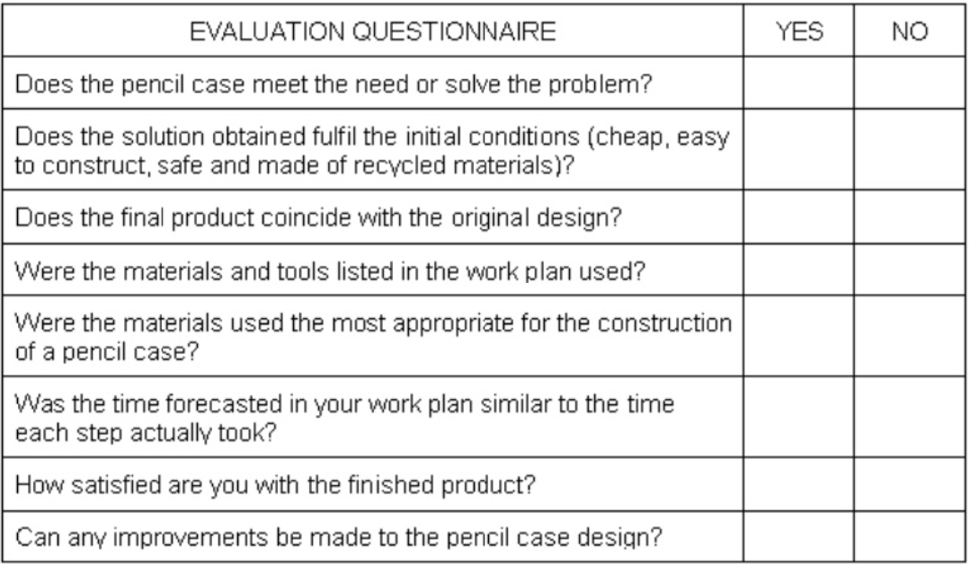
PHASES OF THE TECHNOLOGICAL PROCCESS

Slide 24
PHASES OF THE TECHNOLOGICAL PROCCESS
Documenting the process: project report.
After fininshing the process,
collect al the documentation
to explain the method used
and show the solution
obtained.

Slide 25
Exercises
20,21, 22, 23, 24, 25, 28, 31, page 24-25.

Slide 26
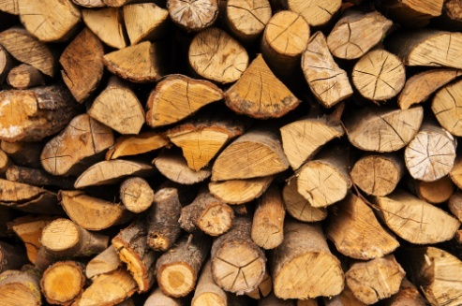
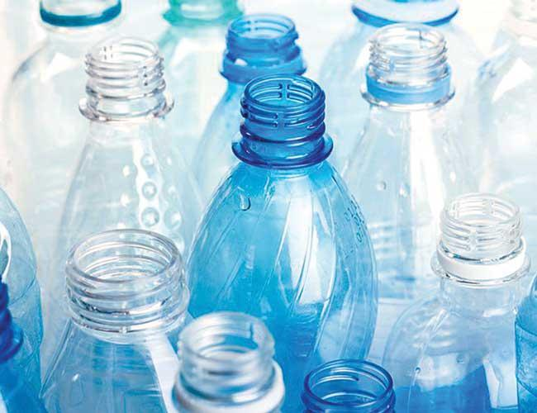
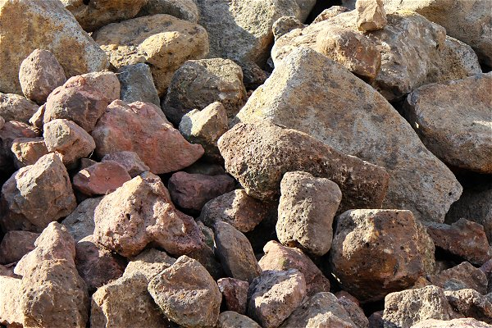
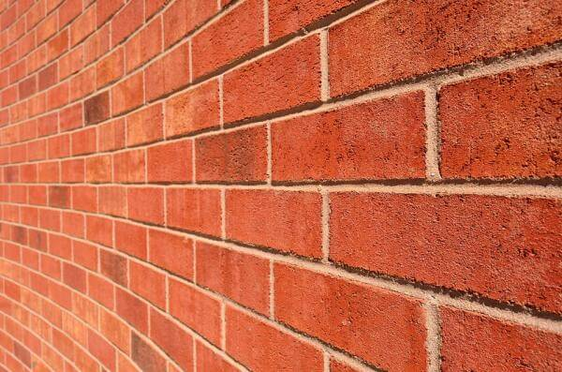
MATERIALS
Wood
Plastic
Metal
Textile
Rocks
Ceramic

Slide 27
MATERIALS
1
Wood
Plastic
Metal
Textile
Rocks
Ceramic

Slide 28
MATERIALS
1
Wood
Plastic
Metal
Textile
Rocks
Ceramic
2

Slide 29
MATERIALS
1
Wood
Plastic
Metal
Textile
Rocks
Ceramic
3
2

Slide 30
MATERIALS
1
Wood
Plastic
Metal
Textile
Rocks
Ceramic
3
2
4

Slide 31
MATERIALS
1
Wood
Plastic
Metal
Textile
Rocks
Ceramic
3
2
4
5

Slide 32
MATERIALS
1
Wood
Plastic
Metal
Textile
Rocks
Ceramic
3
2
4
5
6

Slide 33
Exercises
For home: 31, page 19.

Slide 34
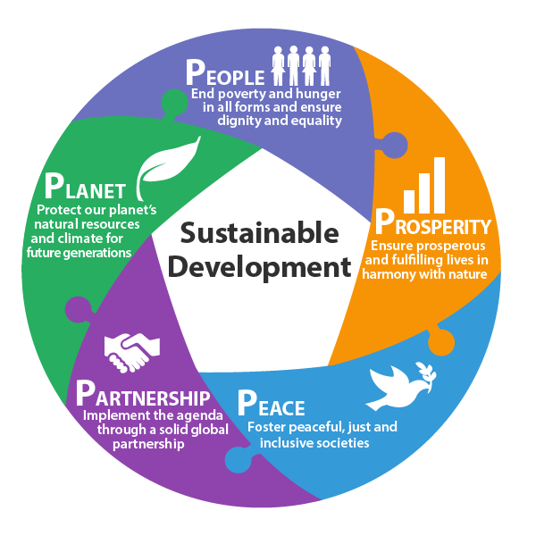
Sustainable Development
Development that satisfies the needs of the present without compromising the capacity of future generations, guaranteeing the balance between economic growth, care for the environment and social well-being.

Slide 35
Sustainable Development
ENVIRONMENTAL SUSTAINABILITY
renewable energies
saving water
sustainable mobility
sustainable construction
SOCIAL SUSTAINABILITY
fairly-distributed quality of life
healthcare and education
gender equality
ECONOMIC SUSTAINABILITY
wealth for all, without harming the environment.

Slide 36
Exercises
In the classroom: 34, page 21

Slide 37
Exercises
Haz una presentación en ordenador (en power point o similar) en grupos de cuatro alumnos, describiendo las principales tecnologías de alguna de las siguientes sociedades históricas:
Sociedad cazadora y recolectora.
Sociedades horticultoras
Sociedades agrícolas y urbanas
Sociedades industriales
Sociedades avanzadas
Puedes ayudarte de lo descrito en la página 20 del libro o usar otras fuentes.
La presentación deberá ser en INGLÉS
y deberá exponerse en clase por todos
los miembros del grupo.

