Slide 1
TECHNOLOGY UNIT 2
Technical drawing

Slide 2
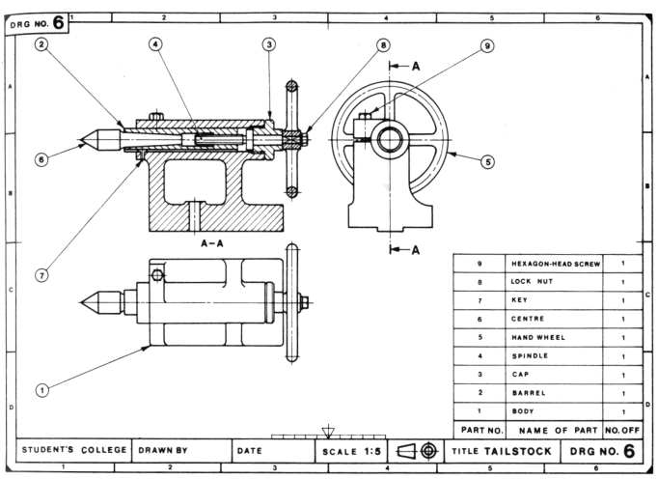
Technical drawing

Slide 3
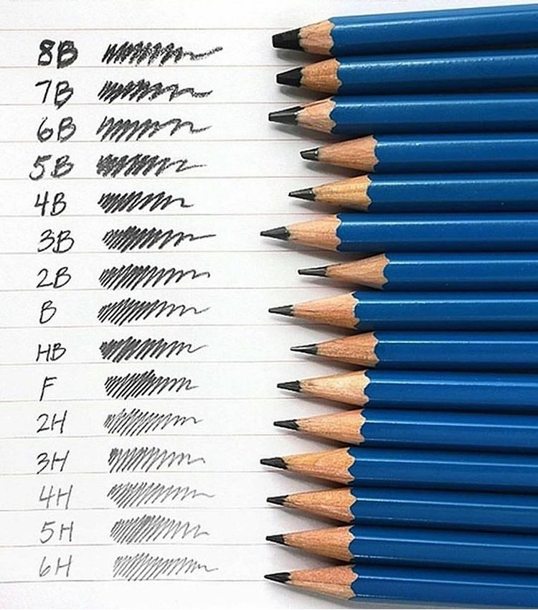
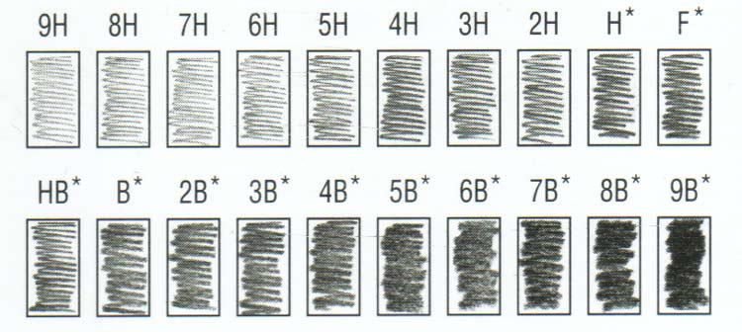
Drawing tools – The pencil
B type - Soft pencils.
H type - Hard pencils.
HB – medium type.
The most common,
for any use.

Slide 4
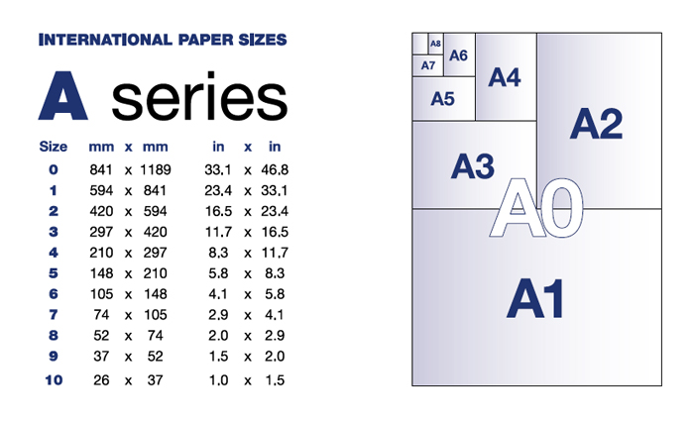
Drawing tools - Papers
The one we usually use is the A4 type.

Slide 5
Exercises
1, 2 page 46.

Slide 6
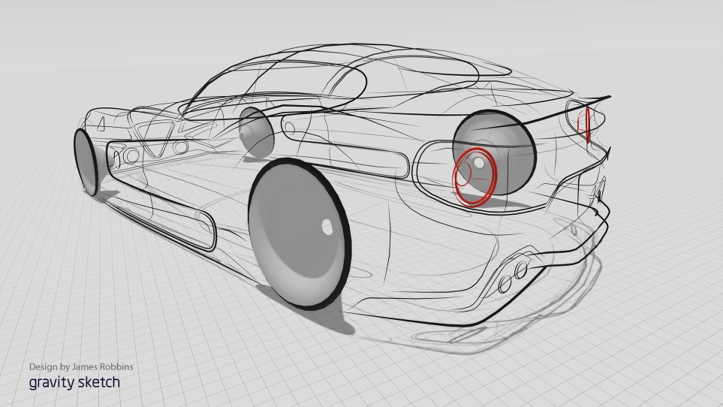
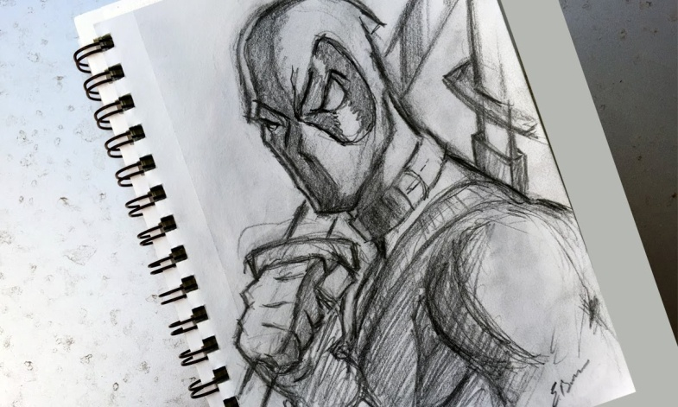
The sketch (boceto)
A rough or unfinished drawing or painting, often made to assist in making a more finished picture.

Slide 7
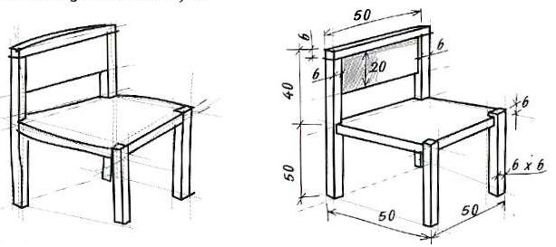
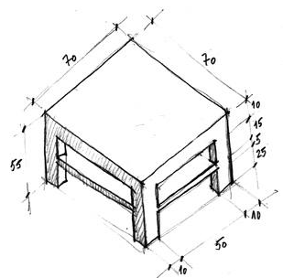
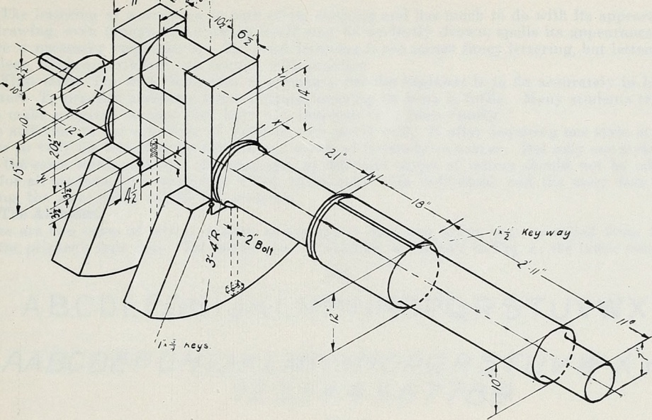
Sketch Dimensions (croquis)
Sketch with sizes. We have to represent the sizes of our previous sketch.

Slide 8
Exercises
3 page 46.

Slide 9
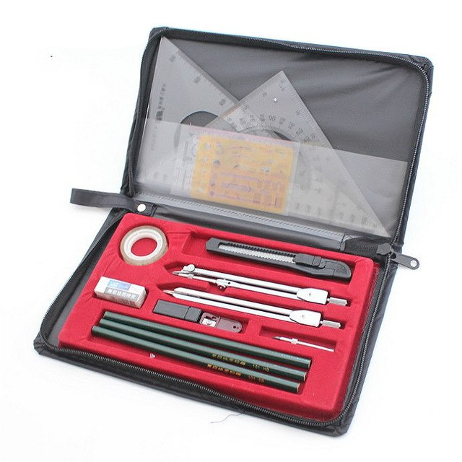
Drawing tools

Slide 10
Drawing tools
A line that has one defined endpoint is called a ray and extends endlessly in one direction. A ray is named after the endpoint and another point on the ray.
Ruler

Slide 11
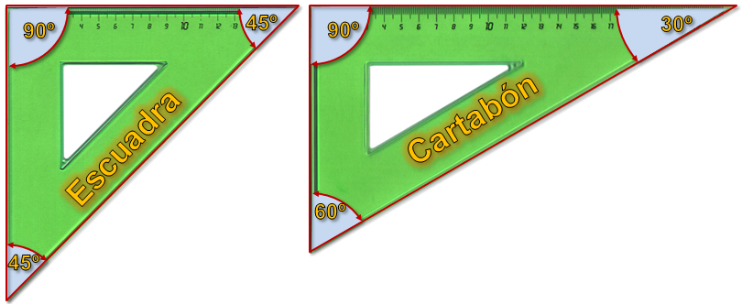
Drawing tools
Square Bevel

Slide 12
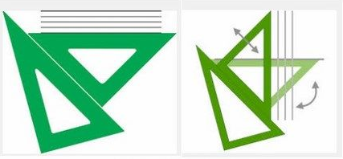
Drawing tools
Parallel lines: lines in a plane which do not meet; that is, two lines in a plane that do not intersect or touch each other at any point are said to be parallel.
Perpendicular lines: two lines which meet at a right angle (90 degrees).

Slide 13
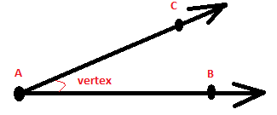
Drawing tools
The angle that is formed between two rays with the same endpoint is measured in degrees. The point is called the vertex.

Slide 14
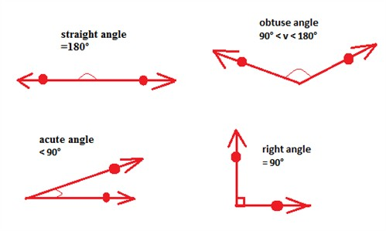
Drawing tools
Angles can be either straight, right, acute or obtuse.
An angle is a fraction of a circle where the whole circle is 360°. A straight angle is the same as half the circle and is 180° whereas a right angle is a quarter of a circle and is 90°.

Slide 15
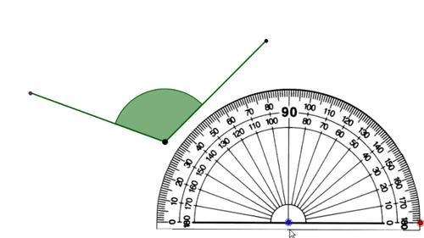
Drawing tools
You measure the size of an angle with a
protractor.

Slide 16
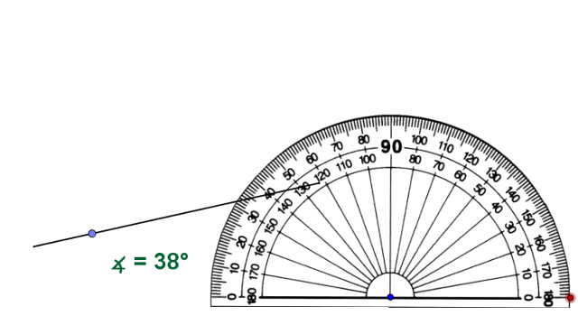
Drawing tools
You measure the size of an angle with a
protractor.

Slide 17
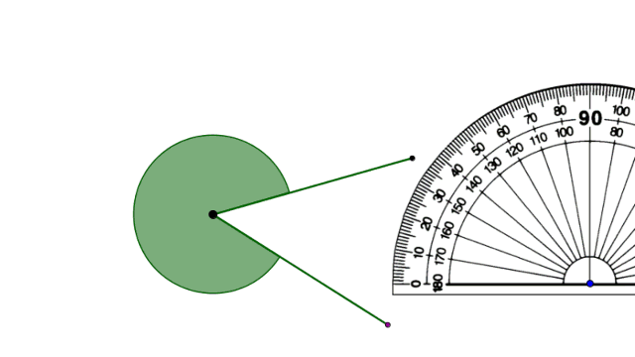
Drawing tools
You measure the size of an angle with a
protractor.

Slide 18
Drawing tools

Slide 19
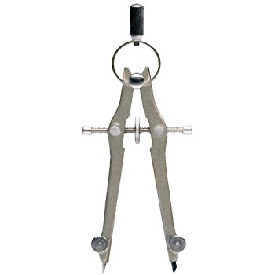
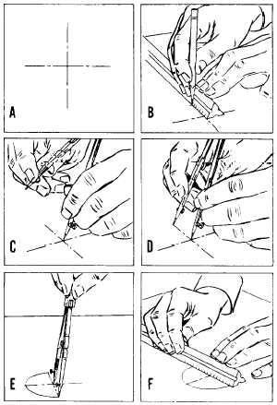
Drawing tools
Bow or math compass.

Slide 20
Exercises
4, 5, 6, 7, 8, 9 page 46.

Slide 21
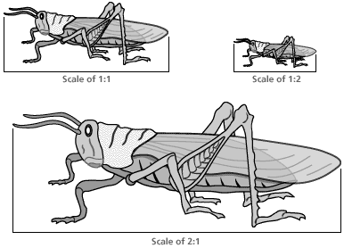
Spatial scale
The scale ratio of a model represents the proportional ratio of a linear dimension of the model to the same feature of the original.
The scale can be expressed as a ratio (1:10), as a fraction (1/10) and as a graphical (bar) scale.
1:1 Means the real size of the object.
1:2 The object is represented by half of its original size
2:1 The object is represented by the double of its original size.
X:Y -> Original size * X/Y = scaled size

Slide 22
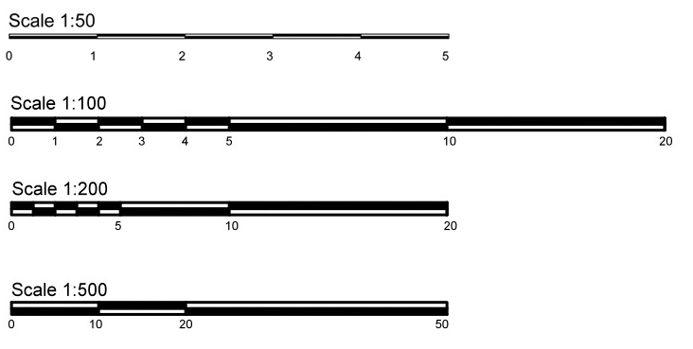
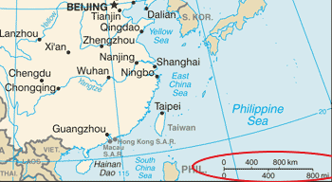
Spatial scale
Scale bars. Used in maps.

Slide 23
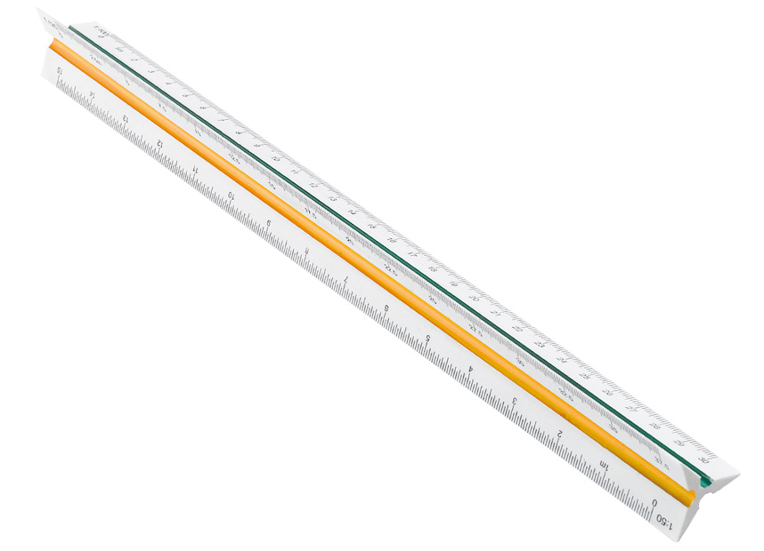
Spatial scale
Engineer scale
How to use: https://www.youtube.com/watch?v=8LfT-8mhdhI

Slide 24
Exercises
14, 15 page 46.

Slide 25
Dimensioning
The purpose of dimensioning is to provide a clear and complete description of an object.
A complete set of dimensions will permit only one interpretation needed to construct the part. Dimensioning should follow these guidelines.
Accuracy: correct values must be given.
Clearness: dimensions must be placed in appropriate positions.
Completeness: nothing must be left out, and nothing duplicated.
Readability: the appropriate line quality must be used for legibility.

Slide 26
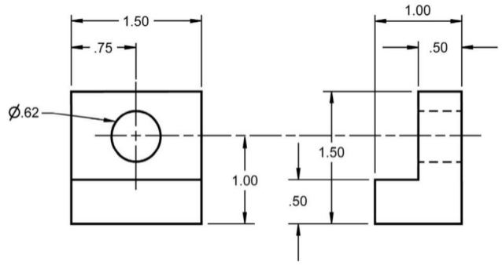
Dimensioning
An example

Slide 27
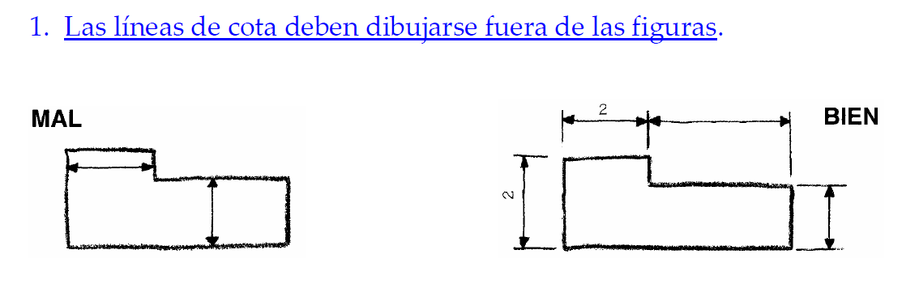
Dimensioning - rules

Slide 28
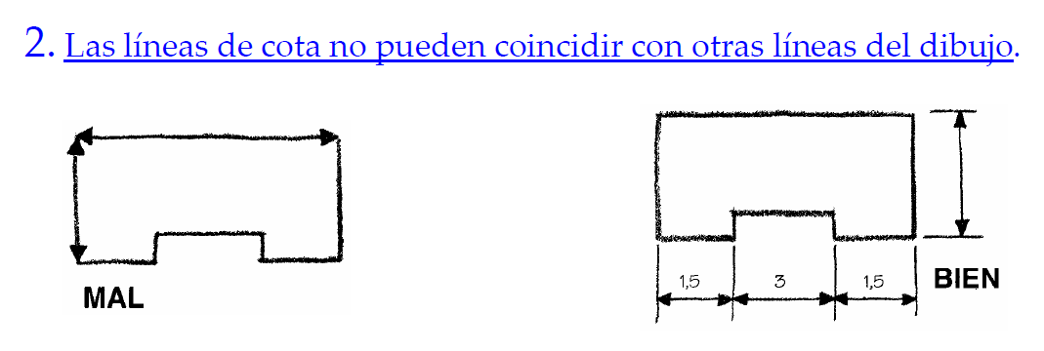
Dimensioning - rules

Slide 29
Dimensioning - rules

Slide 30
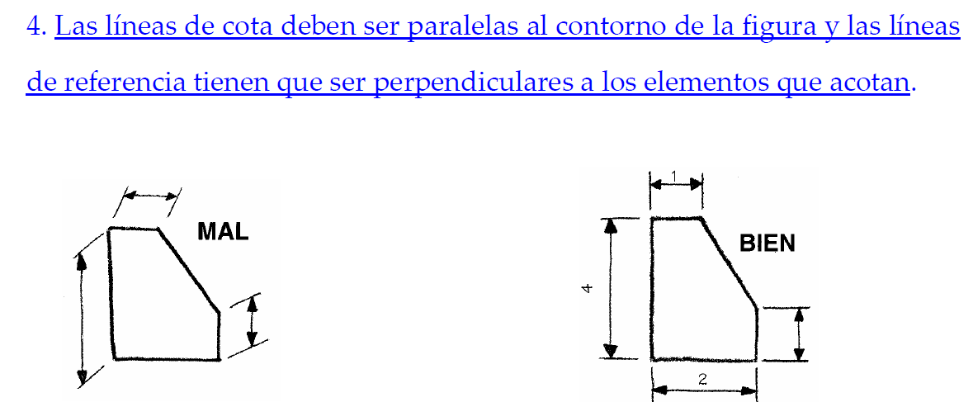
Dimensioning - rules

Slide 31
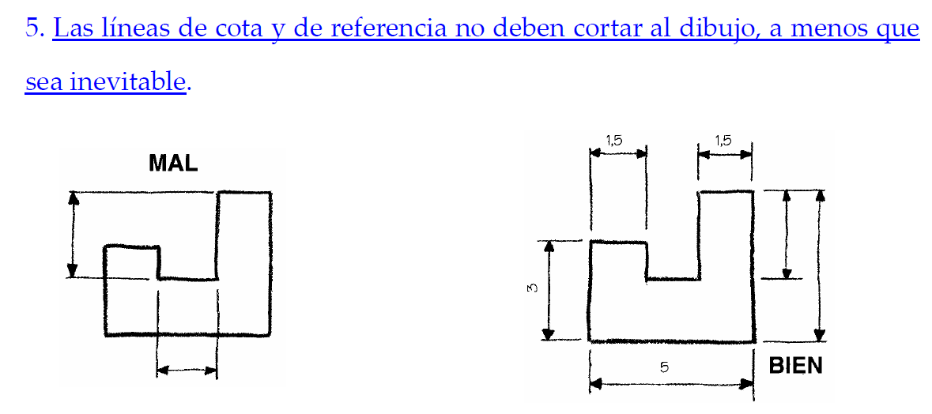
Dimensioning - rules

Slide 32
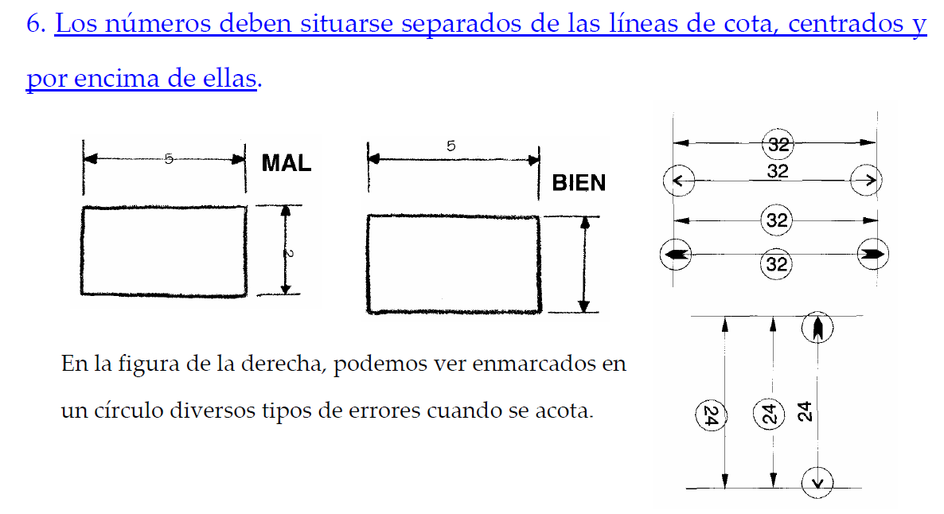
Dimensioning - rules

Slide 33
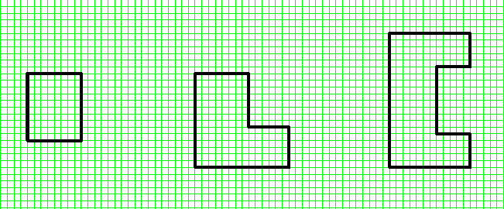
Exercises
Dimensions of the following pictures.
Each square = 2 mm.

Slide 34
Exercises
Dimensions of the following pictures.
Each square = 2 mm.

Slide 35
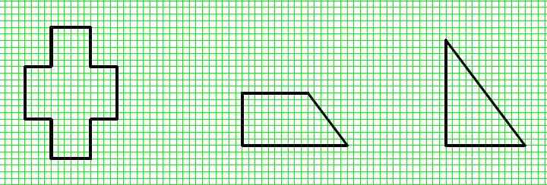
Exercises
Dimensions of the following pictures.
Each square = 2 mm.

Slide 36
Exercises
Dimensions of the following pictures.
Each square = 2 mm.

Slide 37
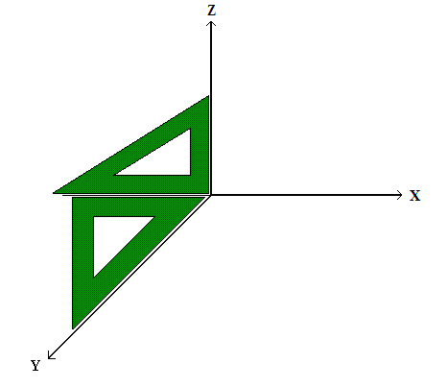
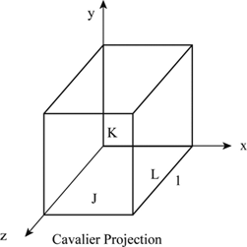
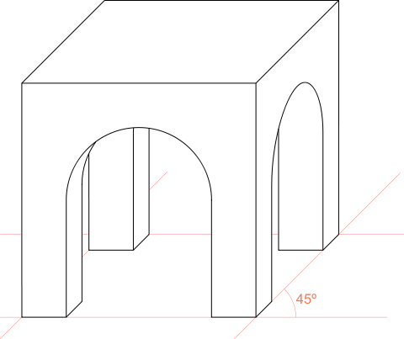
Oblique projection - Cavalier
Oblique projection is a simple type of technical drawing of graphical projection used for producing two-dimensional images of three-dimensional objects. The objects are not in perspective, so they do not correspond to any view of an object that can be obtained in practice, but the technique does yield somewhat convincing and useful images.

Slide 38
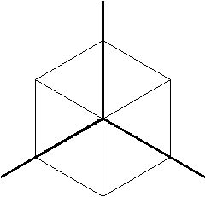
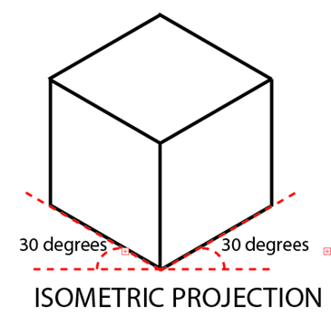
Isometric projection
Isometric projection is a method for visually representing three-dimensional objects in two dimensions in technical and engineering drawings. It is an axonometric projection in which the three coordinate axes appear equally foreshortened and the angle between any two of them is 120 degrees as you can see in the picture.
120 degrees axes.

Slide 39
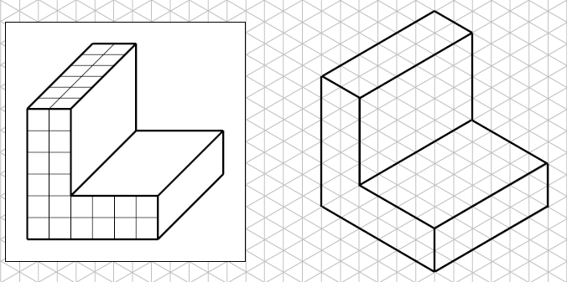
Isometric vs cavalier

Slide 40
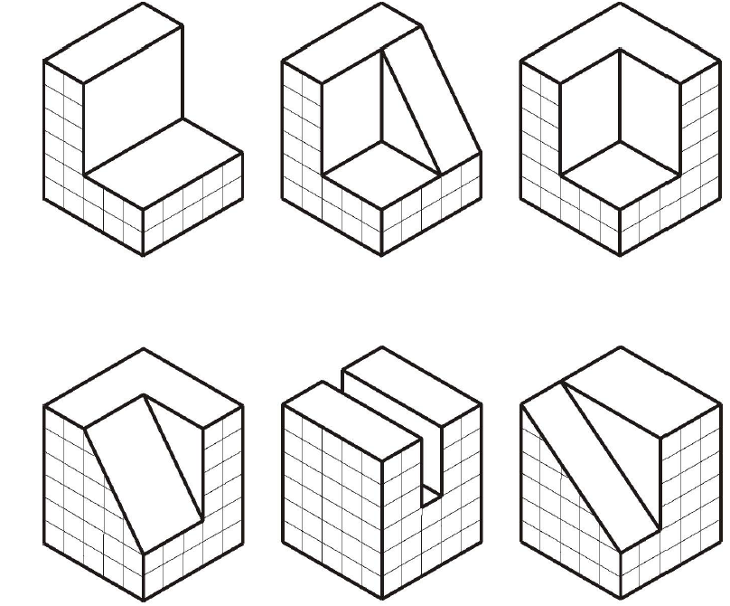
Exercises
Draw the following pictures in a cavalier projection.

Slide 41
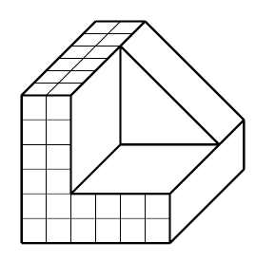
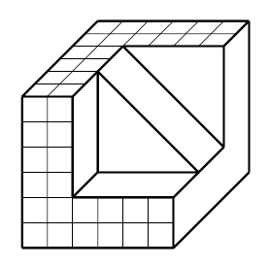
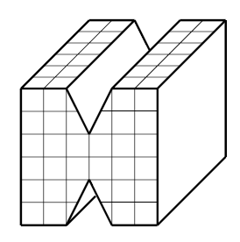
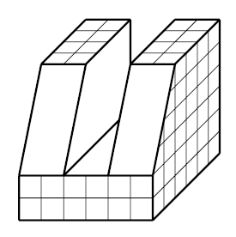
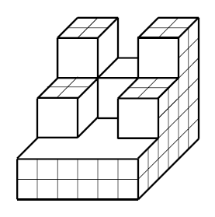
Exercises
Draw the following pictures in an isometric projection.

Slide 42
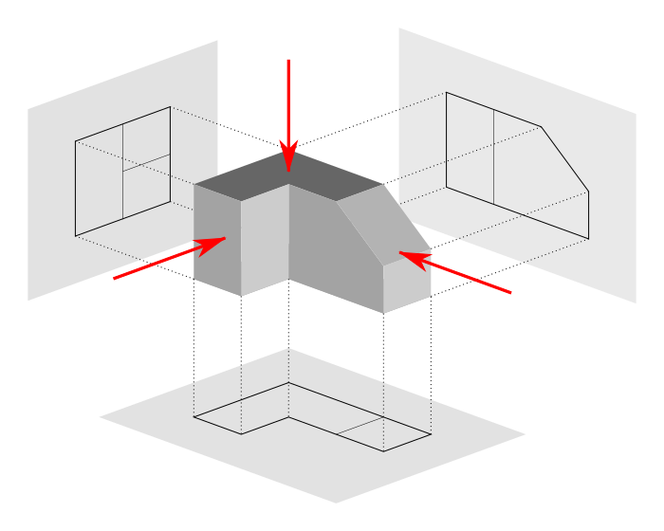
Views of an object
Orthogonal projections.

Slide 43
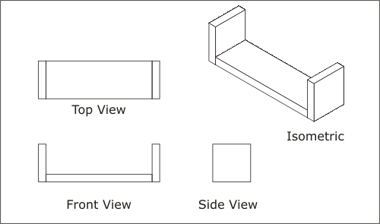
Views of an object
Front view – “Alzado” in spanish.
Top view – “Planta” in spanish.
Side/End view – “Perfil” in spanish.

Slide 44
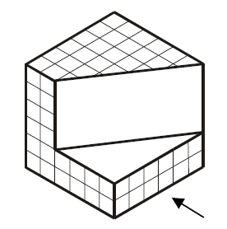
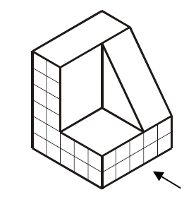
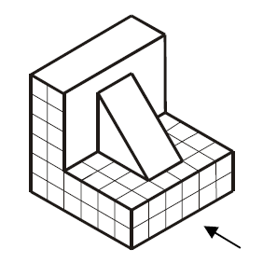
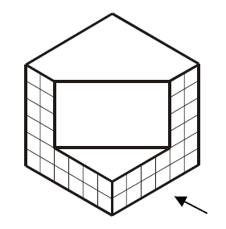
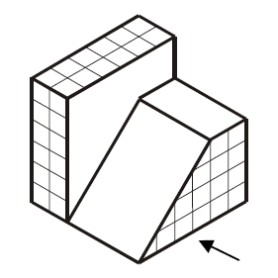
Exercises
Views of the following pictures.

Slide 45
Views of an object + dimensioning

Slide 46
Exercises
17, 19, 21, 22 page 47.

