Slide 1
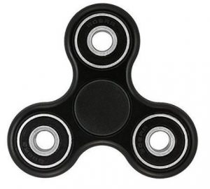
Name:
Lay your spinner down here
You have now 3 minutes to write as many words as you can

