Slide 1
Halloween

Slide 2
In the UK Halloween is celebrated on the 31st of October, on All Hallows Eve (the eve of All Saints day)
Halloween comes from a Celtic festival, called Samhain.
The Celts celebrated the end of summer and the start of winter.

Slide 3
On this night they believed ghosts, witches and demons roamed the earth.
They built bonfires and wore costumes to send evil sprits and ghosts away.

Slide 4
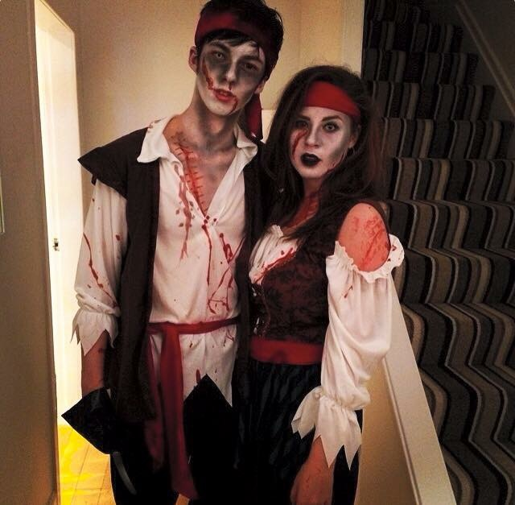
Costumes
In the past people would dress up to confuse evil spirits.
Nowadays people, especially children, dress up for fun.
Costumes can be funny or scary.

Slide 5
Trick or Treat
Trick or Treating is another tradition where children dress up and go from door to door. They knock on the door and shout trick or treat.
This started in the Middle ages when when children and poor adults would beg for money and food in exchange for songs and prayers.

Slide 6
In Scotland we call this guising.
Typically we knock on the door, say trick or treat and tell a joke or sing a song and in exchange we get sweets, fruit and sometimes nuts.

Slide 7
The Celts used pumpkins to frighten evil spirits.
Now, many families carve pumpkins together as a tradition. They cut a a face in it and out a candle inside to make it light up.
These pumpkins are called Jack-o-lantern’s

Slide 8
Apple bobbing
Another Halloween tradition in the UK is a game called apple bobbing.
Fill a bucket with water and put lots of apples in it, then you have to try and take a bite from an apple without using your hands.
In Scotland we call this dooking for apples

