Slide 1
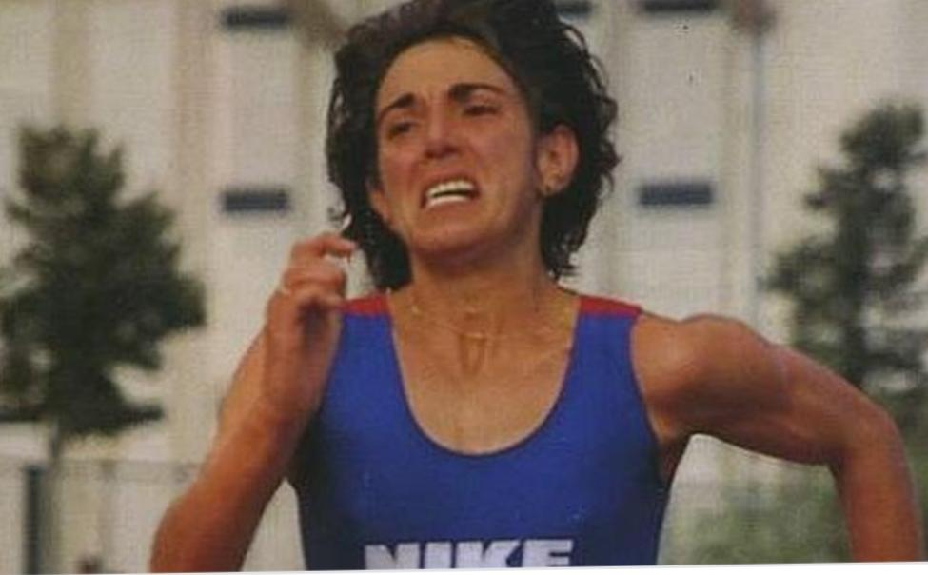
ANA ISABEL ALONSO.
ANA ISABEL ALONSO

Slide 2
BIOGRAPHY

Slide 3
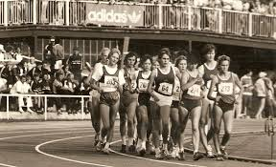
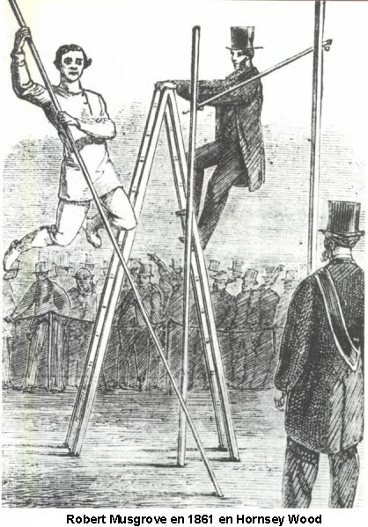
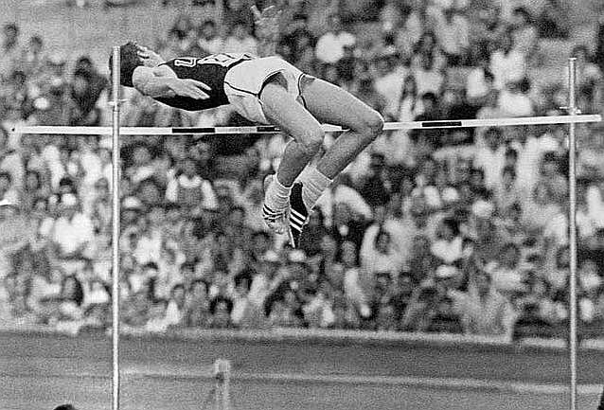
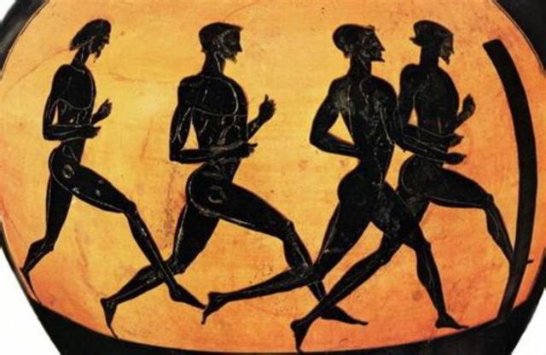
ORIGINS OF THE SPORT

Slide 4
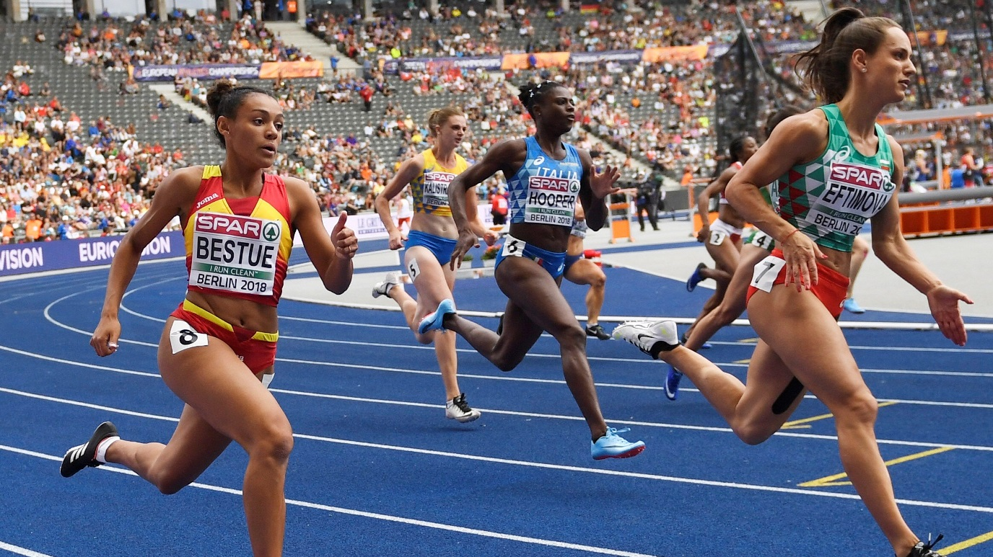
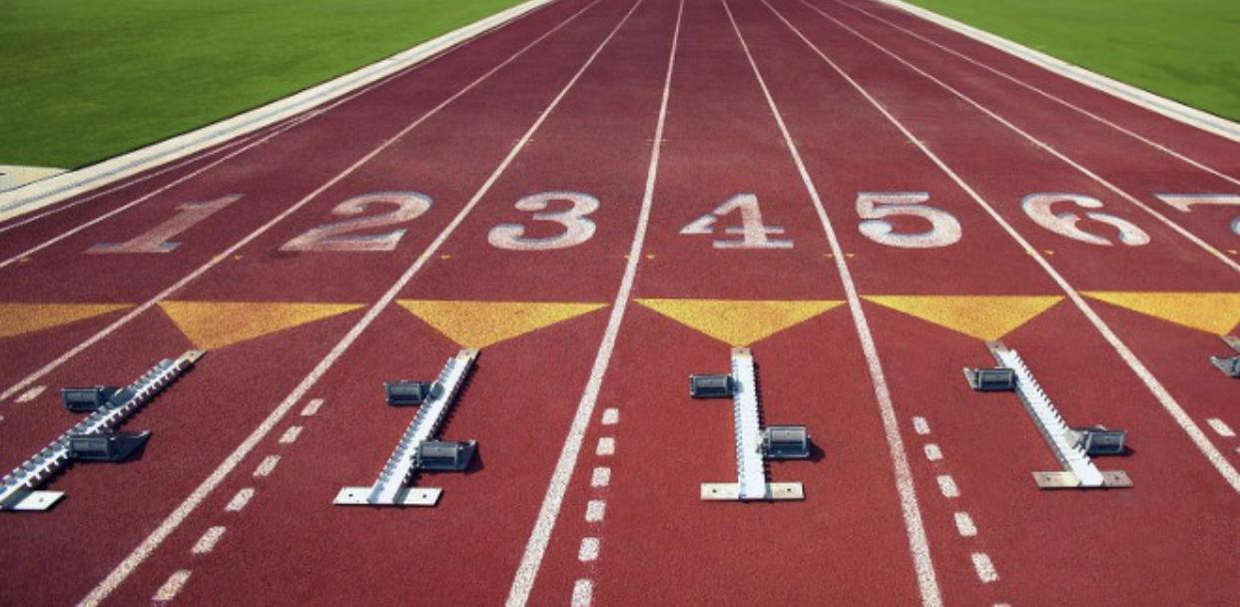
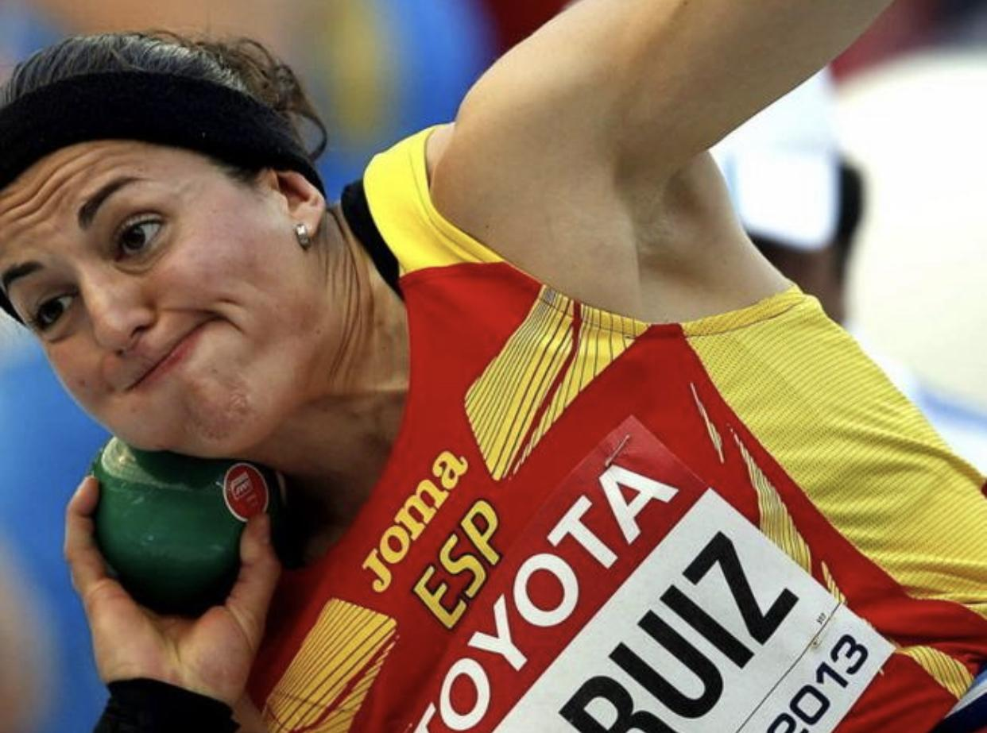
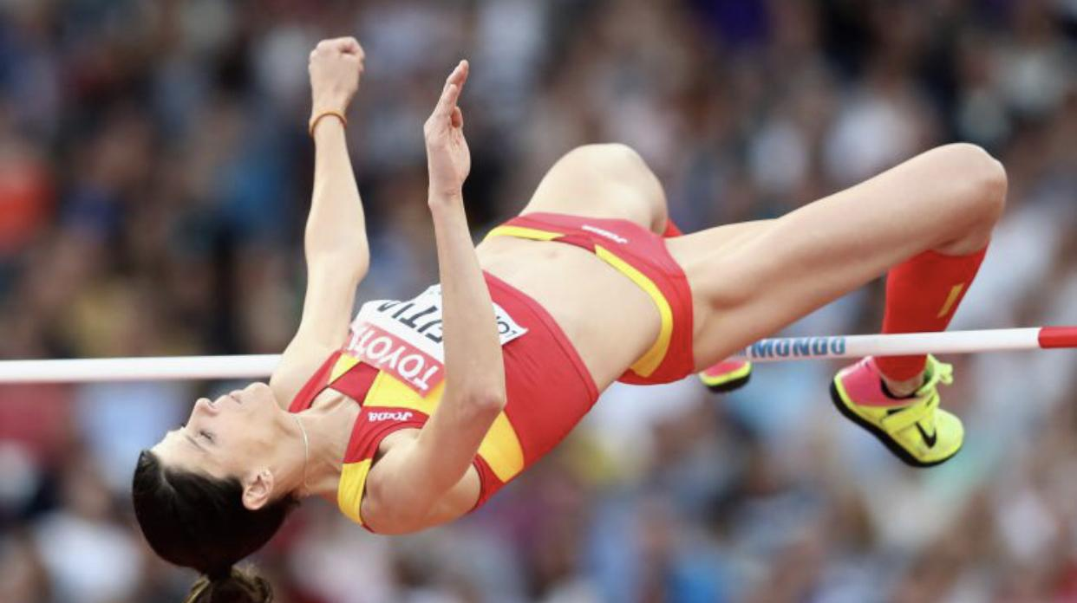
DESCRIPTION OF THE SPORT
-Running
-Jumping
-Throwing
-Walking

Slide 5
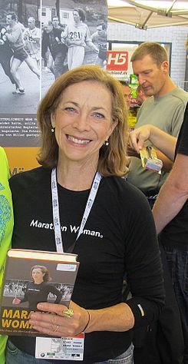
When women started to play it
Kathrine Switzer

Slide 6
CONCLUSION

