Slide 1
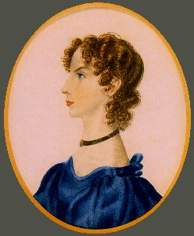
ANNE BRONTË

Slide 2
TABLE OF CONTENTS: - Life - Written works - Historical context in which she lived - Explanation of a work - Anecdote

Slide 3
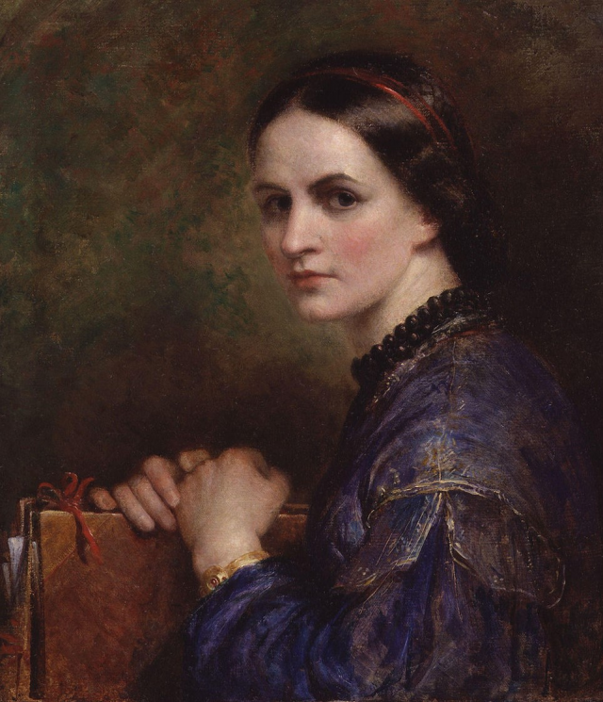
LIFE
Anne Brontë (Thorton, West Yorkshire, January 17, 1820-Scarborough, May 28, 1849) was a British novelist and poet, the youngest of the Brontë family, author of two novels that are now classics of English literature.
Anne Brontë was born into a romantic family, and not only because three great writers came out of her, but because of their lives and their circumstances, brother Branwell included. Reading the novels of the three sisters is to delve into their biographies.

Slide 4
NOVELS
AGNES GREY (1847)
Is based on Brontë's own
experiences in the field. It was
the author's first novel. Similar
to the novel by his sister, Jane
Eyre, this is a novel that points
out the precarious position a
governess faced and how it
affected a young woman.

Slide 5
The Tenant of Wildfell Hall
It is her second novel. It was published for the first time in 1848 under the pseudonym of Acton Bell. The novel is considered one of the first feminist novels.

Slide 6
HISTORICAL CONTEXT IN WHICH SHE LIVED
Anne Brontë lived the Victorian era of the history of the United Kingdom that marked the apex of its Industrial Revolution and the British Empire. Although this expression is commonly used to refer to the extensive reign of Victoria I (June 20, 1837-22 January 1901), some scholars anticipate the beginning of the period, characterized by profound changes in cultural sensitivities and concerns for policies, to the enactment of the Reform Act of 1832. Historically, this stage was preceded by the Regency and continued by the Edwardian period.

Slide 7
Explanation of a work: The Tenant of Wildfell Hall
The novel is divided into three volumes:
First part: Gilbert Markhan tells how a mysterious widow arrives at an old mansion nearby.
Second part: This, taken from the diaries of Helen, describes his marriage. He is also consent, selfish and inmoderate. Both men and women are dregaded.

Slide 8
Third part: She explains that she is not free to marry because he is sick. The two are reconciled and married.

Slide 9
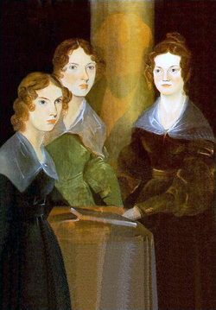
ANECDOTE
One of the most fascinating episodes of literature: three sisters touching their 30’s are secluded at home avoiding rigid Victorian England ties to develop their imagination and experiences in masterpieces such as 'Jane Eyre' and 'Wuthering Heights’. In 'All that fire' (planet), her latest novel, Angels case delves into the universe of Haworth, home of Charlotte, Emily and Anne Brontë.

Slide 10
Conclusion
In short, Anne Brontë is a highly recommended author. Her work entertains and teaches. Anne is delicate, deep and intelligent. Anne Brontë was a great observer of her surroundings and her portrait of the society is as elegant as accurate.

