Slide 1
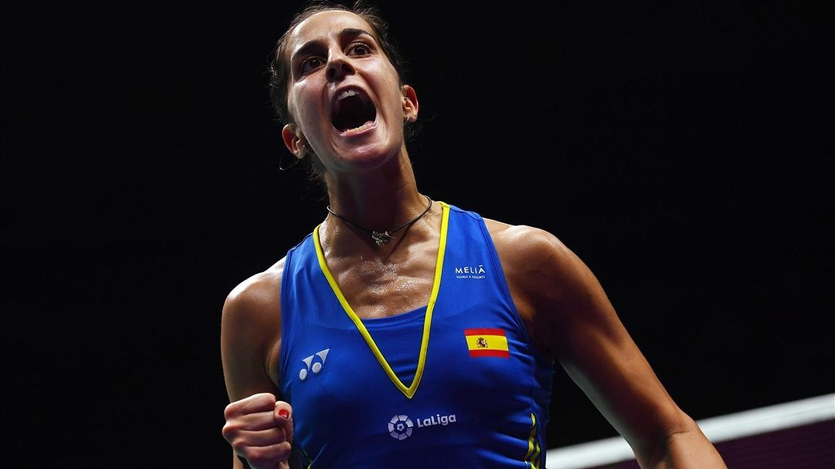
CAROLINA MARÍN
By: Andrea, Rosa, Paula, Nerea and Moha

Slide 2
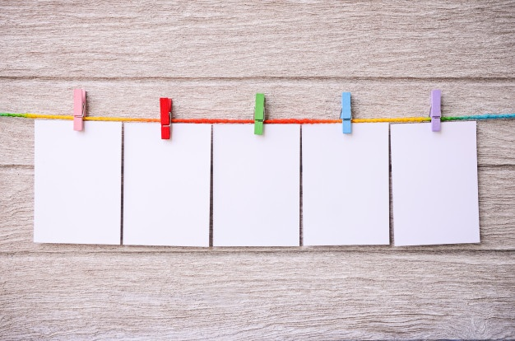
TABLE OF CONTENTS
BRIEF BIOGRAPHY
DESCRIPTIONS OF THE SPORT
WHEN WOMEN STARTED TO PLAY IT AND WHETHER OR NOT THEY HAD
PROBLEMS
ORIGINS OF THE SPORT
OWN CONCLUSION

Slide 3
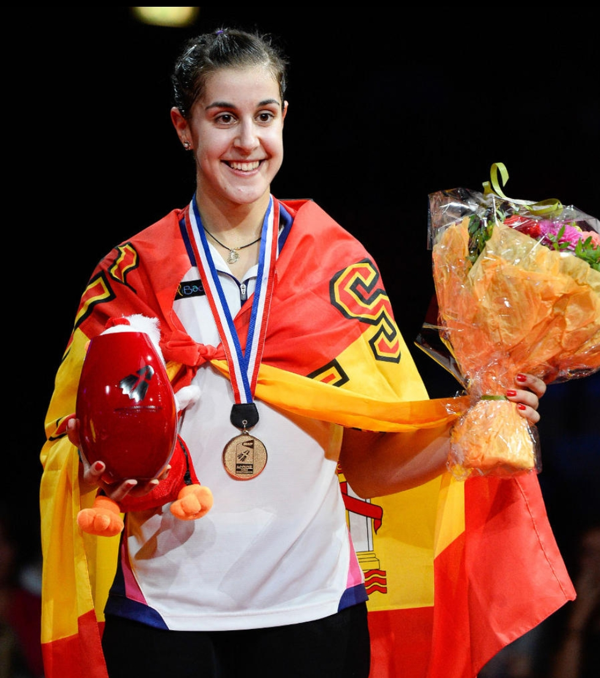
BRIEF BIOGRAPHY
Spanish badminton player.
She is 26 years old.
She became an Olympic champion in Rio de Janeiro.
Huelva’s sports centre was renamed in honour of Carolina.

Slide 4
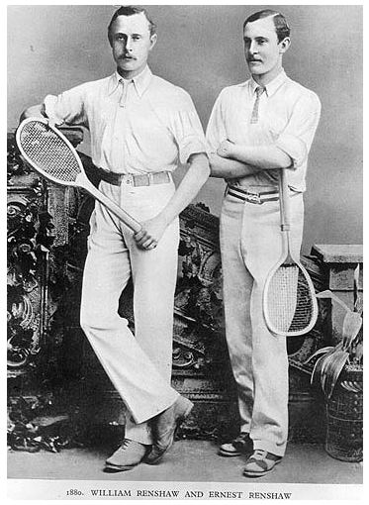
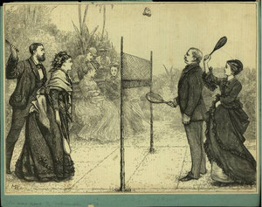
ORIGINS OF THE SPORT
- IT WAS BORN IN INDIA
- FOR THE RICH FAMILIES
- WOMEN PARTICIPATED
- IT BECAME FAMOUS IN ENGLAND

Slide 5
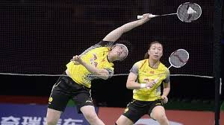
DESCRIPTIONS OF THE SPORT

Slide 6
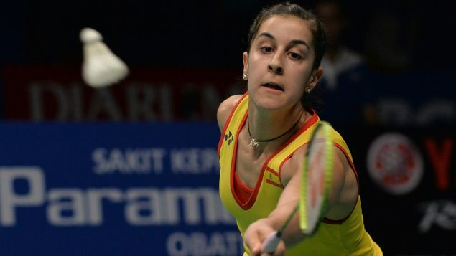
WHEN WOMEN STARTED TO PLAY IT AND WHETHER OR NOT THEY HAD PROBLEMS

Slide 7
OWN CONCLUSION
The conclusion about this relevant sport figure is that you have to play sports, no matter whether or not you are a woman. And the most important thing of all is to do what you like most, even if that is an adventure or risky sport.

