Slide 1
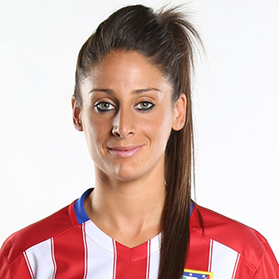
Esther González
Written by:
Beltrán Casas Padial
Andrés López López
Pablo Bonilla Montoro
Iván Giménez Acosta

Slide 2
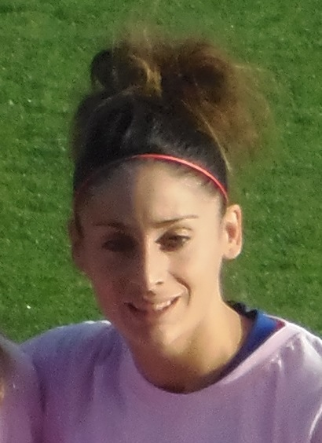
1.Esther González’s biography
Esther González Rodríguez was born on 8th December 1992 in Huéscar, Andalusia, Spain.
She is a Spanish football striker who plays for the Atlético de Madrid in the Spanish Football First Division and the Spanish national team. At club level, she previously played for Levante UD, Atlético Málaga and Sporting Huelva.
Esther made her senior international debut in March 2016, as a substitute in a 0–0 friendly draw with Romania in Mogoșoaia.
She played the 2009 U-17 European Championship, where Spain was the runner-up.

Slide 3
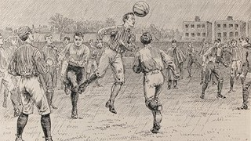
2.ORIGINS OF THE SPORT
It began in 1863, when the paths of "rugby-football" (rugby) and "association football" (football) separated in England, being founded the oldest association in the world: the "Football Association" (Football Association of England), the first governing body of sport.

Slide 4
3.DESCRIPTION OF THE SPORT
Football is a sport where one team plays against the other.
Each team has 11 players. You must score in the goal to win the match. To play this sport you need a ball and 2 goals.

Slide 5
4.When women started to play it and difficulties
González was rewarded with a special mention for being a sports feminine model and an example for other women who wanted to make a way themselves in this area. In the presentation of her prize, a video was projected. It showed her parents and her first trainer in the Huéscar’s football school. They were commenting on the difficulties that she had to overcome in order to practise her favorite sport in a man’s world.

Slide 6
5.Conclusion
As a conclusion, we have seen the difficulties that women had in order to play football and the injustices they had to suffer for being a woman.

