Slide 1
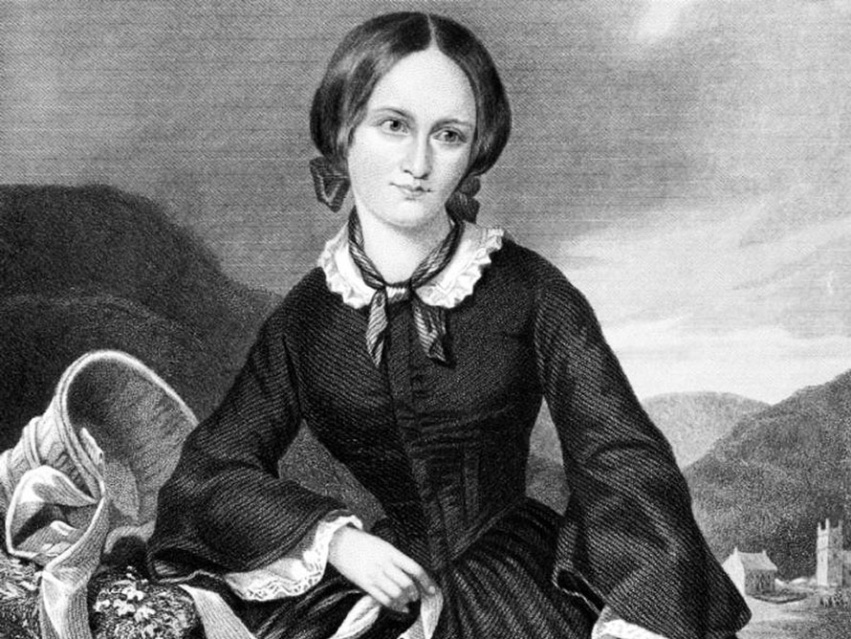
EMILY BRONTË

Slide 2
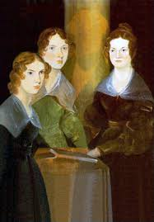

Slide 3
WUTHERING HEIGHTS

Slide 4
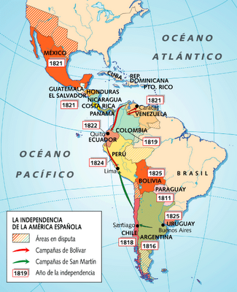
INDEPENDENCE OF HISPANO-AMERICAN COLONIES

Slide 5
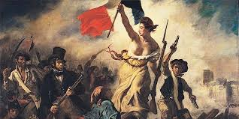
REVOLUTION OF 1830 (FRANCE)

Slide 6
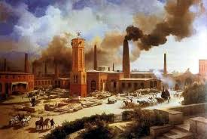
INDUSTRIAL REVOLUTION (USA)

Slide 7
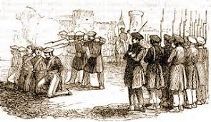
SECOND CARLIST WAR (SPAIN)

Slide 8
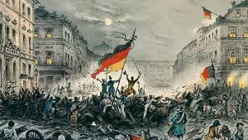
REVOLUTION OF 1848 (FRANCE)

Slide 9
