Slide 1

Setting goals

Slide 2
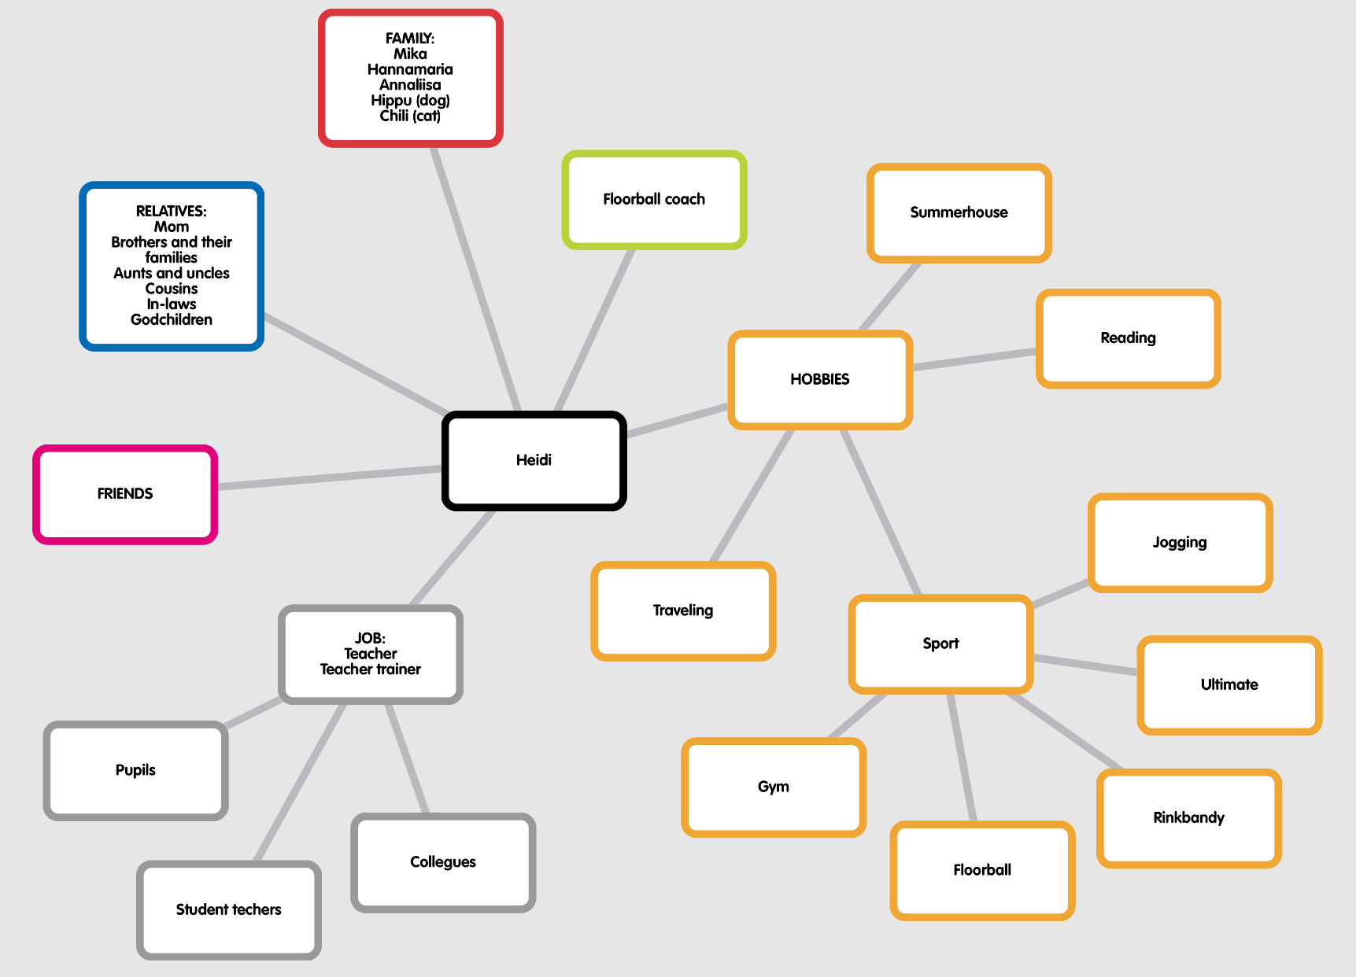

Slide 3
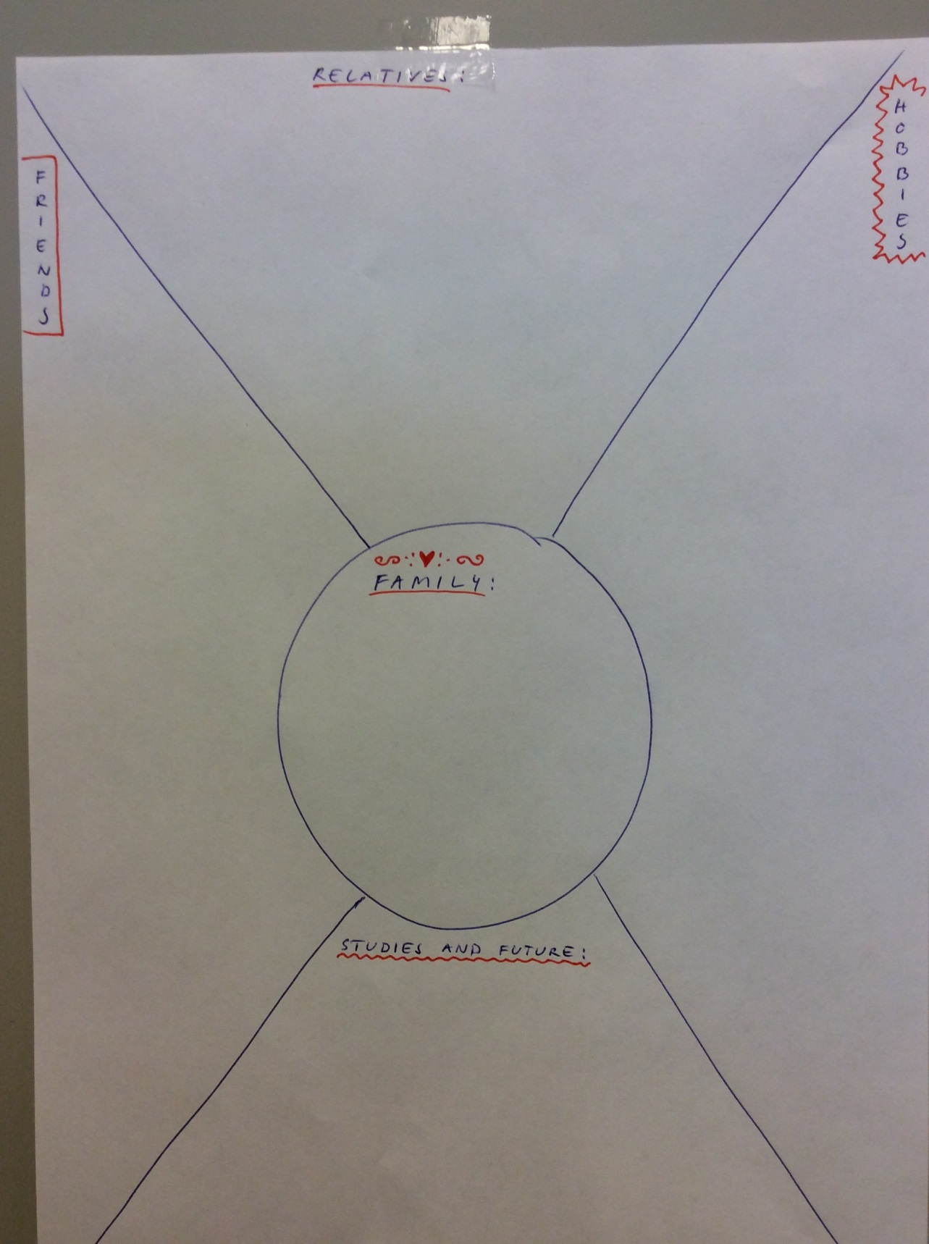
Or You can prefer to do it this way…

Slide 4

The Family
What and who am I in a family?
What is my role in a family?
What are my responsibilities and tasks in a family?
How long do I spend time with my family?
What does my family mean to me?

Slide 5
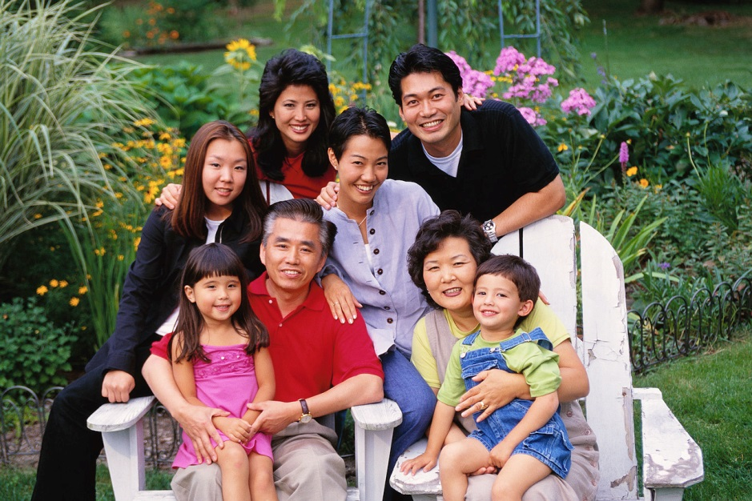
Relatives
Who am I within my relatives?
What is my duty within my relatives?

Slide 6

School/Future job
What is my job?
What would I like to do?
What kind of education is required?
What does it mean now concerning my studies?
What good can I do for my school?

Slide 7

Friends
Who are my friends?
Whose friend am I?
What do my friends mean to me?
How and how much I spend time with my friends?

Slide 8
Hobbies
What are my hobbies?
Why?
What do my hobbies mean to me?
What would I like to have as my hobby?

Slide 9
Some examples of persons that have set goals in their life
Inspite of inllness or injury: Leo-Pekka Tähti
Contradictory the expectations of others: Susan Boyle
Breaking the prejudice concerning sex: Female presidents, prime ministers, bishops, football referee (Krista Heikkinen)
Inspite of lack of education: Tiger Woods, Ben Stiller, Walt Disney, Steve Jobs
Inspite of poverty: Eminem, Pelé
Inspite of young age: Patrik Laine

