Slide 1
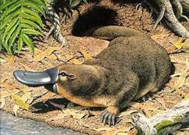
PLATYPUS

Slide 2
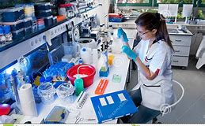
SCIENTIFIC NAME
Ornithorhynchus
Anatinus

Slide 3
HABITAT
Freshwater, lakes,rivers
,lagoons, farm dams, and streams.

Slide 4
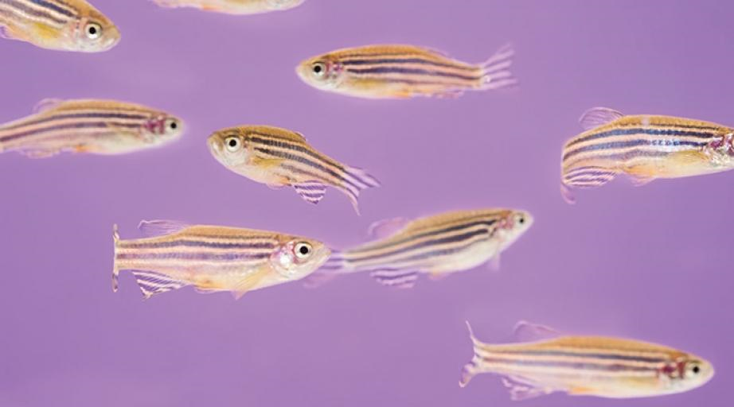
FOOD
Aquatic insects and their larvae, crustaceans and aquatic mollusk earthworms, small fishand even some plants resources

Slide 5
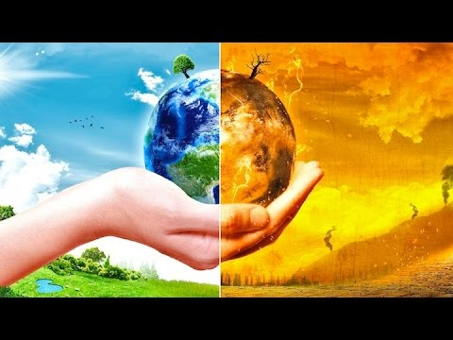
DANGERS
Climate change and humans actions

Slide 6
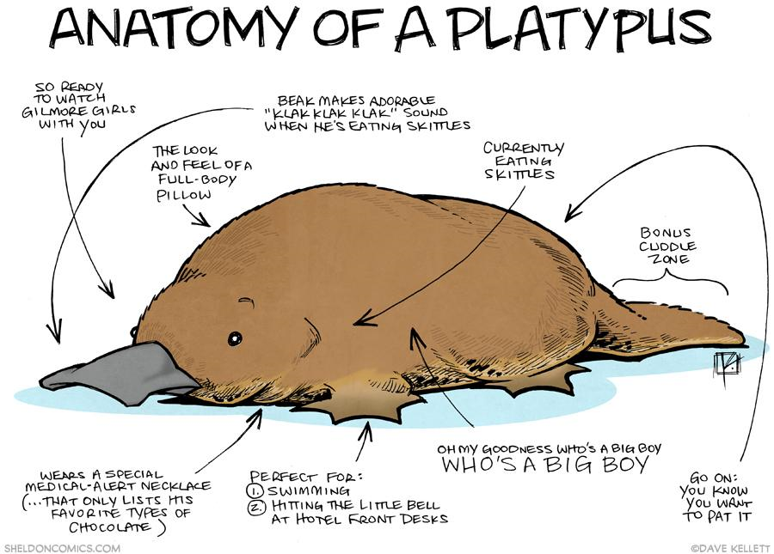
A.)Size: 50 Centemetres
B.) Colour: Brown and blonde
C.) Parts of their body: Peak, small eyes , spurs, tail and paws.

Slide 7
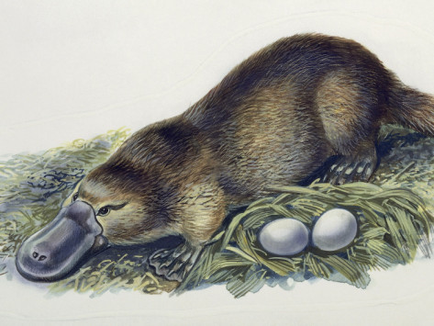
PERSONALITY
It tends to be solitary and only meets with other individuals when the breeding season begins. If the territory of one male encounters that of another, it turns out to be a problem, but since it does not manifest an aggressive behavior prefers to avoid the other by modifying its feeding schedules.

Slide 8
QUANTITY 2018
Unknown

Slide 9
Quantity 2020
Unknown

