Slide 1
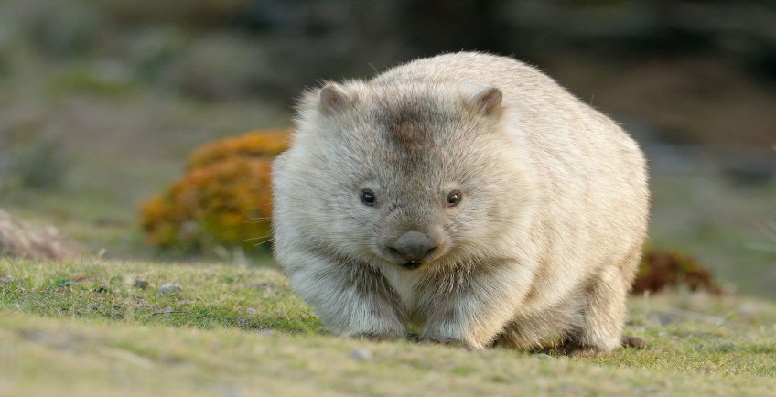
wombat scientific name: vombatidae

Slide 2
group
They are herbivores.
They feed from plants

Slide 3
habitat
They live in the forest of australia.

Slide 4
food
They usually eat grass

Slide 5
dangers
Wombats are dangerous and attack humans

Slide 6
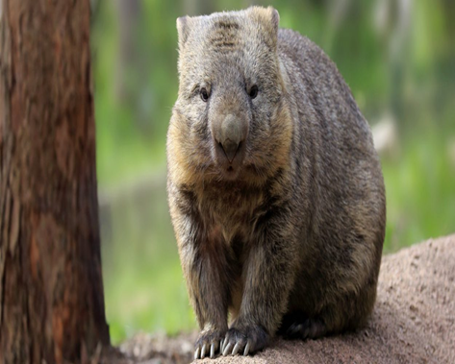
Physical description
SIZE:
length: 100centimetres
weight: 20-35kilograms
COLOR:
they are beige to brown and from black to gray
PARTS OF THE BODY:
it has two small eyes, two small ears, 4 short legs and is hairy

