Slide 1
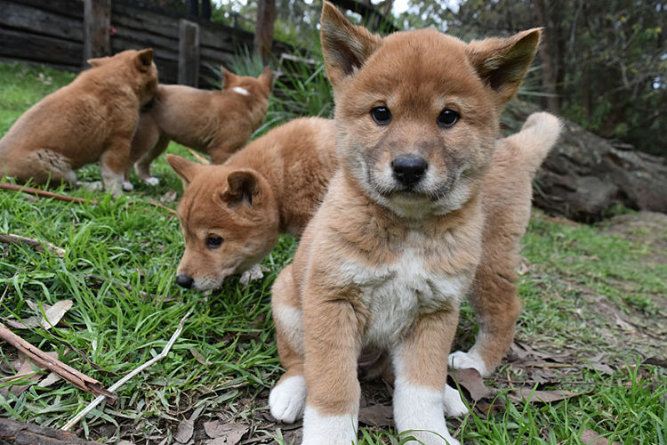
DINGO
The dingo (Canis lupus dingo) is a subspecies of Australasia's own wolf, probably a descendant of the Asian wolf.​.

Slide 2
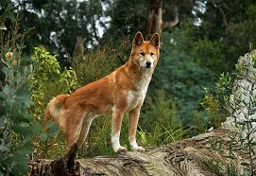
WHO IS THE DINGO ?
Dingo is a subspecies of Australasia's own wolf, probably a descendant of the Asian wolf.Dingo is commonly described as an Australian wild dog, but it is not limited to Australia and is not native to it. Wikipedia

Slide 3
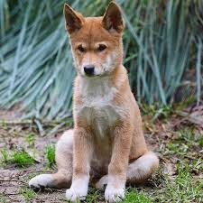
SCIENTIFIC NAME
The scientific name of dingo Canis Lupus Dingo

Slide 4
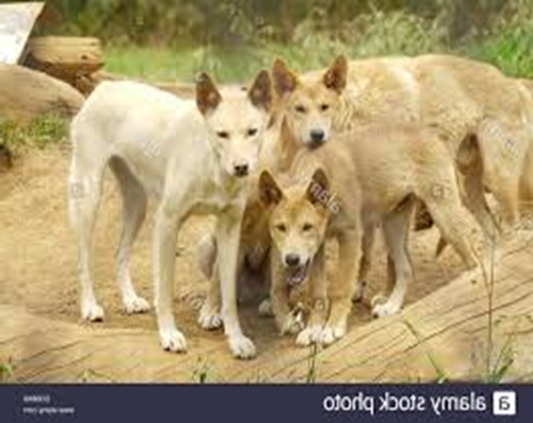
GROUP
The group of dingo is wolf

Slide 5
HABITAT
The dingo habitat is australian

Slide 6
FOOD
Dingoes eat mammals reptile birds and insects

Slide 7
DANGERS
The dangers of dingoes are only humans

Slide 8
Physical description
A)Size:1,2-1,5m
B)Colour:Redhear
C)Parts of their body:tail,ears,eyes,ears,legs.

Slide 9
Personality
The personality of the dingoes is aggressive

