Slide 1
COMPARISON OF TWO CITIES!
Granada & London

Slide 2
Rules & Instructions:
You have to describe and compare the two cities.
You have to talk about the weather in these two different cities.
You should be original.
You will win 1 point if your sentence is okay.
You will win 2 points if you use a long or an irregular adjective.
The group that gets the most points, wins.

Slide 3
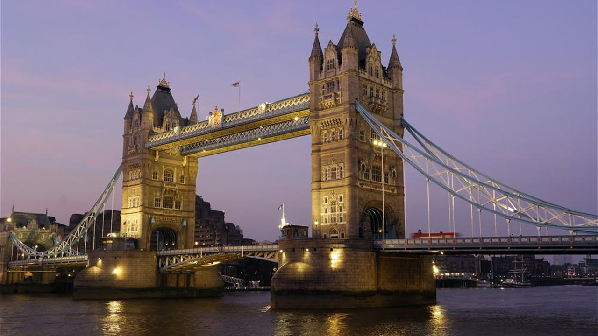
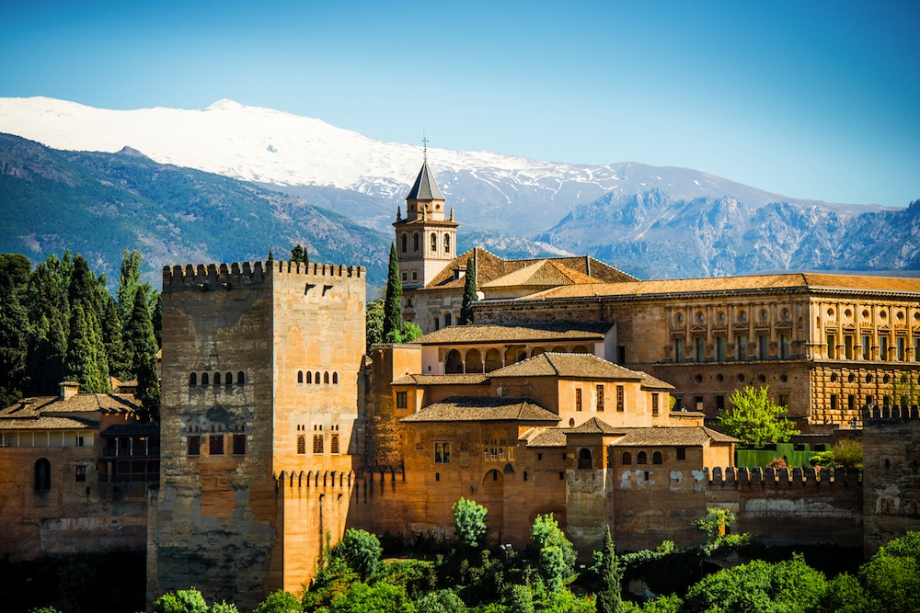
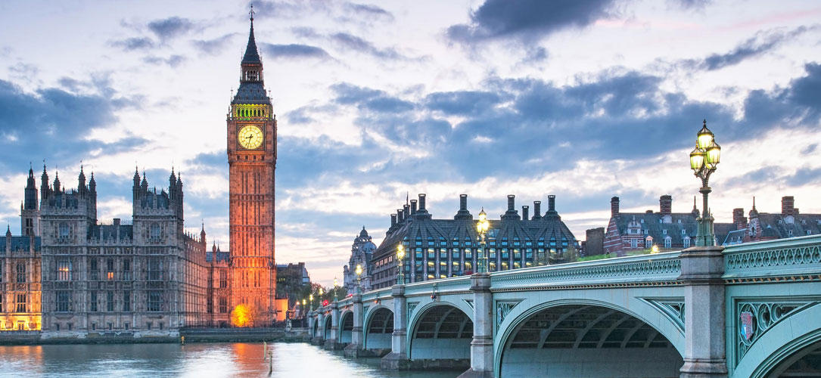

Slide 4
READY? STEADY? GO!

