Slide 1
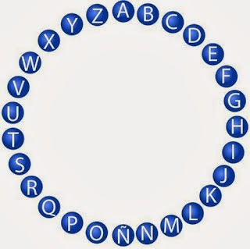
PASS THE WORD!
Vocabulary

Slide 2
A
(Noun)
A vehicle designed for air travel that has wings and one or more engines.

Slide 3
B
(Adjective)
Not interesting or exciting.

Slide 4
c
(Verb)
To hold something or someone with your hands, arms, or on your back and transport it, him, or her from one place to another

Slide 5
D
(Verb)
To make a picture of something or someone with a pencil or pen.

Slide 6
E
(Adjective)
Opposite of cheap.

Slide 7
F
(Noun)
It is used as a basic medical treatment after someone has been hurt in an accident or suddenly become ill.

Slide 8
G
(Noun)
School subject. The study of the systems and processes involved in the world's weather, mountains, seas, lakes, etc. and of the ways in which countries and people organize life within an area.

Slide 9
H
(Verb)
To take and keep something in your hand or arms.

Slide 10
I
(Verb)
Third person singular present of ‘be’.

Slide 11
J
(Verb)
To push yourself suddenly off the ground and into the air using your legs.

Slide 12
K
Word CONTAINING ‘K’.
(Noun)
A large bag used to carry things on your back, used especially by people who go camping or walking.

Slide 13
L
(Adjective)
Big in size or amount.

Slide 14
M
(Verb)
To produce something, often using a particular substance or material.

Slide 15
N
(Adjective)
Opposite of quiet.

Slide 16
O
Word CONTAINING ‘O’.
(Noun)
Flashlight a small light that is held in the hand and usually gets its power from batteries.

Slide 17
P
(Verb)
To do or play something usually in order to become skilled at it.

Slide 18
Q
(Adjective)
Opposite of noisy.

Slide 19
R
(Noun)
A substance used to repel something.

Slide 20
S
(Verb)
Travel on the water.

Slide 21
T
(Noun)
A shelter made of canvas or a similar material and supported by poles and ropes, that you can fold up and carry with you.

Slide 22
U
Word CONTAINING ‘U’.
(Noun)
A substance that you put on your skin to prevent it from being damaged by the sun.

Slide 23
V
Word CONTAINING ‘V’.
(Verb)
To jump into water, especially with your head and arms going in first, or to move down under the water.

Slide 24
W
(Noun)
A clear liquid, without colour or taste, that falls from the sky as rain and is necessary for animal and plant life.

Slide 25
X
Word CONTAINING ‘X’.
(Noun)
A container with stiff sides and sometimes a lid.

Slide 26
Y
Word CONTAINING ‘Y’.
(Verb)
To travel by aircraft, or to go somewhere or cross something in an aircraft.

Slide 27
Z
(Noun)
An area in which animals, especially wild animals, are kept so that people can go and look at them or study them.

