Slide 1
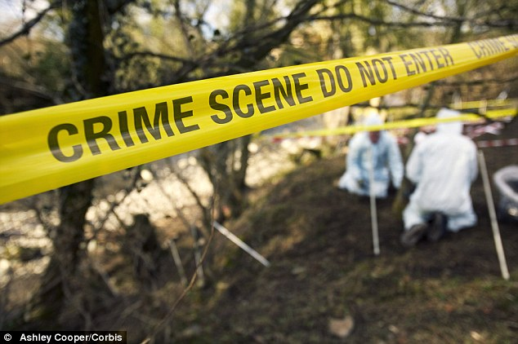
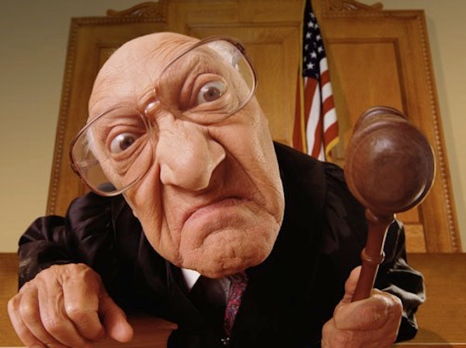
Pass the Word:
Crime & Criminals

Slide 2
A
setting fire to a building.

Slide 3
B
breaking into someone’s house to steal something.

Slide 4
C
someone who has committed a crime.

Slide 5
D
a person who investigates and discovers information or clues about a crime.

Slide 6
e
Signs or indications of a crime

Slide 7
F
Federal Bureau of Investigation. Group of police officers

Slide 8
G
An organized group of criminals.

Slide 9
H
A person who uses computers to commit crimes

Slide 10
I
The action of investigating something or someone.

Slide 11
j
A person who is in charge of a trial and decides if a person is guilty or innocent.

Slide 12
K
to take a person away illegally by force.

Slide 13
L
someone whose job is to give advice to people about the law and represent someone in a trial.

Slide 14
M
someone who kills another person

Slide 15
N
containing “n”: detonating an explosive device with the plan of harming people or property

Slide 16
O
the act of insulting, hurting or offending someone

Slide 17
P
The civil force of a state responsible for the prevention and detection of crime.

Slide 18
Q
An angry disagreement between two or more people.

Slide 19
R
The action of robbing a person or place / stealing something.

Slide 20
S
A person employed by a government to obtain secret information about someone or something.

Slide 21
T
Use of violence, especially murder and bombing

Slide 22
U
Word containing “U”: behaving illegally and dishonestly; especially those in power.

Slide 23
V
the crime of intentionally damaging someone’s property.

Slide 24
W
A person who sees a crime.

Slide 25
X

Slide 26
Y
Words containing “Y”: doing something illegal over the Internet.

Slide 27
Z
Word containing “ Z”: stealing large amounts of money that you are responsible for.

