Slide 1
Economic Globalisation
3 A-B

Slide 2
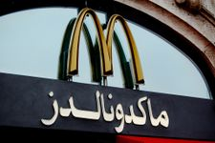
What does globalisation mean?
Here are some examples of economic globalisation:
Globalisation is the way that local or national ways of doing things become global, that is, done together around the world. It is about economics or trade, technology, politics, and culture. People feel differently about globalisation: some think it helps everyone while others think it hurts some people.
Produce from different countries can be shared globally through international trade.

Slide 3
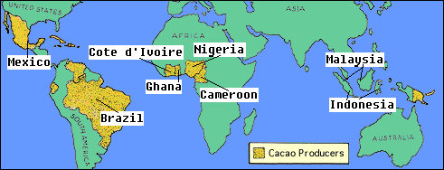
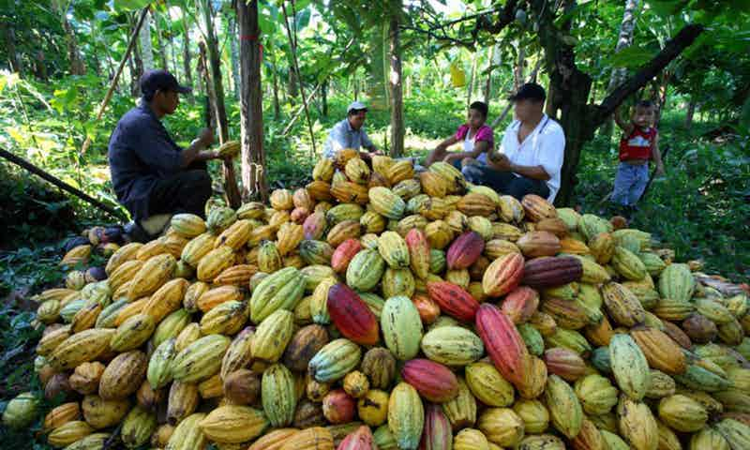
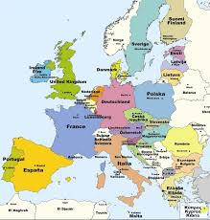
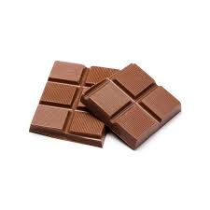
3. Then it is sent through International Trade to developed countries who buy chocolate such as the continent of Europe
CHOCOLATE – Where does it come from?
2. This is cacao as a raw material
1. Cacao is produced in these developing countries
4. Retailers/stores sell the chocolate

Slide 4
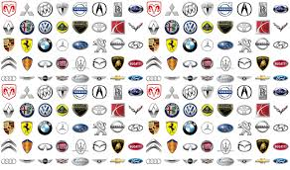
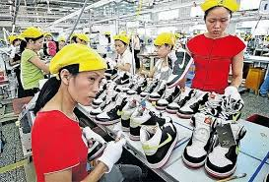
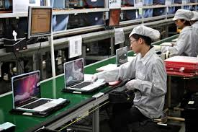
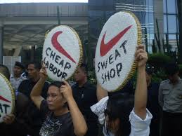
Car brands
Apple
Nike
Fast food companies
Oil companies

Slide 5
Which are the advantages and disadvantages of economic globalisation? Let’s discuss it!

Slide 6
Possible answers

