Slide 1
Languages, Accents and dialects of the UK
4 ESO

Slide 2
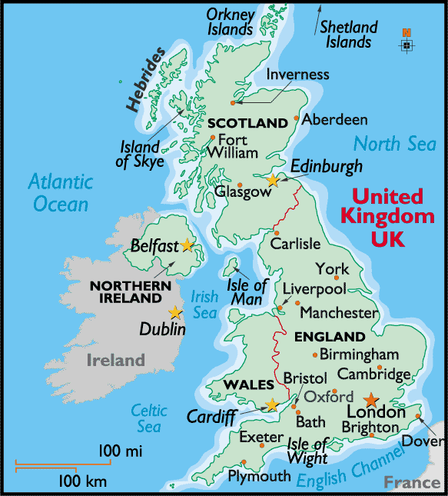
Can you guess how many Official languages are spoken in the uk? What are they?
British English (spoken in the whole of the UK)
Welsh (spoken in Wales)
Gaelic (spoken in some parts of Scotland)
Irish (spoken in some parts of Northern Ireland)
British Sign Language (by those in the deaf community)
This Photo by Unknown Author is licensed under CC BY-NC-ND

Slide 3
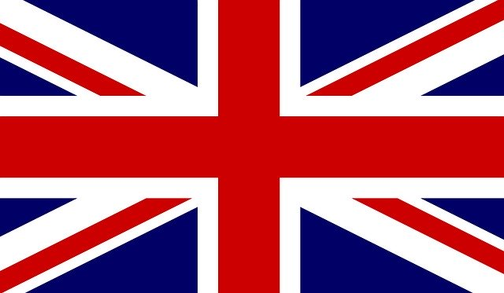
languages – British English
British English is the kind of English language which is used in the United Kingdom, and in most countries which were in the British Empire.
British English is the English you learn in Spain, why is that? What other types of English are there?
Can anyone remember the differences between American English and British English?
Change these words to British English:
Center Labor Organization
Color Meter Gray

Slide 4
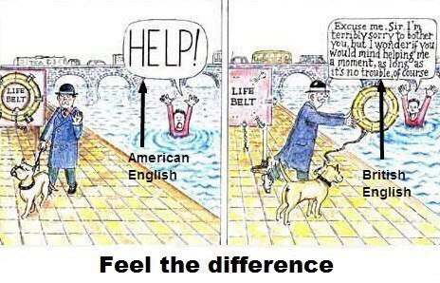
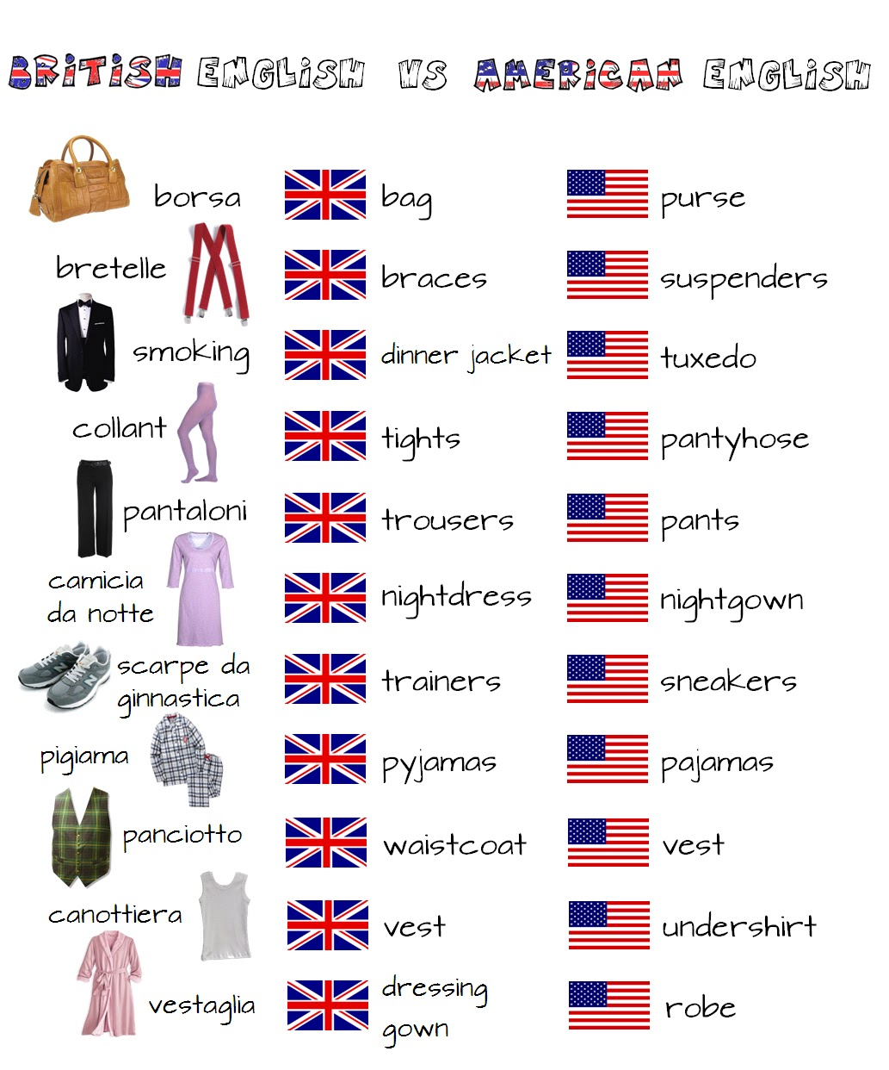
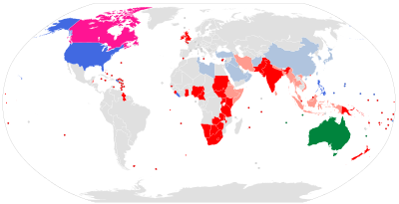
This Photo by Unknown Author is licensed under CC BY-SA-NC
This Photo by Unknown Author is licensed under CC BY-SA
This Photo by Unknown Author is licensed under CC BY-NC

Slide 5
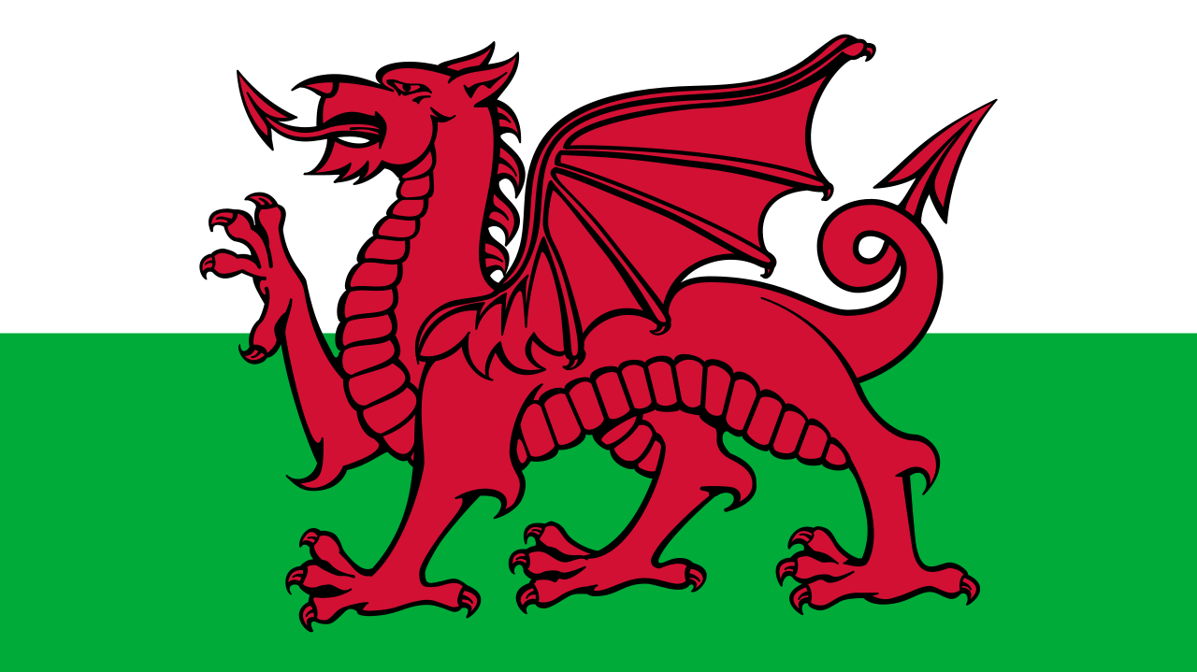
Languages - Welsh
The Welsh language is the Celtic language of Wales that is still spoken throughout the country.
Around 21% of the people of Wales (about 600,000 people).
Many people in Wales say they can understand some form of Welsh, such as spoken, written, or can read Welsh, even if they do not speak it all the time.
Welsh is a compulsory subject for children in all schools in Wales, and it is taught as a second language in non-Welsh language schools.
In Welsh, it is known as Cymraeg, or yr iaith Gymraeg, which means "the Welsh language" in Welsh.
This Photo by Unknown Author is licensed under CC BY-SA

Slide 6
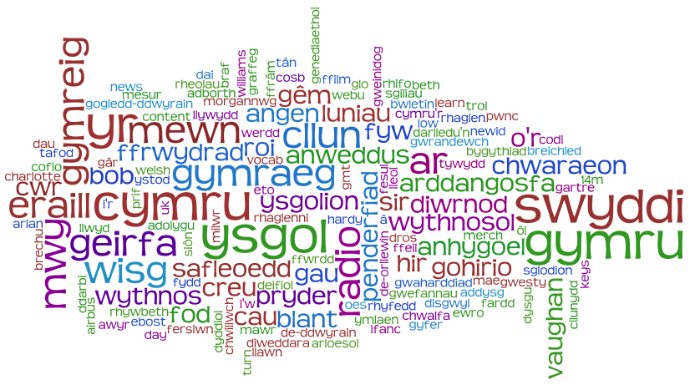
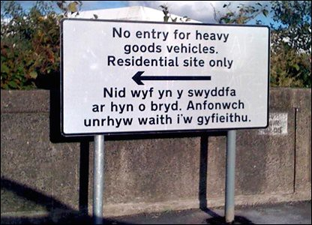
This Photo by Unknown Author is licensed under CC BY-NC-ND
This Photo by Unknown Author is licensed under CC BY-NC-ND
This Photo by Unknown Author is licensed under CC BY-SA

Slide 7
Languages – Gaelic
Gaelic (Gàidhlig) is a Scottish language.
It was spoken by most Scottish people in the past but after the union of England and Scotland, Gaelic was considered a barbaric language and the English language took over ☹.
A census in the United Kingdom in 2001 showed that a total of 58,652 (1.2% of the Scottish population aged over three years old) in Scotland could speak some amount of Gaelic at that time.
Only the Western Isles of Scotland have more people who can speak the language than not (61% of the people here speak Gaelic).
It is not taught in most Scottish schools however there are a few bilingual schools that teach in Gaelic and English.
Gaelic is dying out, but many people are starting to learn the language.

Slide 8
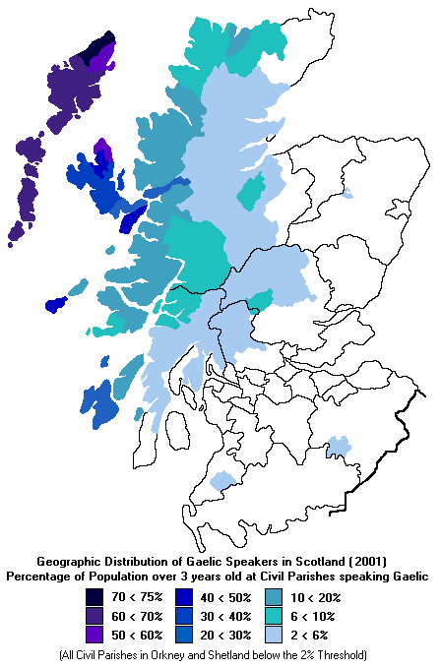
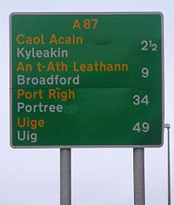
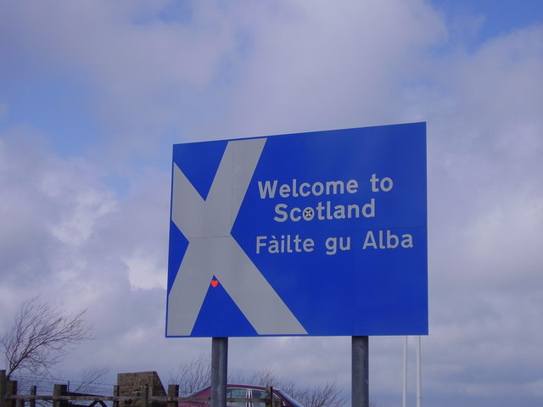
This Photo by Unknown Author is licensed under CC BY-SA
This Photo by Unknown Author is licensed under CC BY-SA
This Photo by Unknown Author is licensed under CC BY-SA

Slide 9
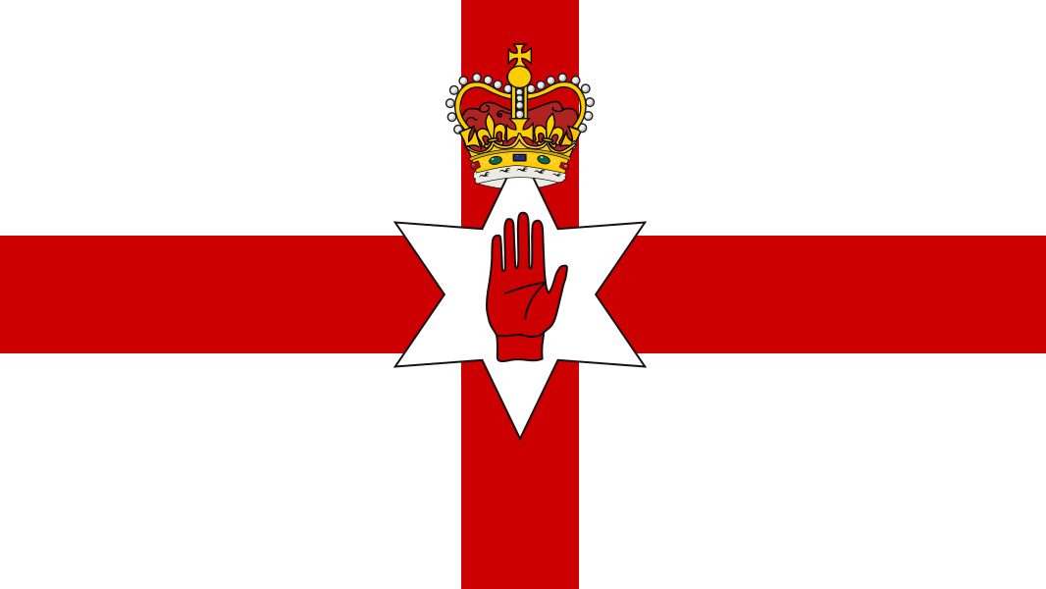
Languages - irish
Irish or Gaeilge is a language spoken in Ireland. Irish is a Celtic language.
Many people who speak Irish can understand some Scottish Gaelic, but not Welsh.
There are around 1.5 million speakers. The places where Irish is spoken a lot are called Gaeltachts or, in Irish, Gaeltachtaí. Around 70% of the people in these areas can speak Irish.
Irish has no yes or no words.
This Photo by Unknown Author is licensed under CC BY-SA

Slide 10
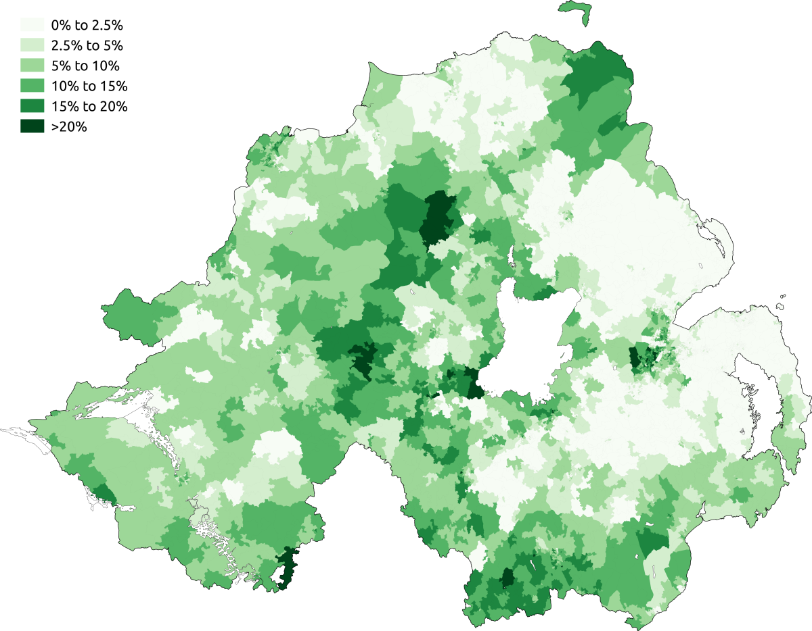
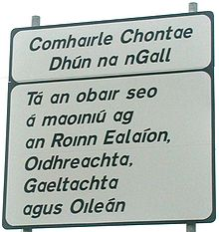
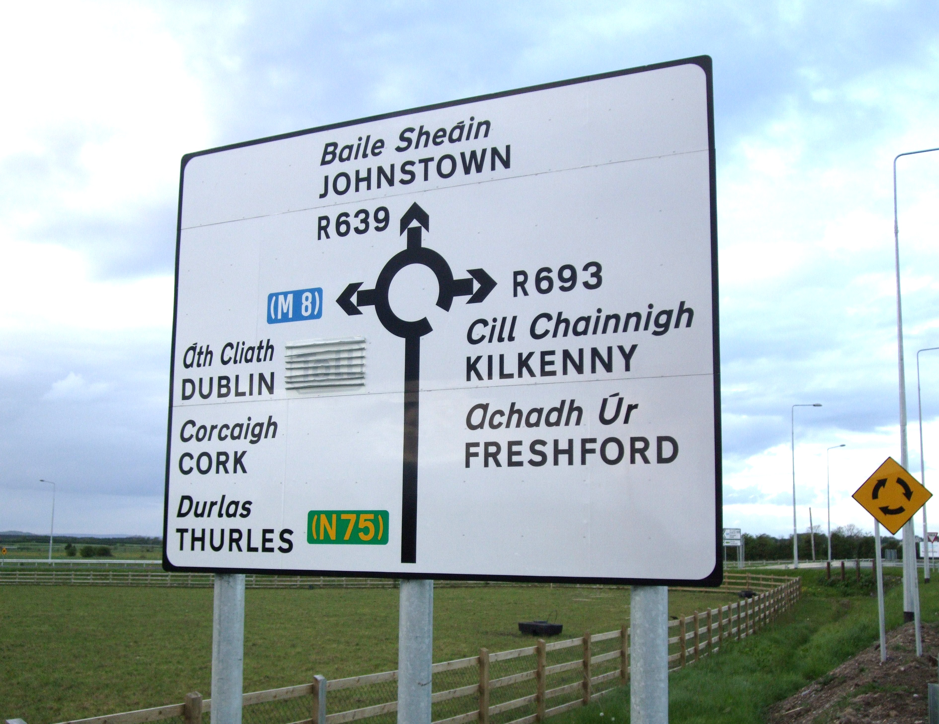
This Photo by Unknown Author is licensed under CC BY-SA
This Photo by Unknown Author is licensed under CC BY-SA
This Photo by Unknown Author is licensed under CC BY-SA

Slide 11
Dialects
What does the word dialect mean? What are they?
Dialects are a particular form of a language which is peculiar to a specific region or social group.

Slide 12
Accents
What does the word accent mean? What is an accent?
An accent is the way a person speaks. Some people pronounce words differently. A lot of the time, different countries that speak the same language pronounce the same words in a different way.

Slide 13
Accents of the UK
There are many different accents in the UK. It depends on where people live, it can even change greatly by city and town.
Accents are characterised by slang words, pronunciation, intonation and social class.

Slide 14
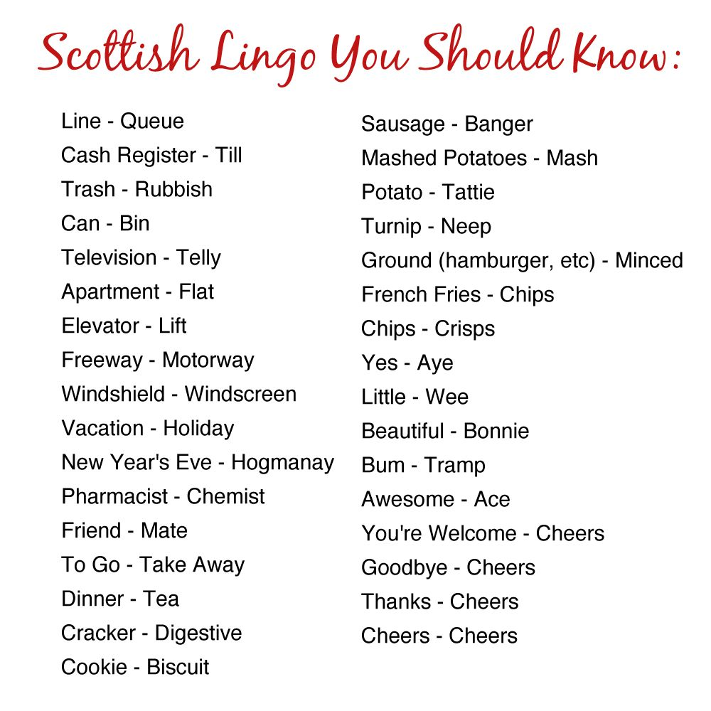
Scottish slang

