Slide 1
ABOUT ME
Juan Antonio Nuñez Escobar
1º B

Slide 2
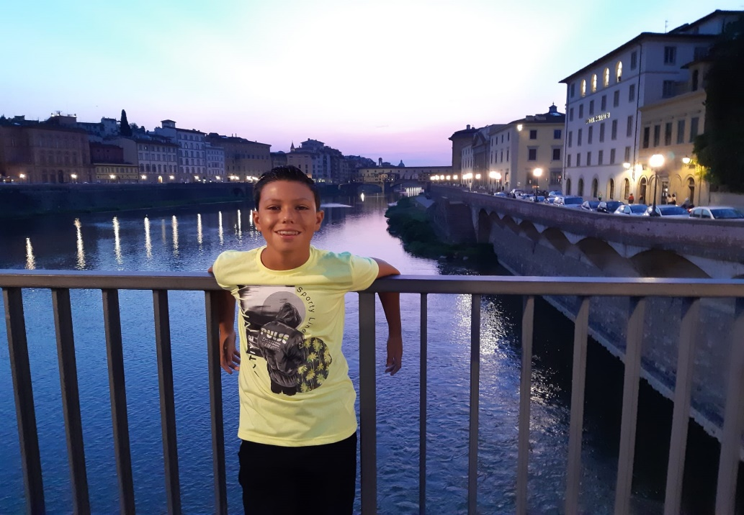
This his me
My name is Juan Antonio

Slide 3
MY BIRTDAY
I am 12 years old and my birthday on
24 th september

Slide 4
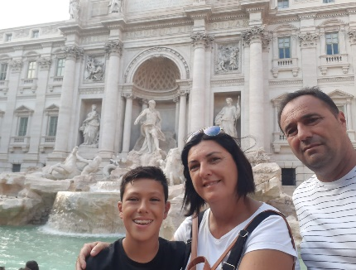
MY FAMILY
My mother ´s name is Angeles and my father ´s name is Juan Antonio.I haven ´t got any brothers or sisters.
I have got an uncle, and his name is Juan Antonio. My aunts names´are Eva, Manoli and Juana.
I have got eight cousins! Their names are Ainhoa,Melanie,Tania,Lupe,Emilio,Susana,Tamara and Lorena.
My cousin Tamara´s daughter name is Amanda she is 1 year old and Susana´s son
name is Aitor. He is 7 years old.
My grandmother Emilia has got a dog and its name is Yaki.My cousin Melanie has got
a dog ist name is Mia.

Slide 5
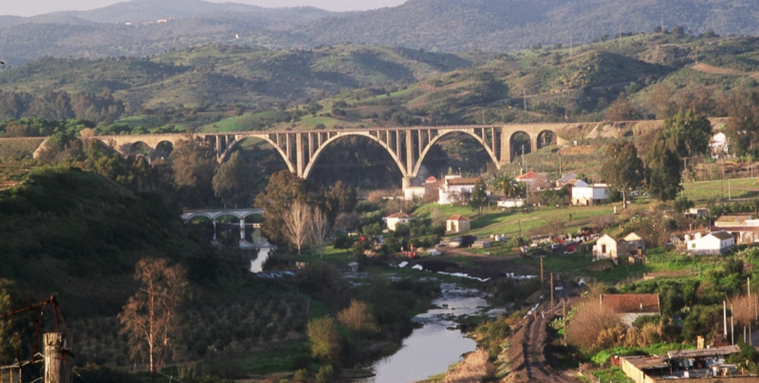
MY HOME
I ´m from spain.I live in Francisco Mallen Bravo street, in Villanueva del Río y Minas

Slide 6
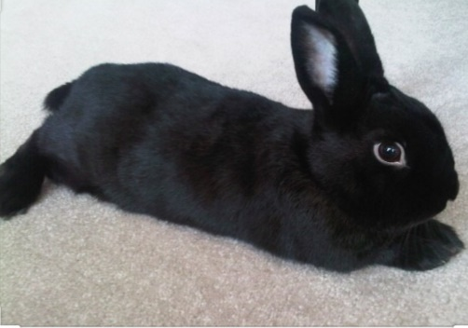
MY FAVOURITE
My favourite animal
My favourite animal is the rabbit. I had a rabbit callet kiki.

Slide 7
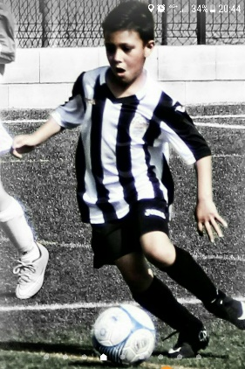
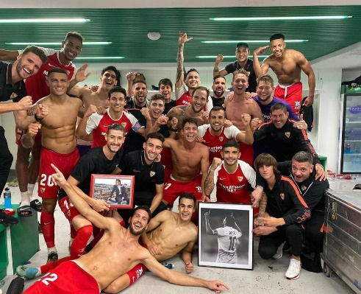
My favourite activities
I love football, I train two days a week and on weekends ,I play matches with my team. My favourite team is Sevilla F.C.

Slide 8
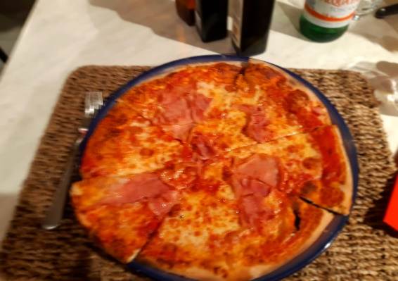
My favourite foods
My favourite foods are pizzas and Burgers . I don´t like vegetables but my parents love them

Slide 9
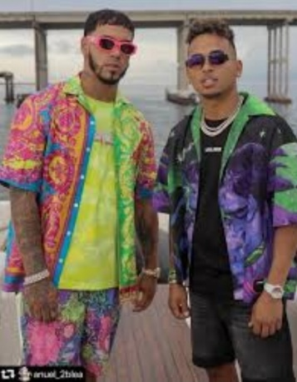
My favourite singers
My favourite singers are Ozuna and Anuel AA,and my favourite song is“China”. I love music . I listen to music whenever I can.

