Slide 1
ABOUT ME

Slide 2
This is me
My name is Raúl
I am 12 years old and my birthay is on 11th March.
I’m from Seville and I live in Villanueva del Río y Minas

Slide 3
My Family
My mother’s name is Mónica and she is 40 years old.
My father’s name is Raúl and he is 42 years old .
I’ve got one sister and her name is Marta, she is 15 years old.

Slide 4
My favorite animal
My favorite animals are dogs because they’re very funny and loving.
I have a dog. It is medium size and it is brown and white.

Slide 5
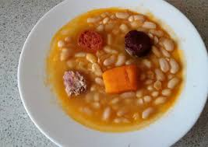
My favorite food
My favorite food is peas because my mother cooks them very well.

Slide 6
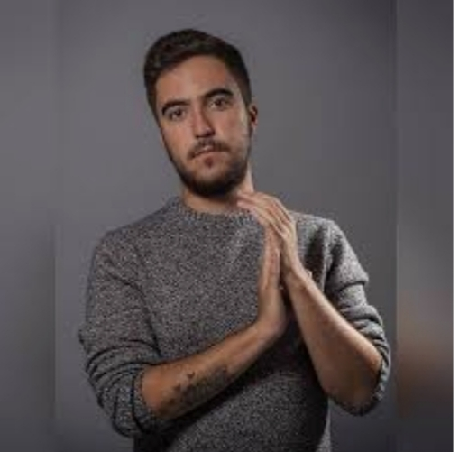
My favorite music
My favorite music is pop and my favorite singer is Beret. His most beautiful song is:
`` Te echo de menos´´

Slide 7
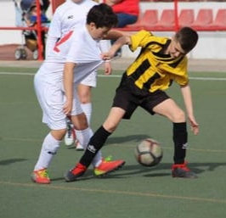
My favorite sport
I love football because I am very active and I like to run.

Slide 8
Made by: Raúl Larinto Ruiz.

