Slide 1
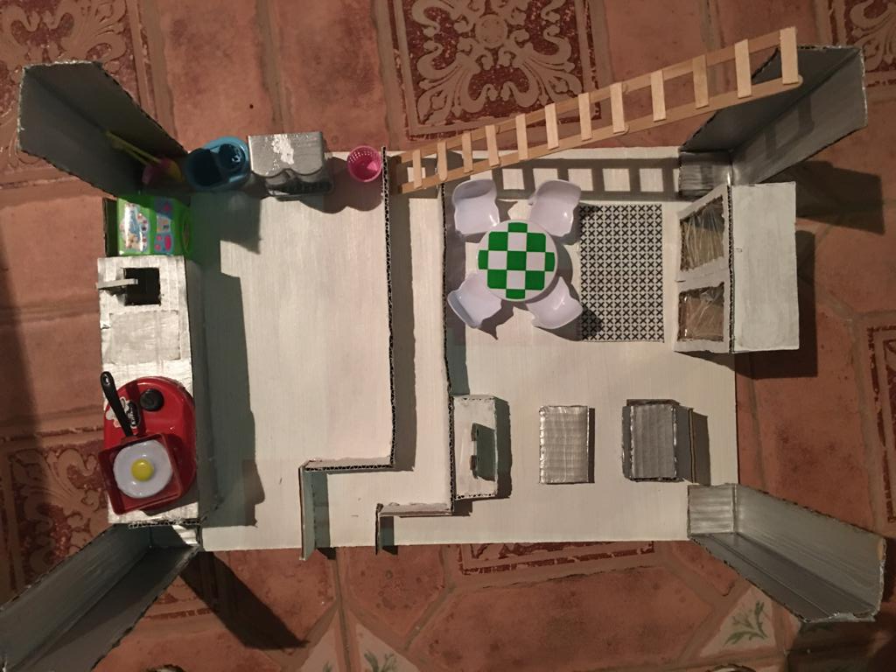
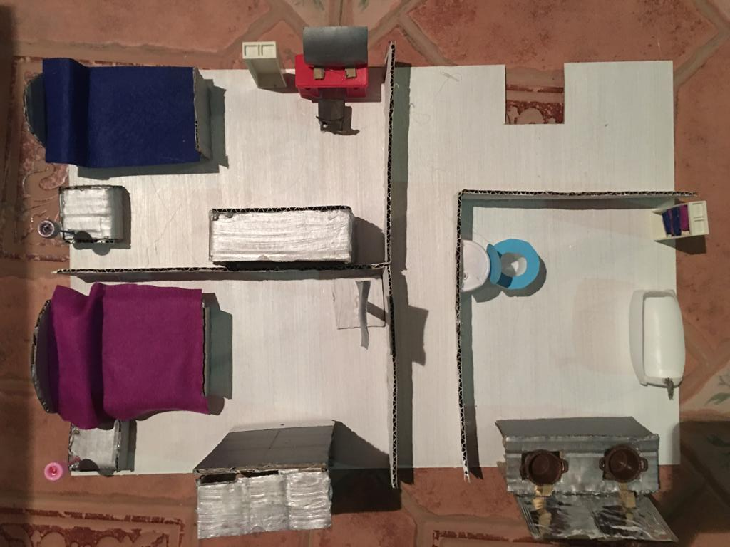
MY HOUSE
JUAN ANTONIO NUÑEZ
RAUL LARINTO

Slide 2
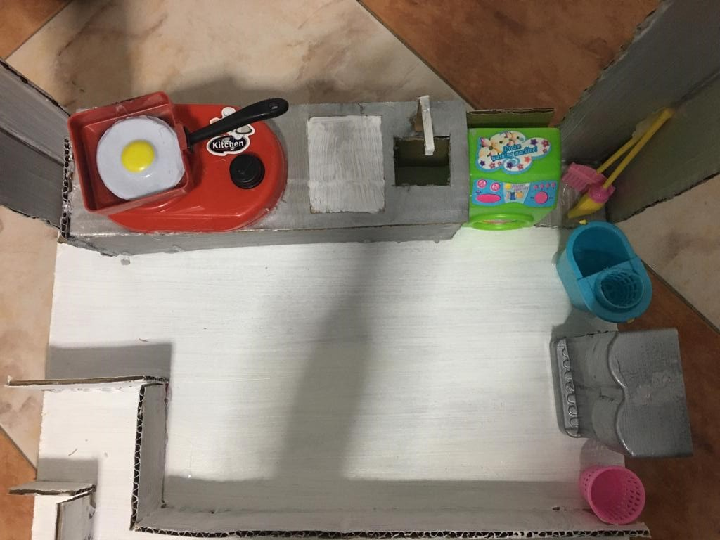
My house has got ground floor. In there, there is a kitchen that. There is a red cooker. There is also one gray sink next to it there is a washing machine, and one gray fridge. Under it, there is a freezer.The dad is cooker a egg
KITCHEN

Slide 3
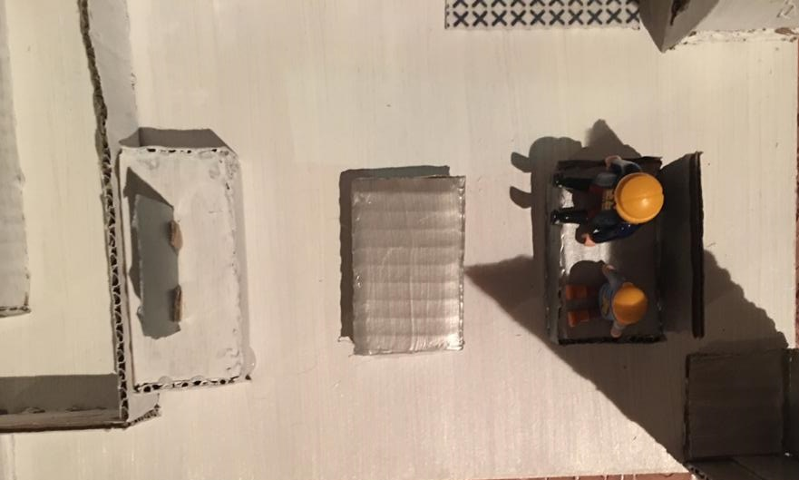
LIVING ROOM
I have got a gray sofá , and also a gray table. I have got a black TV and also a white cupboard. The floor is white. There is also a big air conditioning console and beautiful lamp. The mother is watching TV whit her daughter

Slide 4
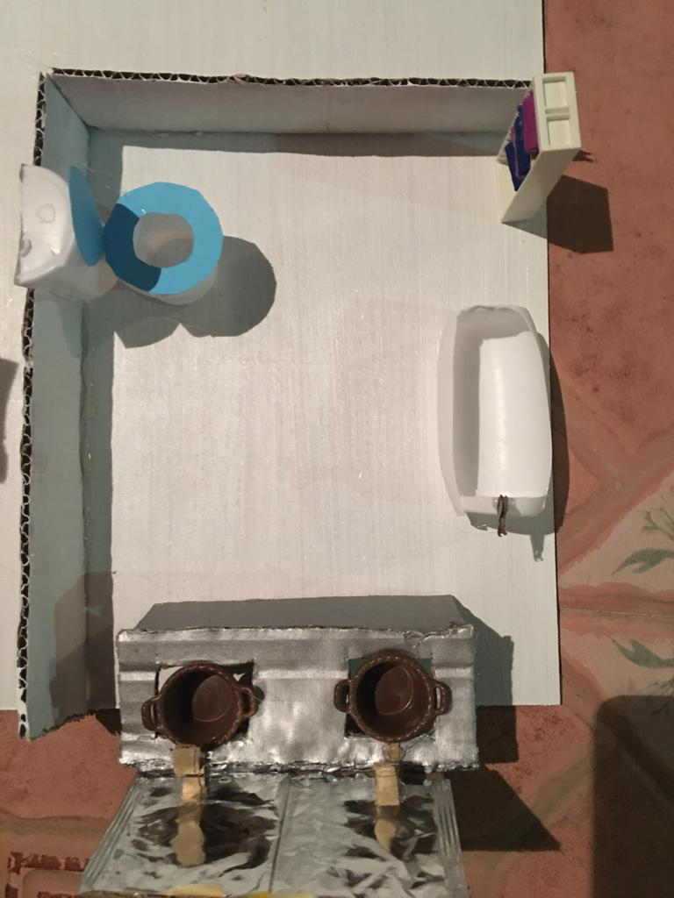
BATHROOM
This is my bathroom. The floor is white, there is a white WC close to the wall, there are two gray basin.The bathtub is next to the basin. There are two cupboards one big cupboard under the basin, and a small cupboard opposite the bathtub.

Slide 5
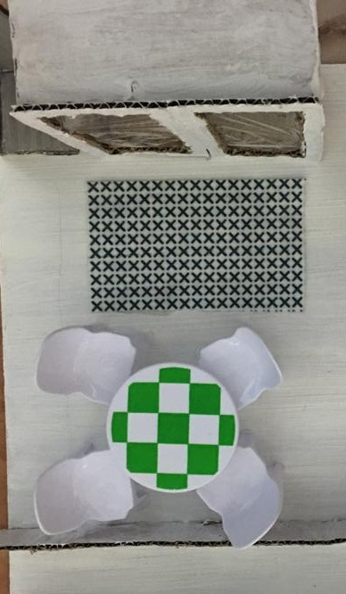
This is my dining room There is a white table in the middle, there is a white cupboard next to the table, the table has got four chairs, there is a carpet.
DINING ROOM

Slide 6
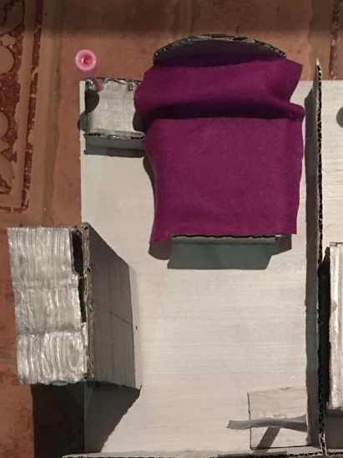
THE BEDROOM PARENT
There is my bedroom parent
There is a purple bed close to the wall, the TV is opposite to the bed, there is a small table and a wardrobes next to the bed there is also big wardrobe at the and of the bedroom

Slide 7
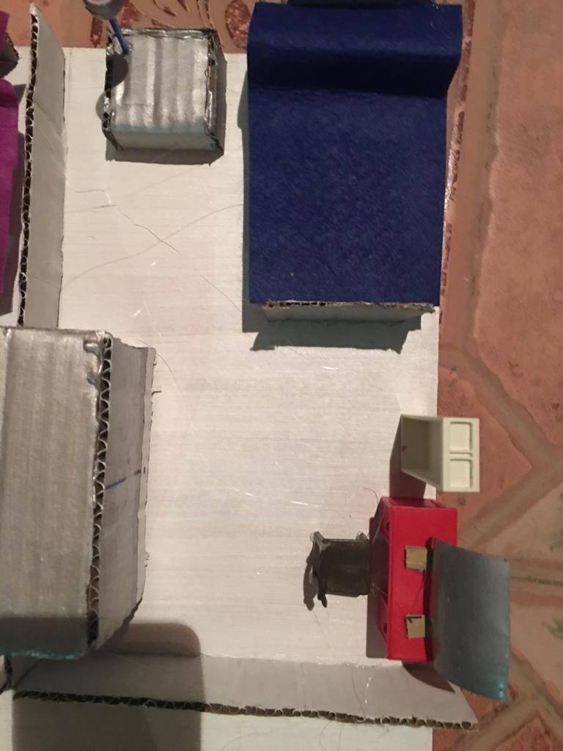
This is my bedroom There is a desk. On the desk there is a small TV. Next to the TV, there is a shelf with some books on it. In the chair in front of the desk. There is a cupboard close to a wall. The big cupboard have got two white doors, and white drawers. My bed is blue and big, and next to bed there is whit small table
BEDROOM

