Slide 1
Thales’ theorem
Brought to you by:
Guillermo Álvarez Román
IES Jardín de Málaga 2ºB
Notes:
Hello miss, I hope you like what I did.

Slide 2
First of all, Thales was a mathematician, philosopher, geometrician, physicist and greek legislator in the Ancient Greece

Slide 3
Also, he was born in Miletus, a greek polis where today is Turkey

Slide 4
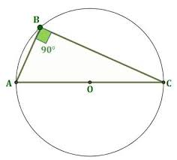
The theorem
Draw a circle
Then, mark the centre.
Draw a line that passes through the center.
Label that points A and C
Draw a point in any part of the circle’s line.
Label it B.
Finally, join the points A/B and B/C

Slide 5
The theorem
Now, you have a triangle and you/y’all have a 90º angle called “ACB angle” because of the points that forms that angle.
As you know, a triangle rectangle has 180º if you sum all the angles in it, and one of its angles must measure 90º, but, there is an operation to calculate that 90º. It is
Easy
More or less

Slide 6
The theorem
You must do that 7 steps but now, YOU ADD another step.
8. We draw a line between the point O and the point B.
Then, you’ll have two triangles. These triangles are called now AOB and BOC. ALso, lines from O to every point is called radium.

Slide 7
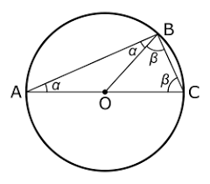
The theorem
Then, in each triangle, you’ll have two angles that measure the same than the other.
We name these angles (in each triangle) X, normally, and in the other triangle, Y, usually.

Slide 8
The theorem
Then, you/y’all must do the next operation.
X+X+Y+Y= 180º
2X+2Y= 180º
2(X+Y)= 180º
2(X+Y) 180º
2 2
=
X+Y=90º

Slide 9
The theorem
This proofs the Thales’ theorem. The angle ACB is equals to 90º.

Slide 10
What do we use this theorem for?
We use it to measure distances that are too far away from us. We use it to discover the connection between proportion and also to calculate the weight in architecture.
It has been very important to develop engineering, building structures and to develop mechanic devices .

Slide 11
Hope you all enjoyed it
If you’ve got a question, then ask me.
Made it by: Guillermo Álvarez Román

