Slide 1
FEELING WITH IAN

Slide 2
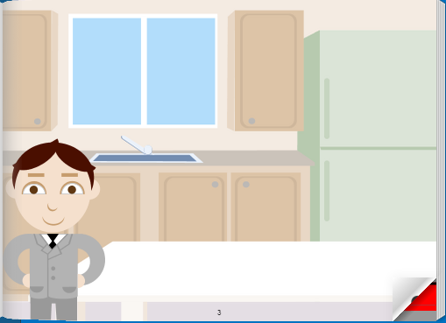

Slide 3
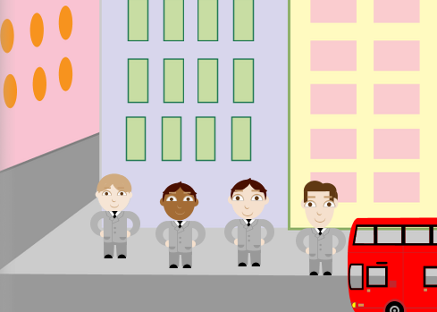

Slide 4
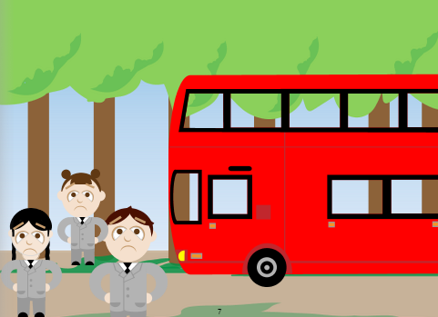

Slide 5
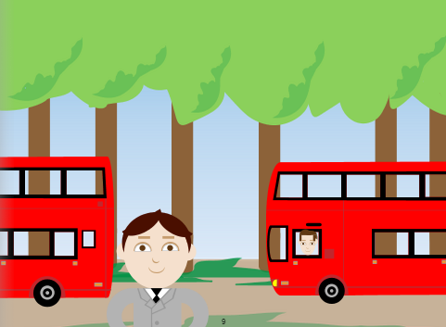

Slide 6
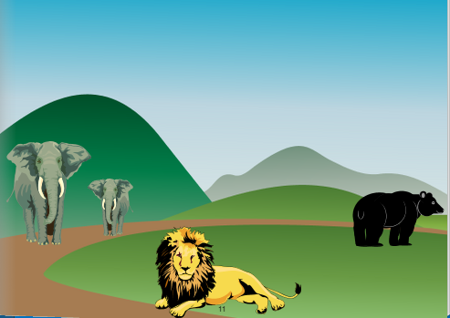

Slide 7
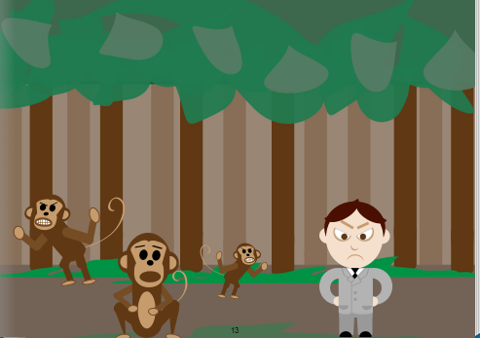

Slide 8
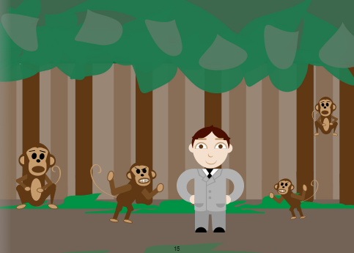

Slide 9
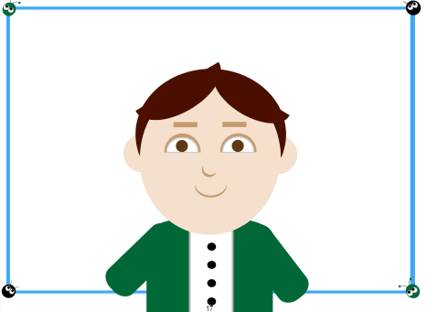

Slide 10
THE END

Slide 11
Questions about the story
How did Ian feel when he and his friends went to the zoo?
How did Ian feel when the wheel exploted?
How did Ian feel when his father arrived with a new bus?
How did Ian feel when he slipped with a banana´s skin?
How did Ian feel when monkeys worried about him?
How did Ian feel when he arrived home?
EXCITED
SAD
HAPPY
ANGRY
SPECIAL
TIRED

