Slide 1
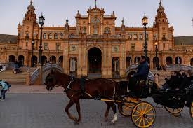
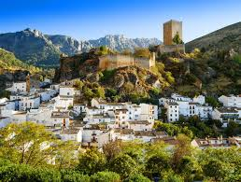
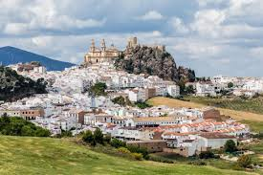
DESCRIBING SPECIAL PLACES OF ANDALUSIA

Slide 2
SEARCH INFORMATION AND WRITE ABOUT:
What is it?
Where is it?
How is it?
Why do you like it?
Points of interest and history
Your experiences and feelings.
Important aspects.

Slide 3
“PLAYA DE LOS GENOVESES!”(Example)
My favourite place of Andalusia is “Playa de los Genoveses”.
It´s located in Níjar, Almería, and it´s the most beautiful place I´ve ever seen. It´s located on the eastern coast of Cabo de Gata Natural Park. There´s no bars, no shops, no boat rental companies, no toilets…Just 1200 metres of white sand, dunes, cacti, eucalyptus trees and blue sea.The water is transparent and you can sea a lot of fish swimming. The water is not too warn and there aren´t high waves. It´s like being in a natural pool in a wild environment.
I used to go with my family and friends and I´ve got very good memories of this place.

Slide 4
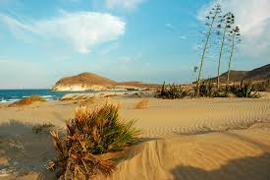
Include a photo or drawing.

Slide 5
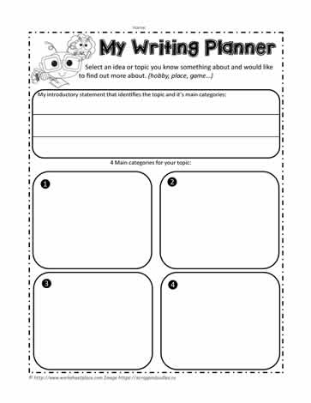
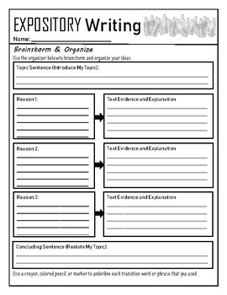
You can use a graphic organizer

Slide 6
WORD BANK
• Linkers and connectors: first of all, to begin with, on the one hand, on the other hand, whereas, because, because of, in order to, besides, for this reason, finally, in conclusion, and, also.
• Adjectives: attractive, beautiful, calm, fascinating, picturesque, vibrant, ancient, majestic, contemporary, quiet, noisy, traditional, modern, exceptional, historic, natural, peacefull, relaxing, urban, wild.

