Slide 1
MUSEUMS

Slide 2
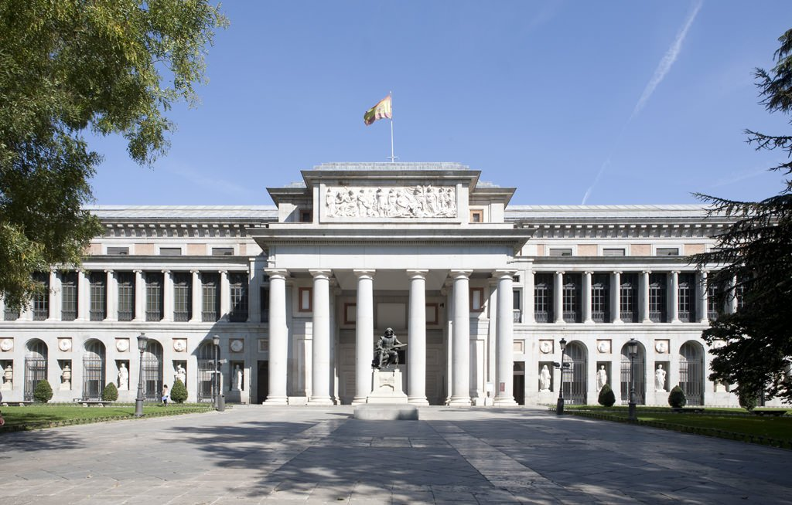
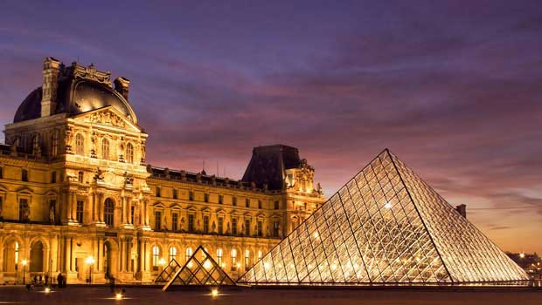
WHICH OF THESE IS THE BRITISH MUSEUM?

Slide 3
WHAT YEARS WAS THE MUSEUM BUILT BETWEEN?
1947-1959
1823-1848
1753-1757

Slide 4
HOW MANY OBJETS ARE THERE IN EXHIBITION?
About 1,500 objects
About 50,000 objects
About 25,000 objects

Slide 5
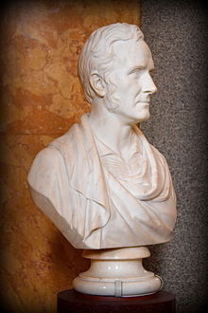
WHICH ARCHITECT DESIGNED IT?
Robert Smirke
Banister Fletcher
Ernest George

Slide 6
WHEN WAS THE WAX MUSEUM INAUGURATED?
In 2002
In 1923
In 1835

Slide 7
WHICH OTHER FAMOUS MUSEUM IS NEAR THE WAX MUSEUM?
The Sherlock Holmes Museum
National Gallery
Imperial War Museum

Slide 8
IS THE WAX MUSEUM ALSO CALLED IN ANOTHER WAY?
The Queen’s Museum
The Wax Museum doesn´t have another name
Madame Tussauds Museum

Slide 9
IN WHAT FAMOUS VIDEOGAME WAS MADAME TUSSAUDS FEATURED?
In Assassin’s Creed Unity
In BioShock 2
In Uncharted 4

Slide 10
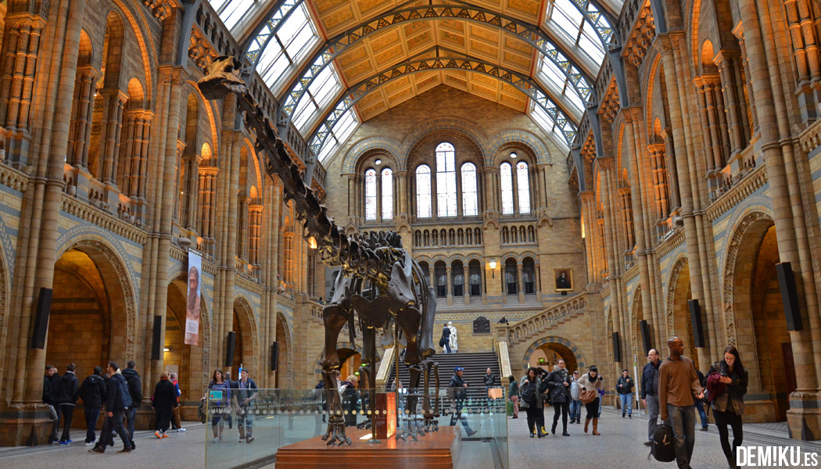
WHAT TYPE OF DINOSAUR IS THE ONE INTHE ENTRANCE OF THE NATURAL HISTORY MUSEUM?
A Stegosaurus
A Tyrannosaurus rex
A Diplodocus

Slide 11
WHICH MUSEUM IS CLOSER TO OUR HOTEL?
The Wax Museum
The British Museum
The Natural History Museum

