Slide 1
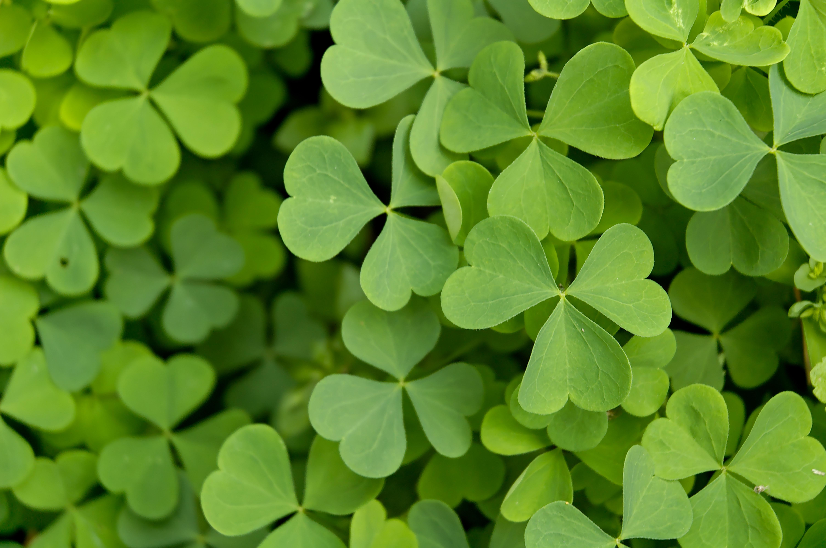
Saint Patrick’s Day
17th March

Slide 2
During which century did the patron saint of Ireland, Saint Patrick, live?
4th Century
5th Century
6th Century
7th Century

Slide 3
2. What was the first coloUr associated with Saint Patrick’s Day before the coloUr green?
Blue
Purple
Red
Gold

Slide 4
Irish is the ____________ most reported ancestry in the United States?
First
Second
Fifth
Tenth

Slide 5
Which Irish actor has portrayed the English King Henry VIII?
Kenneth Branagh
Jonathan Rhys Meyers
Peter O’Toole
Liam Neeson

Slide 6
What is Saint Patrick’s original name reported to be?
Arthur Guinness
James Hoban
Brian Boru
Maewyn Succat

Slide 7
What is the oldest Irish pub in the United States?
Patrick’s of Pratt Street
The Stagger Inn in Castlerea
Hibernian Pub in Raleigh
The Black Rose in Boston

Slide 8
What is the etymology of Dublin?
Merchant’s harbour
White fort
Good air
Black pool

Slide 9
True or False: Saint Patrick was kidnapped from his homeland and taken to Ireland as a slave.
True
False

Slide 10
What are the colors of the flag of Ireland?
Green, orange, and purple
Green, white, and red
Green, white, and purple
Green, white, and orange

Slide 11
Where is the Book of Kells, an illuminated religious manuscript, kept?
Trinity College Library in Dublin
Bodleian Library in Oxford
Widener Library in Cambridge
Central Library in Dublin

Slide 12
Which Southern Irish county’s main town of the same name was once the capital of Ireland?
Kilkenny
Tipperary
Meath
Kildare

Slide 13
What is Ireland’s second most populated city?
Limerick
Cork
Derry
Galway

Slide 14
What day in the life of Saint Patrick does March 17th supposedly mark?
His birthday
His death day
The day he became a slave
The day he bought his freedom

Slide 15
What Irish musical group holds the record for Most Grammy Awards won by a group?
Van Morrison
Mumford and Sons
Enya
U2

Slide 16
How much sunshine does Ireland get each year?
Between 30 and 40 hours
Between 1100 and 1600 hours
Between 3000 and 3800 hours
Between 5600 and 6000 hours

Slide 17
Which Irish author wrote Ulysses?
Samuel Beckett
Oscar Wilde
James Joyce
C. S. Lewis

Slide 18
What location claims to be the burial place of St. Patrick?
Down Cathedral in DownPatrick
St. Patrick’s Cathedral in Dublin
Cathedral Church of St Edan in Ferns
Westminster Cathedral in London

Slide 19
In myth, what type of animal does Saint Patrick banish from Ireland?
Seagull
Rat
Snake
Dog

Slide 20
What does the Irish phrase “Éirinn go Brách” mean in English?
“Ireland Forever”
“In Ireland We Trust”
“Ireland is Home”
“Ireland Comes First”

Slide 21
In myth, what religious idea did Saint Patrick teach the Irish with a “three-leaf” clover, also called a shamrock?
Resurrection
Holy trinity
The last supper
The Roman Empire

Slide 22
How many tourists does Ireland hope to receive in 2013?
400,000
1.3 million
2 million
7.6 million

Slide 23
In Ireland, how many leaves do traditional St. Patrick’s Day clovers have?
One
Two
Three
Four

Slide 24
What year did Chicago first dye the river green to celebrate St. Patrick’s Day?
1903
1962
1975
1989

