Slide 1
He for She
HeForShe (often referred to as He for She) is a solidarity campaign for the advancement of women initiated by UN Women.
The main goal of this campaign is to get boys and men into the fight for gender inequalities.
Women can’t do it alone, as men are almost one half of the global population. We need everybody to get involved.

Slide 2
There was a special meeting on the 20th
September 2014 to start the campaign
HeForShe. It was hosted by UN Women
Goodwill Ambassador Emma Watson,
whose speech -about her own path to
feminism and her call to involve men
and boys in promoting gender equality-
was widely circulated via social media.
In three days, HeForShe got succesfully the 100,000 men in the campaign, and at that event, UN Women made a call to mobilize all of them.

Slide 3
According to Emma’s speech, feminism is not about making the female gender better than male. Through her words, she opened the door to a new way of thinking with gender inequality, which affects both men and women within our society. She strongly encouraged men to get involved to help enact this change,
as we must try hard to
create a community that
equally values every man
and woman within it.
Why has the word [feminism]
become such an
uncomfortable one?

Slide 4
"For the record, feminism by definition is the belief that men and women should have equal rights and opportunities.“ - Emma Watson says.
Many colleges and universities support HeForShe all around the world.
The campaign tries to eradicate differences between men and women, and to provide the same opportunitites to men and women.
Because this needs to stop as we’re all humans. There’s no country in the world with absolute equality between men and women. As Emma Watson says, she had the luck of being treated the same as her male mates, of being payed the same as well. But lots of women do not have that luck, actually.

Slide 5
HeForShe website
The website of the campaign is such a cool website. When you first enter, you can see quotes from girls, boys, women and men. Through their words, they support the campaign. You have also a map to check out the HeForShe commitments and equality issues in your country. In Spain,
the priority issues are work,
violence and politics or
education. But then, in
the USA, the priority issues
are everyone of them.

Slide 6
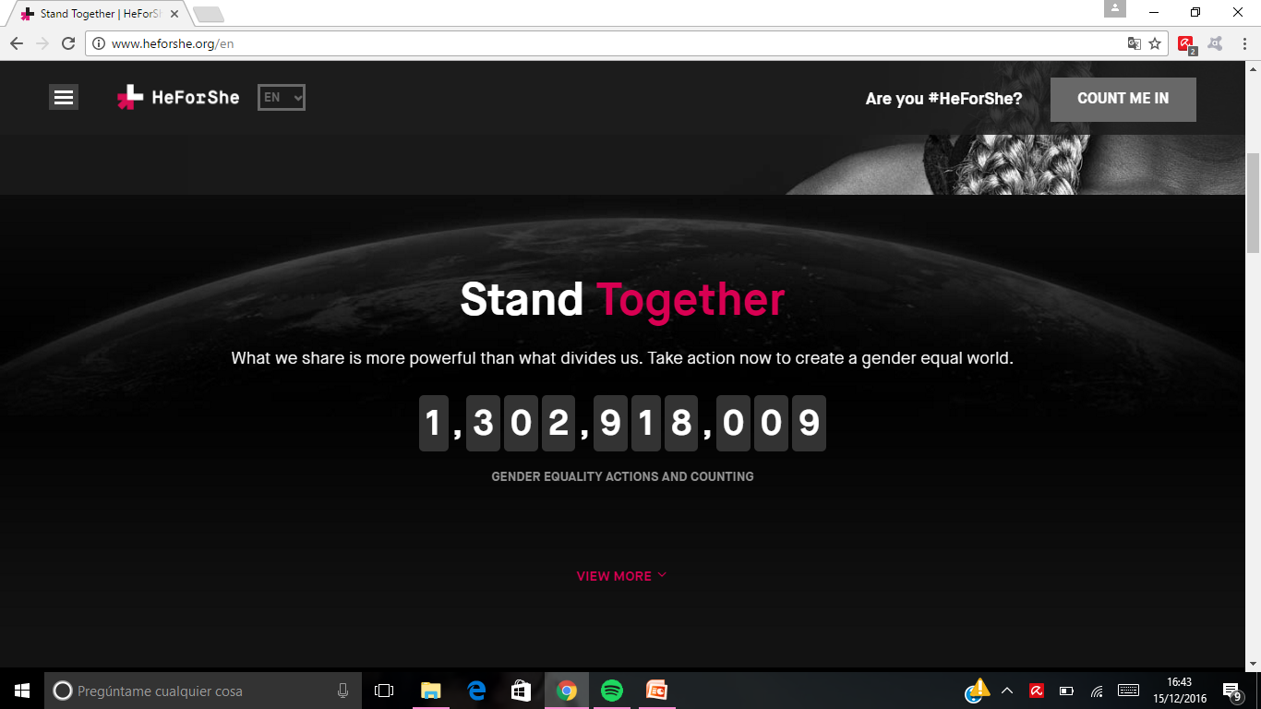
If you take a look right down you see how many people is in the campaign, and the number changes.

Slide 7
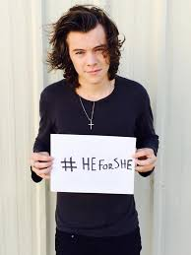
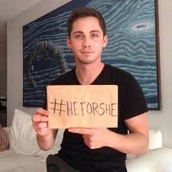
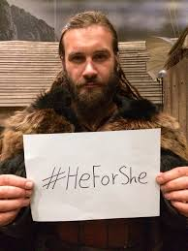
The HeForShe movement
So as you’ve seen it’s a very important campaign fighting just to make women recieve what they deserve. Respect, equality, the same rights as men, and so on. Here we can see some famous people supporting the campaign.
Harry Styles (singer, actor, model, songwriter. Also the love of my life and a person with a huge heart)
Logan Lerman (The Perks of Being a Wallflower movie)
Clive Standen (Vikings)

