Slide 1
POPULATION
POPULATION CHANGES
IMMIGRATION AND EMIGRATION

Slide 2
Population of a territory
It is the total number of people that live here.

Slide 3
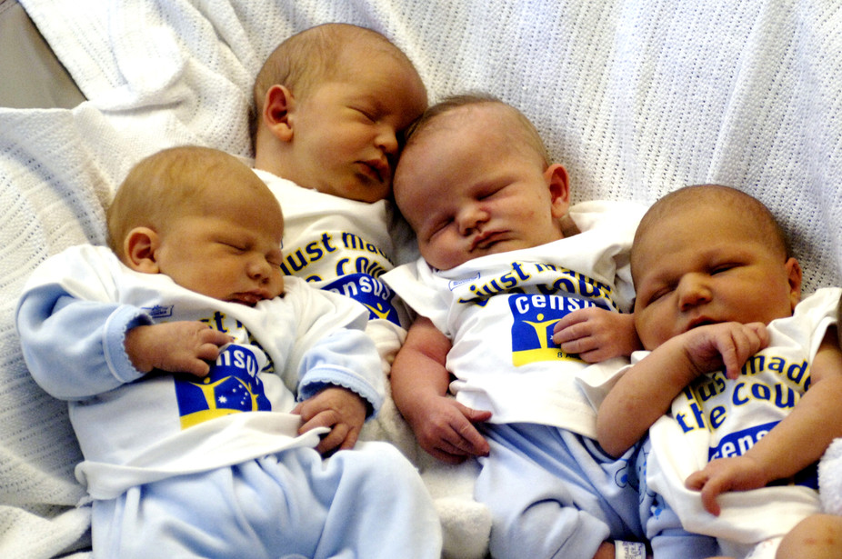
Birth rate
It is the number of people who are born
in a place in a certain period of time.

Slide 4
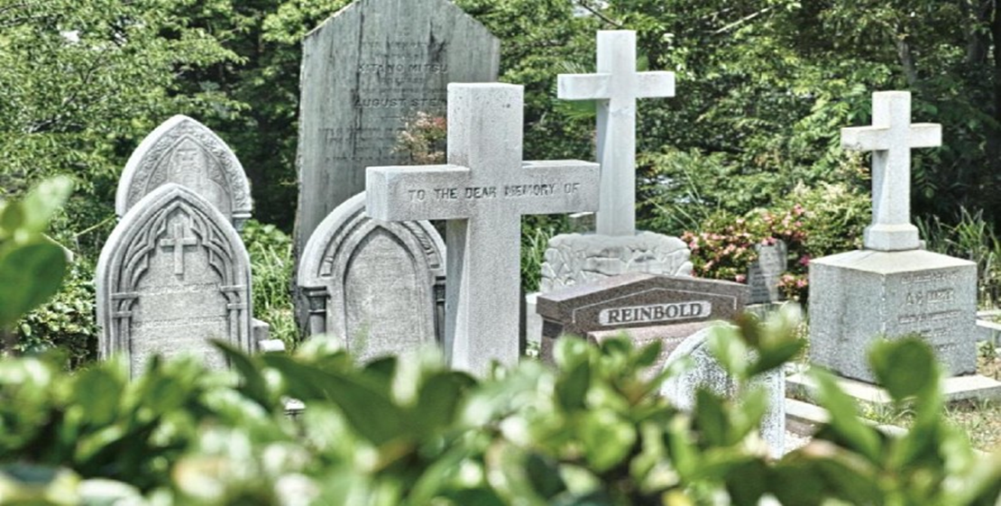
Death rate
It is the number of people who die in a place in a certain period of time.

Slide 5
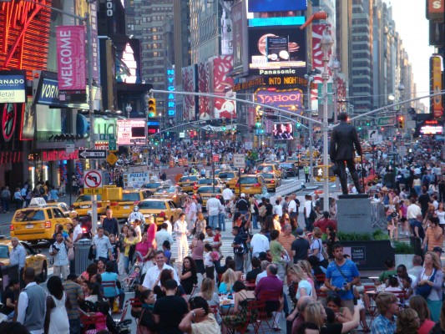
Natural population increase
When there are more births than deaths, the population grows.

Slide 6
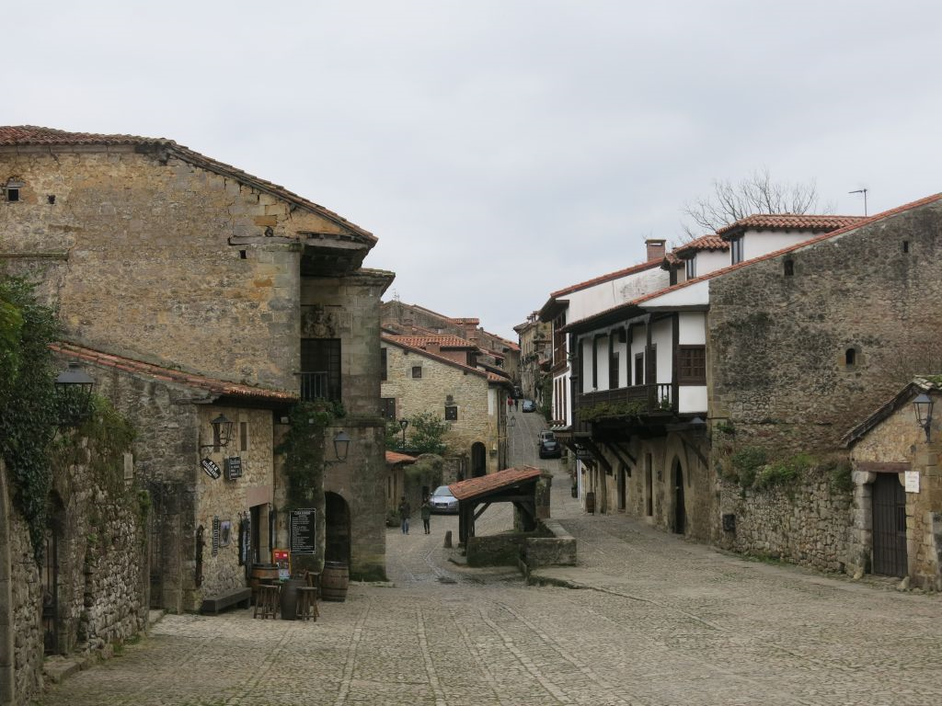
Natural population decrease
When there are more deaths than births, the population decreases.

Slide 7
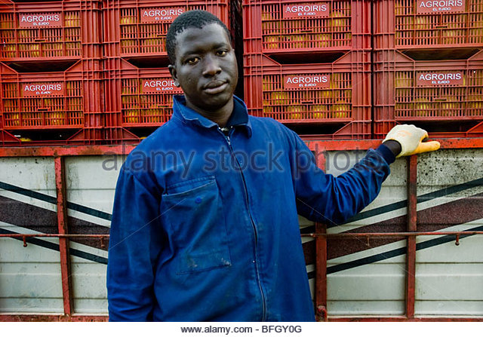
Inmigration
It is when people come to a place to live.

Slide 8
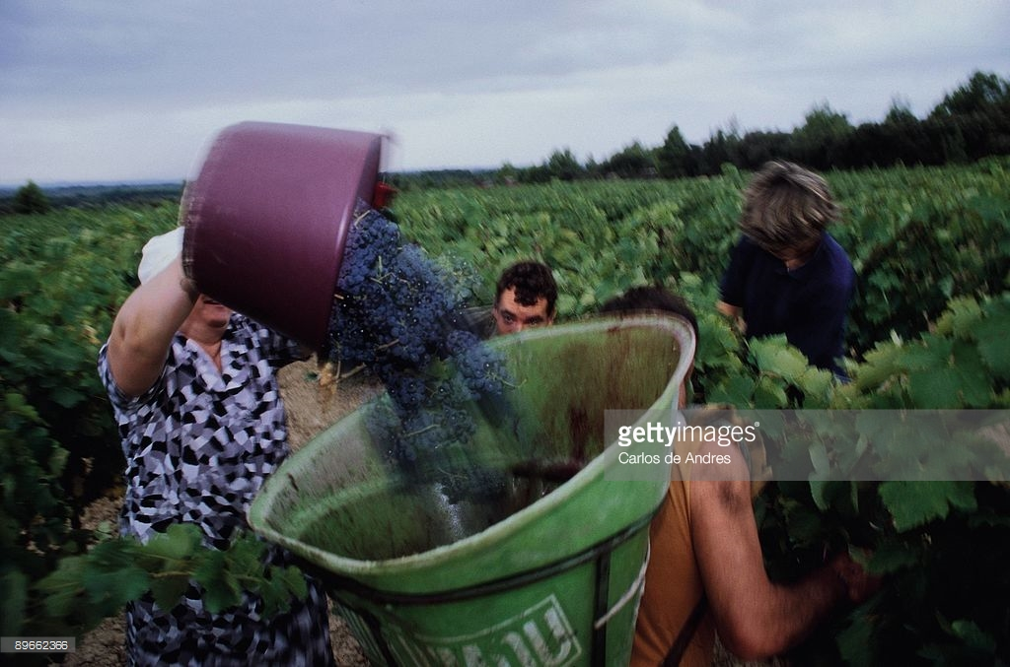
Emigration
It is when people leave a place to live somewhere else.

