Slide 1
MATTER AND ENERGY
UNIT 5

Slide 2
MATTER
It is everything that occupies space.

Slide 3
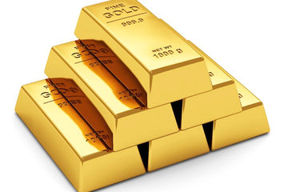
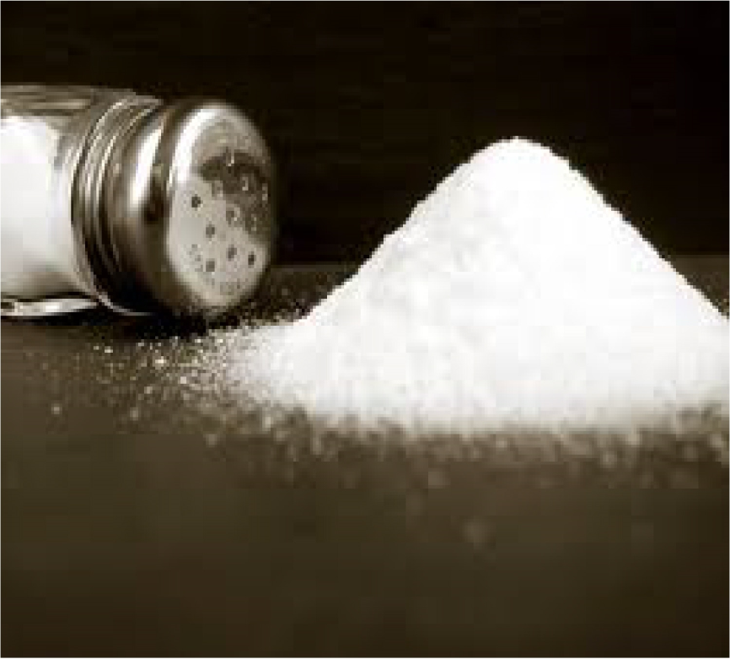
Pure substances
They are formed from just one type of matter.

Slide 4
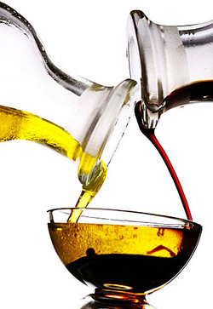
Mixtures
They are formed from various components.

Slide 5
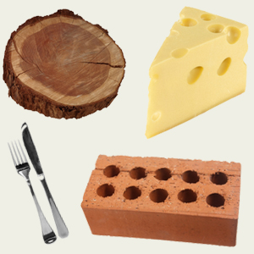
Solids
They have got their own shape.

Slide 6
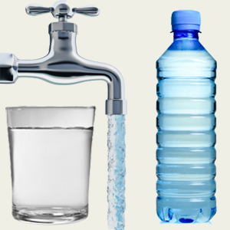
Liquids
They takes the form of their container.

Slide 7
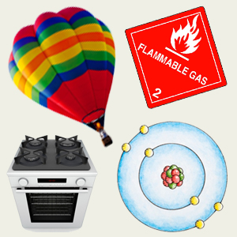
Gas
It expands to fill the available space.

Slide 8
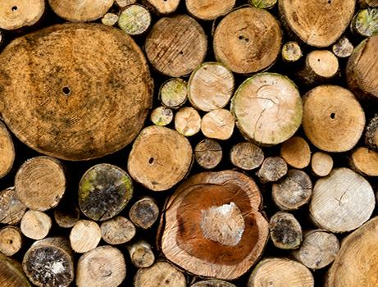
Natural materials
We get them directly from nature.

Slide 9
Man –made materials
They are made by transforming natural materials.

