Slide 1
NATURAL SCIENCE UNIT 3
HUMAN BEINGS

Slide 2
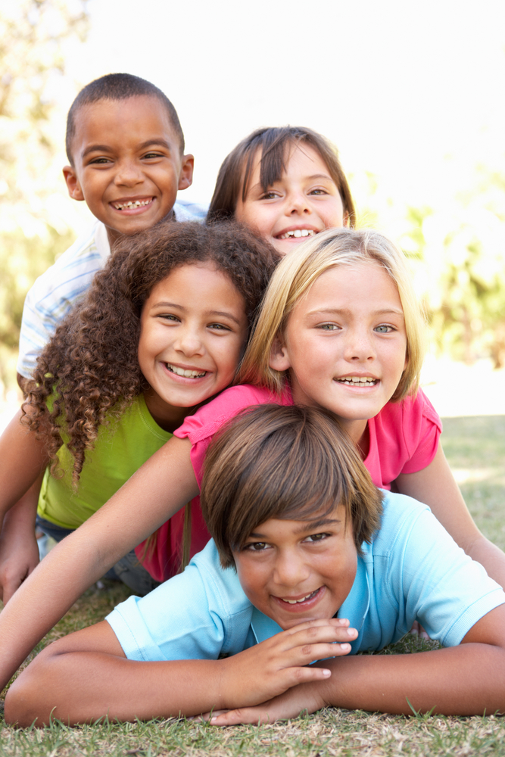
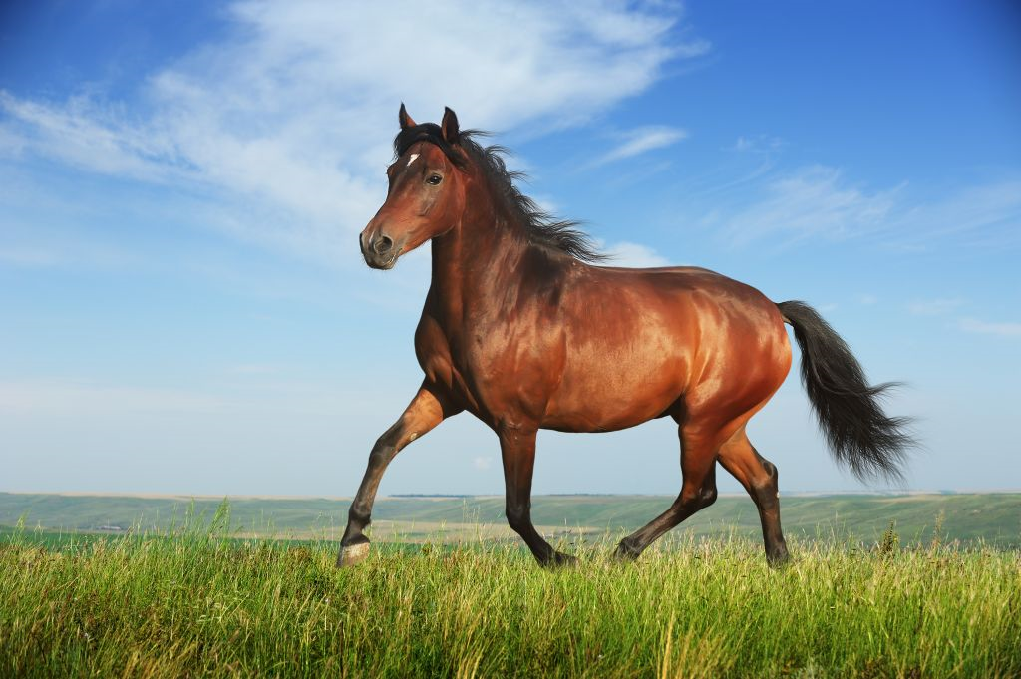
What type of living organism are we?
We are: mammals, viviparous, land animals, omnivores and vertebrates.

Slide 3
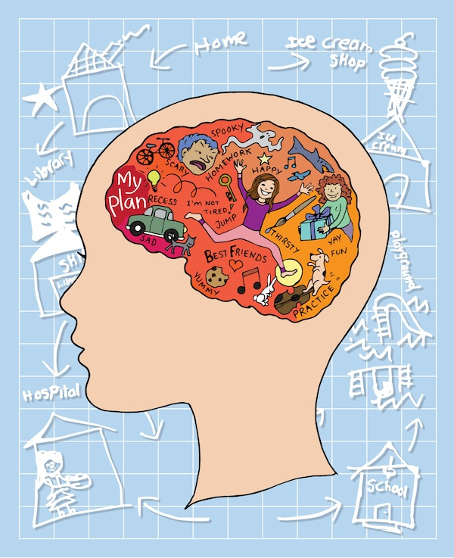
We are different from other animals
Our body is covered in skin. We have arms, legs, very sensitive fingertips, toes, brain and opposable thumbs. We are bipeds.

Slide 4
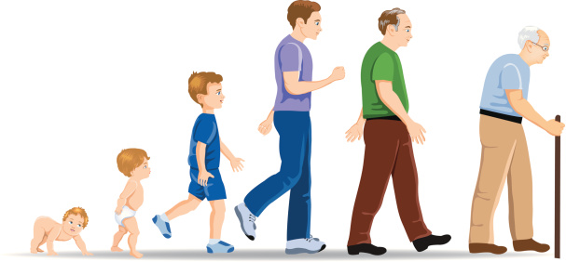
STAGES OF LIFE
CHILDHOOD
ADOLESCENCE
ADULTHOOD
OLD AGE

Slide 5
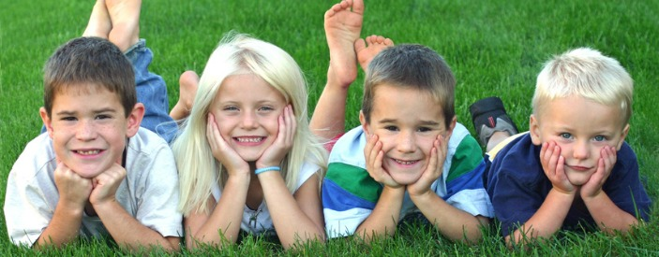
CHILDHOOD
It is the first eleven or twelve years of a human´s life.

Slide 6
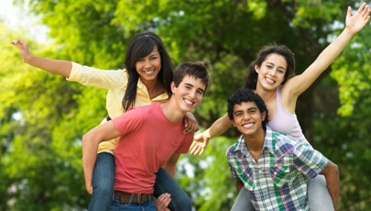
ADOLESCENCE
It starts at about eleven or twelve.

Slide 7
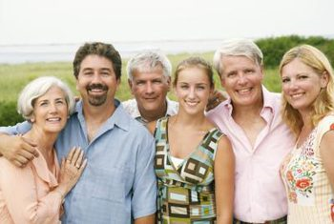
ADULTHOOD
It lasts from twenty until about seventy years of age.

Slide 8
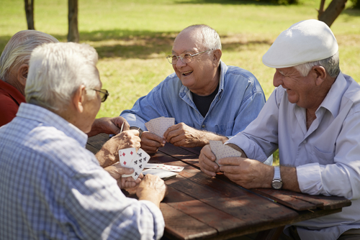
OLD AGE
It starts at about seventy years of age.

